Slide 1
馬太福音 Matthew 11:20-24
²⁰ 耶穌在諸城中行了許多異能，那些城的人終不悔改，就在那時候責備他們，說：²¹ 「哥拉汛哪，你有禍了！伯賽大啊，你有禍了！因為在你們中間所行的異能，若行在推羅、西頓，
²⁰ Then Jesus began to denounce the towns in which most of his miracles had been performed, because they did not repent. ²¹ “Woe to you, Chorazin! Woe to you, Bethsaida! For if the miracles that were performed in you had been performed in Tyre and Sidon,

Slide 2
他們早已披麻蒙灰悔改了。²² 但我告訴你們，當審判的日子，推羅、西頓所受的，比你們還容易受呢！²³ 迦百農啊，你已經升到天上，將來必墜落陰間；因為在你那裏所行的異能，若行在所多瑪，它還可以存到今日。²⁴ 但我告
they would have repented long ago in sackcloth and ashes. ²² But I tell you, it will be more bearable for Tyre and Sidon on the day of judgment than for you. ²³ And you, Capernaum, will you be lifted to the heavens? No, you will go down to Hades. For if the miracles that were performed in you had been performed in Sodom, it would have remained to this day. ²⁴ But I tell

Slide 3
訴你們，當審判的日子，所多瑪所受的，比你還容易受呢！」
you that it will be more bearable for Sodom on the day of judgment than for you.”

Slide 4
臨界點 The Critical Point
馬太福音 Matthew 11:20-24
Notes:
https://en.wikipedia.org/wiki/Fall_of_Mosul

Slide 9
Matthew 11:12
¹² 從施洗的約翰的時候直到現在，天國不斷遭受猛烈的攻擊，強暴的人企圖把它奪去。(CNVT)
¹² From the days of John the Baptist until now, the kingdom of heaven has been subjected to violence, and violent people have been raiding it.

Slide 10
1. 悔改是福音期望的反應 Repentance Is the Expected Response for the Gospel (20)
Matthew 11:20–21 ²⁰ 耶穌在諸城中行了許多異能，那些城的人終不悔改，就在那時候責備他們，說：²¹ 「哥拉汛哪，你有禍了！…
²⁰ Then Jesus began to denounce the towns in which most of his miracles had been performed, because they did not repent. ²¹ “Woe to you, Chorazin!

Slide 11
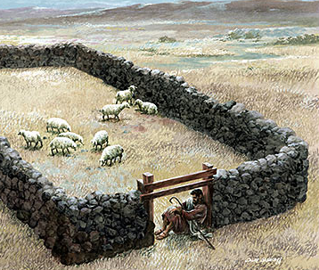
John 10:9
⁹ 我就是門；凡從我進來的，必然得救，並且出入得草吃。
⁹ I am the gate; whoever enters through me will be saved. They will come in and go out, and find pasture.

Slide 12
Matthew 1:21
²¹ … 你要給他起名叫耶穌，因他要將自己的百姓從罪惡裏救出來。」
²¹ … you are to give him the name Jesus, because he will save his people from their sins.”

Slide 13
Matthew 11:20–21
²⁰ 耶穌在諸城中行了許多異能，那些城的人終不悔改，就在那時候責備他們，說：²¹ 「哥拉汛哪，你有禍了！…
²⁰ Then Jesus began to denounce the towns in which most of his miracles had been performed, because they did not repent. ²¹ “Woe to you, Chorazin!

Slide 14
2. 驕傲是不悔改的原因 Pride Is the Reason for Unrepentance (21-24)
Matthew 11:21 ²¹ 「哥拉汛哪，你有禍了！伯賽大啊，你有禍了！因為在你們中間所行的異能，若行在推羅、西頓，他們早已披麻蒙灰悔改了。
²¹ “Woe to you, Chorazin! Woe to you, Bethsaida! For if the miracles that were performed in you had been performed in Tyre and Sidon, they would have repented long ago in sackcloth and ashes.

Slide 15
西頓
推羅
哥拉汛
伯賽大
迦百農

Slide 16
Matthew 11:23
²³ 迦百農啊，你已經升到天上，將來必墜落陰間；因為在你那裏所行的異能，若行在所多瑪，它還可以存到今日。
²³ And you, Capernaum, will you be lifted to the heavens? No, you will go down to Hades. For if the miracles that were performed in you had been performed in Sodom, it would have remained to this day.

Slide 17
Jude 7
⁷ 又如所多瑪、蛾摩拉和周圍城邑的人，也照他們一味地行淫，隨從逆性的情慾，就受永火的刑罰，作為鑑戒。
⁷ In a similar way, Sodom and Gomorrah and the surrounding towns gave themselves up to sexual immorality and perversion. They serve as an example of those who suffer the punishment of eternal fire.

Slide 18
Matthew 11:23
²³ 迦百農啊，你已經升到天上，將來必墜落陰間；
²³ And you, Capernaum, will you be lifted to the heavens? No, you will go down to Hades.

Slide 19
Romans 2:13
¹³ 原來在上帝面前，不是聽律法的為義，乃是行律法的稱義。
¹³ For it is not those who hear the law who are righteous in God’s sight, but it is those who obey the law who will be declared righteous.

Slide 20
Romans 7:18–20
¹⁸ … 立志為善由得我，只是行出來由不得我。¹⁹ 故此，我所願意的善，我反不做；我所不願意的惡，我倒去做。²⁰ 若我去做所不願意做的，就不是我做的，乃是住在我裏頭的罪做的。
¹⁸ … For I have the desire to do what is good, but I cannot carry it out. ¹⁹ For I do not do the good I want to do, but the evil I do not want to do—this I keep on doing. ²⁰ Now if I do what I do not want to do, it is no longer I who do it, but it is sin living in me that does it.

Slide 21
Galatians 3:24
²⁴ 這樣，律法是我們訓蒙的師傅，引我們到基督那裏，使我們因信稱義。
²⁴ So the law was our guardian until Christ came that we might be justified by faith.

Slide 22
3. 滅亡是不悔改的結局 Condemnation Is the Consequence of Unrepentance (21-24)

Slide 23
Matthew 11:21–23 (CUV)
²¹ …因為在你們中間所行的異能，若行在泰爾、西頓，他們早已披麻蒙灰悔改了。…若行在所多瑪，它還可以存到今日。
²¹ …For if the miracles that were performed in you had been performed in Tyre and Sidon, they would have repented long ago in sackcloth and ashes. … had been performed in Sodom, it would have remained to this day.

Slide 24
Matthew 11:22, 24
²² 但我告訴你們，當審判的日子，泰爾、西頓所受的，比你們還容易受呢！
²⁴ 但我告訴你們，當審判的日子，所多瑪所受的，比你還容易受呢！」
²² But I tell you, it will be more bearable for Tyre and Sidon on the day of judgment than for you.
²⁴ But I tell you that it will be more bearable for Sodom on the day of judgment than for you.”

Slide 25
Romans 1:20
²⁰ 自從造天地以來，上帝的永能和神性是明明可知的，雖是眼不能見，但藉著所造之物就可以曉得，叫人無可推諉。
²⁰ For since the creation of the world God’s invisible qualities—his eternal power and divine nature—have been clearly seen, being understood from what has been made, so that people are without excuse.

Slide 26
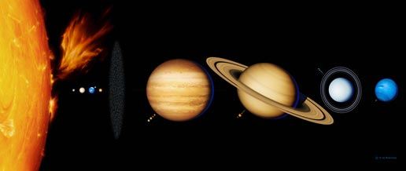

Slide 27
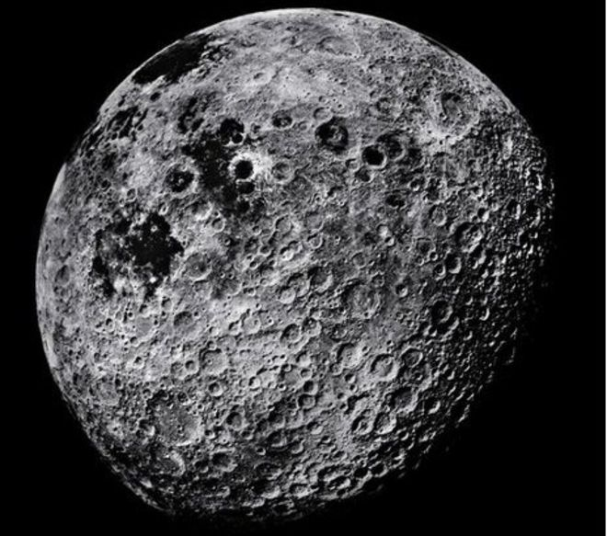
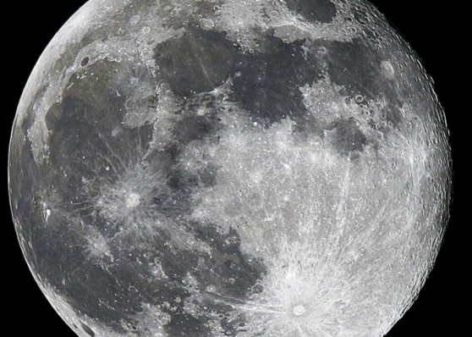

Slide 28
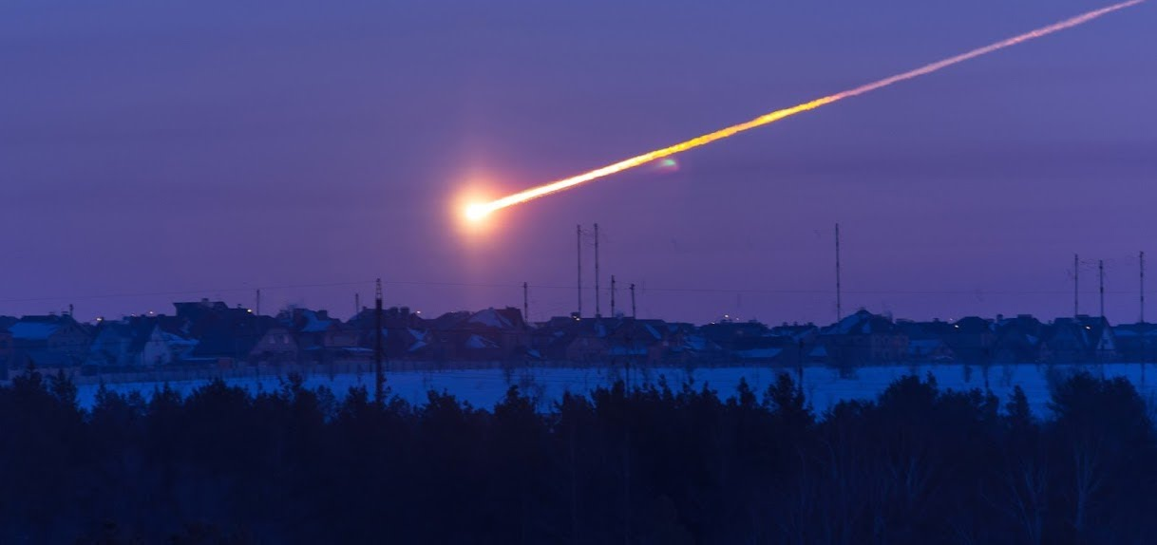
2/15/2013 Chelyabinsk meteor
Notes:
Chelyabinsk meteor

Slide 29
Matthew 11:22, 24
²² 但我告訴你們，當審判的日子，泰爾、西頓所受的，比你們還容易受呢！
²⁴ 但我告訴你們，當審判的日子，所多瑪所受的，比你還容易受呢！」
²² But I tell you, it will be more bearable for Tyre and Sidon on the day of judgment than for you.
²⁴ But I tell you that it will be more bearable for Sodom on the day of judgment than for you.”

