Slide 1
馬太福音 Matthew 12:1–21
¹ 那時，耶穌在安息日從麥地經過。他的門徒餓了，就掐起麥穗來吃。² 法利賽人看見，就對耶穌說：「看哪，你的門徒做安息日不可做的事了！」 ³ 耶穌對他們說：
¹ At that time Jesus went through the grainfields on the Sabbath. His disciples were hungry and began to pick some heads of grain and eat them. ² When the Pharisees saw this, they said to him, “Look! Your disciples are doing what is unlawful on the Sabbath.” ³ He answered,

Slide 2
「經上記著大衛和跟
從他的人飢餓之時所做的事，你們沒有念過嗎？⁴ 他怎麼進了上帝的殿，吃了陳設餅，這餅不是他和跟從他的人可以吃得，惟獨祭司才可以吃。⁵ 再者，律法上所記的，當安息日，祭司在殿裏犯了安息日還是沒
“Haven’t you read what David did when he and his companions were hungry? ⁴ He entered the house of God, and he and his companions ate the consecrated bread—which was not lawful for them to do, but only for the priests. ⁵ Or haven’t you read in the Law that the priests on Sabbath duty in the temple desecrate the Sabbath and yet are

Slide 3
有罪，你們沒有念過嗎？⁶ 但我告訴你們，在這裏有一人比殿更大。⁷ 『我喜愛憐恤，不喜愛祭祀。』你們若明白這話的意思，就不將無罪的當作有罪的了。⁸ 因為人子是安息日的主。」 ⁹ 耶穌離開那地方，進了一個會堂。
innocent? ⁶ I tell you that something greater than the temple is here. ⁷ If you had known what these words mean, ‘I desire mercy, not sacrifice,’ you would not have condemned the innocent. ⁸ For the Son of Man is Lord of the Sabbath.” ⁹ Going on from that place, he went into their synagogue,

Slide 4
¹⁰ 那裏有一個人枯乾了一隻手。有人問耶穌說：「安息日治病可以不可以？」意思是要控告他。¹¹ 耶穌說：「你們中間誰有一隻羊，當安息日掉在坑裏，不把牠抓住、拉上來呢？¹² 人比羊何等貴重呢！所以，在安息日做善事是可以的。」
¹⁰ and a man with a shriveled hand was there. Looking for a reason to bring charges against Jesus, they asked him, “Is it lawful to heal on the Sabbath?” ¹¹ He said to them, “If any of you has a sheep and it falls into a pit on the Sabbath, will you not take hold of it and lift it out? ¹² How much more valuable is a person than a sheep! Therefore it is lawful to do good on the Sabbath.”

Slide 5
¹³ 於是對那人說：「伸出手來！」他把手一伸，手就復了原，和那隻手一樣。¹⁴ 法利賽人出去，商議怎樣可以除滅耶穌。
¹³ Then he said to the man, “Stretch out your hand.” So he stretched it out and it was completely restored, just as sound as the other. ¹⁴ But the Pharisees went out and plotted how they might kill Jesus.

Slide 6
誰是敬虔人? (1) Who is the pious one? (1)
馬太福音 Matthew 12:1-14
Notes:
https://en.wikipedia.org/wiki/Fall_of_Mosul

Slide 7
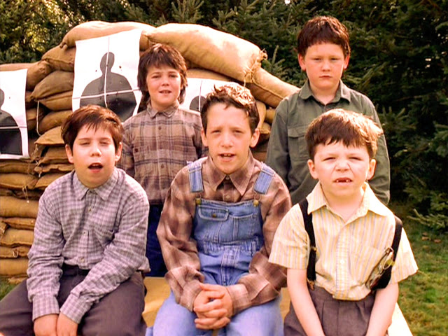
"And on the third day, God created the Remington bolt-action rifle, so that Man could fight the dinosaurs. ... And the homosexuals."

Slide 8
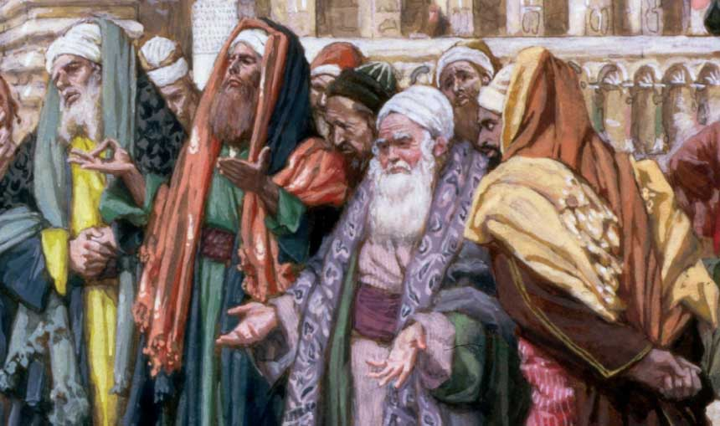
法利賽人 (分開) Pharisee (Separate)

Slide 9
39 樣禁止的活動 The 39 Prohibited Activities
Notes:
http://www.thenazareneway.com/sabbath/39_prohib_sabbath.htm

Slide 10
1. 假敬虔的特徵? Characteristics of Fake Piety
Matthew 12:1–2 那時，耶穌在安息日從麥地經過。他的門徒餓了，就掐起麥穗來吃。² 法利賽人看見，就對耶穌說：「看哪，你的門徒做安息日不可做的事了！」
¹ At that time Jesus went through the grainfields on the Sabbath. His disciples were hungry and began to pick some heads of grain and eat them. ² When the Pharisees saw this, they said to him, “Look! Your disciples are doing what is unlawful on the Sabbath.”

Slide 11
1. 假敬虔的特徵? Characteristics of Fake Piety
撩是鬥非 Stir up dissension

Slide 12
1 Timothy 6:4
⁴ 他是自高自大，一無所知，專好問難，爭辯言詞
⁴ they are conceited and understand nothing. They have an unhealthy interest in controversies and quarrels about words

Slide 13
1. 假敬虔的特徵? Characteristics of Fake Piety
撩是鬥非 Stir up dissension
堅持傳統而不是堅持聖經 Insist on tradition instead of the Bible

Slide 14
Matthew 12:3–4
³ 耶穌對他們說：「經上記著大衛和跟從他的人飢餓之時所做的事，你們沒有念過嗎？⁴ 他怎麼進了上帝的殿，吃了陳設餅，這餅不是他和跟從他的人可以吃得，惟獨祭司才可以吃。
³ He answered, “Haven’t you read what David did when he and his companions were hungry? ⁴ He entered the house of God, and he and his companions ate the consecrated bread—which was not lawful for them to do, but only for the priests.

Slide 15
Matthew 12:5
⁵ 再者，律法上所記的，當安息日，祭司在殿裏犯了安息日還是沒有罪，你們沒有念過嗎？
⁵ Or haven’t you read in the Law that the priests on Sabbath duty in the temple desecrate the Sabbath and yet are innocent?

Slide 16
1. 假敬虔的特徵? Characteristics of Fake Piety
撩是鬥非 Stir up dissension
堅持傳統而不是堅持聖經 Insist on tradition instead of the Bible
錯解聖經 Interpret the Bible wrongly

Slide 17
Matthew 12:6
⁶ 但我告訴你們，在這裏有一人比殿更大。
⁶ I tell you that something greater than the temple is here.

Slide 18
Matthew 12:7
⁷ 『我喜愛憐恤，不喜愛祭祀。』你們若明白這話的意思，就不將無罪的當作有罪的了。
⁷ If you had known what these words mean, ‘I desire mercy, not sacrifice,’ you would not have condemned the innocent.

Slide 19
Matthew 12:8
⁸ 因為人子是安息日的主。」
⁸ For the Son of Man is Lord of the Sabbath.”

Slide 20
Matthew 12:9–10
⁹ 耶穌離開那地方，進了一個會堂。¹⁰ 那裏有一個人枯乾了一隻手。有人問耶穌說：「安息日治病可以不可以？」意思是要控告他。
⁹ Going on from that place, he went into their synagogue, ¹⁰ and a man with a shriveled hand was there. Looking for a reason to bring charges against Jesus, they asked him, “Is it lawful to heal on the Sabbath?”

Slide 21
1. 假敬虔的特徵? Characteristics of Fake Piety
撩是鬥非 Stir up dissension
堅持傳統而不是堅持聖經 Insist on tradition instead of the Bible
錯解聖經 Interpret the Bible wrongly
雙重標準 Double standard

Slide 22
Matthew 12:11
¹¹ 耶穌說：「你們中間誰有一隻羊，當安息日掉在坑裏，不把牠抓住、拉上來呢？
¹¹ He said to them, “If any of you has a sheep and it falls into a pit on the Sabbath, will you not take hold of it and lift it out?

Slide 23
Matthew 12:12
¹² 人比羊何等貴重呢！所以，在安息日做善事是可以的。」
¹² How much more valuable is a person than a sheep! Therefore it is lawful to do good on the Sabbath.”

Slide 24
Matthew 12:13
¹³ 於是對那人說：「伸出手來！」他把手一伸，手就復了原，和那隻手一樣。
¹³ Then he said to the man, “Stretch out your hand.” So he stretched it out and it was completely restored, just as sound as the other.

Slide 25
1. 假敬虔的特徵? Characteristics of Fake Piety
撩是鬥非 Stir up dissension
堅持傳統而不是堅持聖經 Insist on tradition instead of the Bible
錯解聖經 Interpret the Bible wrongly
雙重標準 Double standard
惱羞成怒, 殺人滅口 From shame to rage, and from rage to murder

Slide 26
Matthew 12:14
¹⁴ 法利賽人出去，商議怎樣可以除滅耶穌。
¹⁴ But the Pharisees went out and plotted how they might kill Jesus.

Slide 27
1. 假敬虔的特徵? Characteristics of Fake Piety
撩是鬥非 Stir up dissension
堅持傳統而不是堅持聖經 Insist on tradition instead of the Bible
錯解聖經 Interpret the Bible wrongly
雙重標準 Double standard
惱羞成怒, 殺人滅口 From shame to rage, and from rage to murder

