Slide 1
馬太福音 Matthew 12:22–37
²² 當下，有人將一個被鬼附著、又瞎又啞的人帶到耶穌那裏，耶穌就醫治他，甚至那啞巴又能說話，又能看見。²³ 眾人都驚奇，說：「這不是大衛的子孫嗎？」²⁴ 但法利賽人聽見，就說：
²² Then they brought him a demon-possessed man who was blind and mute, and Jesus healed him, so that he could both talk and see. ²³ All the people were astonished and said, “Could this be the Son of David?” ²⁴ But when the Pharisees heard this, they said,

Slide 2
「這個人趕鬼，無非是靠著鬼王別西卜啊。」²⁵ 耶穌知道他們的意念，就對他們說：「凡一國自相紛爭，就成為荒場；一城一家自相紛爭，必站立不住；²⁶ 若撒但趕逐撒但，就是自相紛爭，他的國怎能站得住呢？²⁷ 我若靠著
“It is only by Beelzebul, the prince of demons, that this fellow drives out demons.” ²⁵ Jesus knew their thoughts and said to them, “Every kingdom divided against itself will be ruined, and every city or household divided against itself will not stand. ²⁶ If Satan drives out Satan, he is divided against himself. How then can his kingdom stand? ²⁷ And if I drive out demons

Slide 3
別西卜趕鬼，你們的子弟趕鬼又靠著誰呢？這樣，他們就要斷定你們的是非。²⁸ 我若靠著上帝的靈趕鬼，這就是上帝的國臨到你們了。²⁹ 人怎能進壯士家裏，搶奪他的家具呢？除非先捆住那壯士，才可以搶奪他的家財。³⁰ 不與我
by Beelzebul, by whom do your people drive them out? So then, they will be your judges. ²⁸ But if it is by the Spirit of God that I drive out demons, then the kingdom of God has come upon you. ²⁹ “Or again, how can anyone enter a strong man’s house and carry off his possessions unless he first ties up the strong man? Then he can plunder his house. ³⁰ “Whoever is

Slide 4
相合的，就是敵我的；不同我收聚的，就是分散的。」³¹ 所以我告訴你們：「人一切的罪和褻瀆的話都可得赦免，惟獨褻瀆聖靈，總不得赦免。³² 凡說話干犯人子的，還可得赦免；惟獨說話干犯聖靈的，今世來世總不得赦免。」
not with me is against me, and whoever does not gather with me scatters. ³¹ And so I tell you, every kind of sin and slander can be forgiven, but blasphemy against the Spirit will not be forgiven. ³² Anyone who speaks a word against the Son of Man will be forgiven, but anyone who speaks against the Holy Spirit will not be forgiven, either in this age or in the age to come.

Slide 5
³³ 「你們或以為樹好，果子也好；樹壞，果子也壞；因為看果子就可以知道樹。³⁴ 毒蛇的種類！你們既是惡人，怎能說出好話來呢？因為心裏所充滿的，口裏就說出來。³⁵ 善人從他心裏所存的善就發出善來；惡人從他心裏所存的惡
³³ “Make a tree good and its fruit will be good, or make a tree bad and its fruit will be bad, for a tree is recognized by its fruit. ³⁴ You brood of vipers, how can you who are evil say anything good? For the mouth speaks what the heart is full of. ³⁵ A good man brings good things out of the good stored up in him, and an evil man brings evil things out of the

Slide 6
就發出惡來。³⁶ 我又告訴你們，凡人所說的閒話，當審判的日子，必要句句供出來；³⁷ 因為要憑你的話定你為義，也要憑你的話定你有罪。」
evil stored up in him. ³⁶ But I tell you that everyone will have to give account on the day of judgment for every empty word they have spoken. ³⁷ For by your words you will be acquitted, and by your words you will be condemned.”

Slide 7
罪無可恕 The Unpardonable Sin
馬太福音 Matthew 12:22-37
Notes:
https://en.wikipedia.org/wiki/Fall_of_Mosul

Slide 8
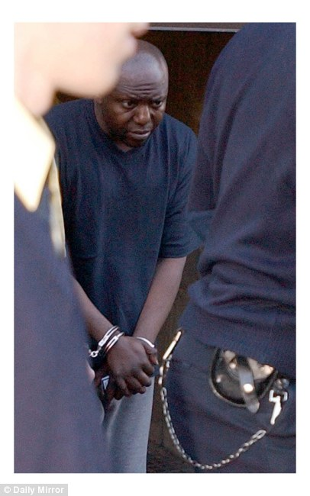
Notes:
http://hk.apple.nextmedia.com/international/art/20050317/4742385
http://www.dailymail.co.uk/news/article-1210923/Brain-eating-convicted-killer-freed-murder-social-worker-bungles.html

Slide 9
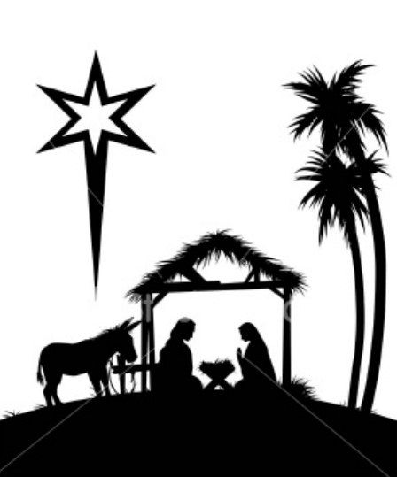
1. 什麼是永不可赦免的罪？ What is the Unpardonable Sin?

Slide 10
1. 什麼是永不得赦免的罪？ What is the Unpardonable Sin?
Matthew 7:28–29
²⁸ 耶穌講完了這些話，眾人都希奇他的教訓；²⁹ 因為他教訓他們，正像有權柄的人，不像他們的文士。
²⁸ When Jesus had finished saying these things, the crowds were amazed at his teaching, ²⁹ because he taught as one who had authority, and not as their teachers of the law.

Slide 11
Matthew 9:33–34
³³ 鬼被趕出去，啞巴就說出話來。眾人都希奇，說：「在以色列中，從來沒有見過這樣的事。」³⁴ 法利賽人卻說：「他是靠著鬼王趕鬼。」
³³ And when the demon was driven out, the man who had been mute spoke. The crowd was amazed and said, “Nothing like this has ever been seen in Israel.” ³⁴ But the Pharisees said, “It is by the prince of demons that he drives out demons.”

Slide 12
Matthew 12:14
¹⁴ 法利賽人出去，商議怎樣可以除滅耶穌。
¹⁴ But the Pharisees went out and plotted how they might kill Jesus.

Slide 13
Matthew 12:22–23
²² 當下，有人將一個被鬼附著、又瞎又啞的人帶到耶穌那裏，耶穌就醫治他，甚至那啞巴又能說話，又能看見。²³ 眾人都驚奇，說：「這不是大衛的子孫嗎？」
²² Then they brought him a demon-possessed man who was blind and mute, and Jesus healed him, so that he could both talk and see. ²³ All the people were astonished and said, “Could this be the Son of David?”

Slide 14
Matthew 12:24
²⁴ 但法利賽人聽見，就說：「這個人趕鬼，無非是靠著鬼王別西卜啊。」
²⁴ But when the Pharisees heard this, they said, “It is only by Beelzebul, the prince of demons, that this fellow drives out demons.”

Slide 15
Matthew 12:25–26 ²⁵ 耶穌知道他們的意念，就對他們說：「凡一國自相紛爭，就成為荒場；一城一家自相紛爭，必站立不住；²⁶ 若撒但趕逐撒但，就是自相紛爭，他的國怎能站得住呢？
²⁵ Jesus knew their thoughts and said to them, “Every kingdom divided against itself will be ruined, and every city or household divided against itself will not stand. ²⁶ If Satan drives out Satan, he is divided against himself. How then can his kingdom stand?

Slide 16
Matthew 12:27
²⁷ 我若靠著別西卜趕鬼，你們的子弟趕鬼又靠著誰呢？這樣，他們就要斷定你們的是非。
²⁷ And if I drive out demons by Beelzebul, by whom do your people drive them out? So then, they will be your judges.

Slide 17
Matthew 12:17–18
¹⁷ 這是要應驗先知以賽亞的話，說： ¹⁸ 看哪！我的僕人， 我所揀選、所親愛、心裏所喜悅的， 我要將我的靈賜給他； 他必將公理傳給外邦。
¹⁷ This was to fulfill what was spoken through the prophet Isaiah: ¹⁸ “Here is my servant whom I have chosen, the one I love, in whom I delight; I will put my Spirit on him, and he will proclaim justice to the nations.

Slide 18
Matthew 12:28
²⁸ 我若靠著上帝的靈趕鬼，這就是上帝的國臨到你們了。
²⁸ But if it is by the Spirit of God that I drive out demons, then the kingdom of God has come upon you.

Slide 19
Matthew 12:29
²⁹ 人怎能進壯士家裏，搶奪他的家具呢？除非先捆住那壯士，才可以搶奪他的家財。
²⁹ “Or again, how can anyone enter a strong man’s house and carry off his possessions unless he first ties up the strong man? Then he can plunder his house.

Slide 20
Matthew 12:30
³⁰ 不與我相合的，就是敵我的；不同我收聚的，就是分散的。」
³⁰ “Whoever is not with me is against me, and whoever does not gather with me scatters.

Slide 21
Matthew 12:31–32 ³¹ 所以我告訴你們：「人一切的罪和褻瀆的話都可得赦免，惟獨褻瀆聖靈，總不得赦免。³² 凡說話干犯人子的，還可得赦免；惟獨說話干犯聖靈的，今世來世總不得赦免。」
³¹ And so I tell you, every kind of sin and slander can be forgiven, but blasphemy against the Spirit will not be forgiven. ³² Anyone who speaks a word against the Son of Man will be forgiven, but anyone who speaks against the Holy Spirit will not be forgiven, either in this age or in the age to come.

Slide 22
1. 什麼是永不得赦免的罪？ What is the Unpardonable Sin?
褻瀆聖靈 Blasphemy against the Holy Spirit (Matt 12:31)

Slide 23
2. 為什麼這是永不得赦免的罪？ Why is This the Unpardonable Sin?
Matthew 12:32
³² 凡說話干犯人子的，還可得赦免；惟獨說話干犯聖靈的，今世來世總不得赦免。」
³² Anyone who speaks a word against the Son of Man will be forgiven, but anyone who speaks against the Holy Spirit will not be forgiven, either in this age or in the age to come.

Slide 24
John 16:8
⁸ 他既來了，就要叫世人為罪、為義、為審判，自己責備自己。
⁸ When he comes, he will prove the world to be in the wrong about sin and righteousness and judgment:
John 16:13
¹³ 只等真理的聖靈來了，他要引導你們明白一切的真理；
¹³ But when he, the Spirit of truth, comes, he will guide you into all the truth.

Slide 25
Luke 23:34
³⁴ 當下耶穌說：「父啊！赦免他們；因為他們所做的，他們不曉得。」
³⁴ Jesus said, “Father, forgive them, for they do not know what they are doing.”

Slide 26
Acts 2:37–38 ³⁷ 眾人聽見這話，覺得扎心，就對彼得和其餘的使徒說：「弟兄們，我們當怎樣行？」³⁸ 彼得說：「你們各人要悔改，奉耶穌基督的名受洗，叫你們的罪得赦，就必領受所賜的聖靈；
³⁷ When the people heard this, they were cut to the heart and said to Peter and the other apostles, “Brothers, what shall we do?” ³⁸ Peter replied, “Repent and be baptized, every one of you, in the name of Jesus Christ for the forgiveness of your sins. And you will receive the gift of the Holy Spirit.

Slide 27
3. 我們可能犯永不得赦免的罪嗎？ Can We Commit the Unpardonable Sin?

Slide 28
1 John 4:1
¹ 親愛的弟兄啊，一切的靈，你們不可都信，總要試驗那些靈是出於上帝的不是，因為世上有許多假先知已經出來了。
¹ Dear friends, do not believe every spirit, but test the spirits to see whether they are from God, because many false prophets have gone out into the world.

Slide 29
Numbers 15:30–31 ³⁰ 但那擅敢行事的，無論是本地人是寄居的，他褻瀆了耶和華，必從民中剪除。³¹ 因他藐視耶和華的言語，違背耶和華的命令，那人總要剪除；他的罪孽要歸到他身上。」
³⁰ “ ‘But anyone who sins defiantly, whether native-born or foreigner, blasphemes the Lord and must be cut off from the people of Israel. ³¹ Because they have despised the Lord’s word and broken his commands, they must surely be cut off; their guilt remains on them.’ ”

Slide 30
Hebrews 10:26
²⁶ 因為我們得知真道以後，若故意犯罪，贖罪的祭就再沒有了；
²⁶ If we deliberately keep on sinning after we have received the knowledge of the truth, no sacrifice for sins is left,

Slide 31
Matthew 12:33
³³ 「你們或以為樹好，果子也好；樹壞，果子也壞；因為看果子就可以知道樹。
³³ “Make a tree good and its fruit will be good, or make a tree bad and its fruit will be bad, for a tree is recognized by its fruit.

Slide 32
Matthew 12:34–35 ³⁴ 毒蛇的種類！你們既是惡人，怎能說出好話來呢？因為心裏所充滿的，口裏就說出來。³⁵ 善人從他心裏所存的善就發出善來；惡人從他心裏所存的惡就發出惡來。
³⁴ You brood of vipers, how can you who are evil say anything good? For the mouth speaks what the heart is full of. ³⁵ A good man brings good things out of the good stored up in him, and an evil man brings evil things out of the evil stored up in him.

