Slide 1
Matthew 21:1-17
As they approached Jerusalem and came to Bethphage on the Mount of Olives, Jesus sent two disciples, ² saying to them, “Go to the village ahead of you, and at once you will find a donkey tied there, with her colt by her. Untie them and bring them to me.
¹ 耶稣和门徒将近耶路撒冷，到了伯法其，在橄榄山那里。² 耶稣就打发两个门徒，对他们说：「你们往对面村子里去，必看见一匹驴拴在那里，还有驴驹同在一处；你们解开，牵到我这里来。

Slide 2
Matthew 21:1-17
³ If anyone says anything to you, say that the Lord needs them, and he will send them right away.” ⁴ This took place to fulfill what was spoken through the prophet:
³ 若有人对你们说什么，你们就说：『主要用它。』那人必立时让你们牵来。⁴ 这事成就是要应验先知的话，说：

Slide 3
Matthew 21:1-17
⁵ “Say to Daughter Zion,
‘See, your king comes to you,
gentle and riding on a donkey,
and on a colt, the foal of a donkey.’ ” ⁶ The disciples went and did as Jesus had instructed them. ⁷ They brought the donkey and the colt and placed their cloaks on them for Jesus to sit on.
⁵ 要对锡安的居民说：看哪，你的王来到你这里， 是温柔的，又骑着驴，就是骑着驴驹子。」⁶ 门徒就照耶稣所吩咐的去行，⁷ 牵了驴和驴驹来，把自己的衣服搭在上面，耶稣就骑上。

Slide 4
Matthew 21:1-17
⁸ A very large crowd spread their cloaks on the road, while others cut branches from the trees and spread them on the road. ⁹ The crowds that went ahead of him and those that followed shouted,
“Hosanna to the Son of David!”
“Blessed is he who comes in the name of the Lord!”
“Hosanna in the highest heaven!”
⁸ 众人多半把衣服铺在路上；还有人砍下树枝来铺在路上。⁹ 前行后随的众人喊着说：
和散那归于大卫的子孙！
奉主名来的是应当称颂的！
高高在上和散那！

Slide 5
Matthew 21:1-17
¹⁰ When Jesus entered Jerusalem, the whole city was stirred and asked, “Who is this?”
¹¹ The crowds answered, “This is Jesus, the prophet from Nazareth in Galilee.”
¹⁰ 耶稣既进了耶路撒冷，合城都惊动了，说：「这是谁？」¹¹ 众人说：「这是加利利拿撒勒的先知耶稣。」

Slide 6
Matthew 21:1-17
¹² Jesus entered the temple courts and drove out all who were buying and selling there. He overturned the tables of the money changers and the benches of those selling doves. ¹³ “It is written,” he said to them, “ ‘My house will be called a house of prayer,’ but you are making it ‘a den of robbers.’”
¹² 耶稣进了 神的殿，赶出殿里一切做买卖的人，推倒兑换银钱之人的桌子，和卖鸽子之人的凳子，¹³ 对他们说：「经上记着说：
我的殿必称为祷告的殿，
你们倒使它成为贼窝了。」

Slide 7
Matthew 21:1-17
¹⁴ The blind and the lame came to him at the temple, and he healed them. ¹⁵ But when the chief priests and the teachers of the law saw the wonderful things he did and the children shouting in the temple courts, “Hosanna to the Son of David,” they were indignant.
¹⁴ 在殿里有瞎子、瘸子到耶稣跟前，他就治好了他们。¹⁵ 祭司长和文士看见耶稣所行的奇事，又见小孩子在殿里喊着说：「和散那归于大卫的子孙！」就甚恼怒，

Slide 8
Matthew 21:1-17
¹⁶ “Do you hear what these children are saying?” they asked him.
“Yes,” replied Jesus, “have you never read,
“ ‘From the lips of children and infants
you, Lord, have called forth your praise’?”
¹⁷ And he left them and went out of the city to Bethany, where he spent the night.
¹⁶ 对他说：「这些人所说的，你听见了吗？」耶稣说：「是的。经上说『你从婴孩和吃奶的口中完全了赞美』的话，你们没有念过吗？」¹⁷ 于是离开他们，出城到伯大尼去，在那里住宿。

Slide 9
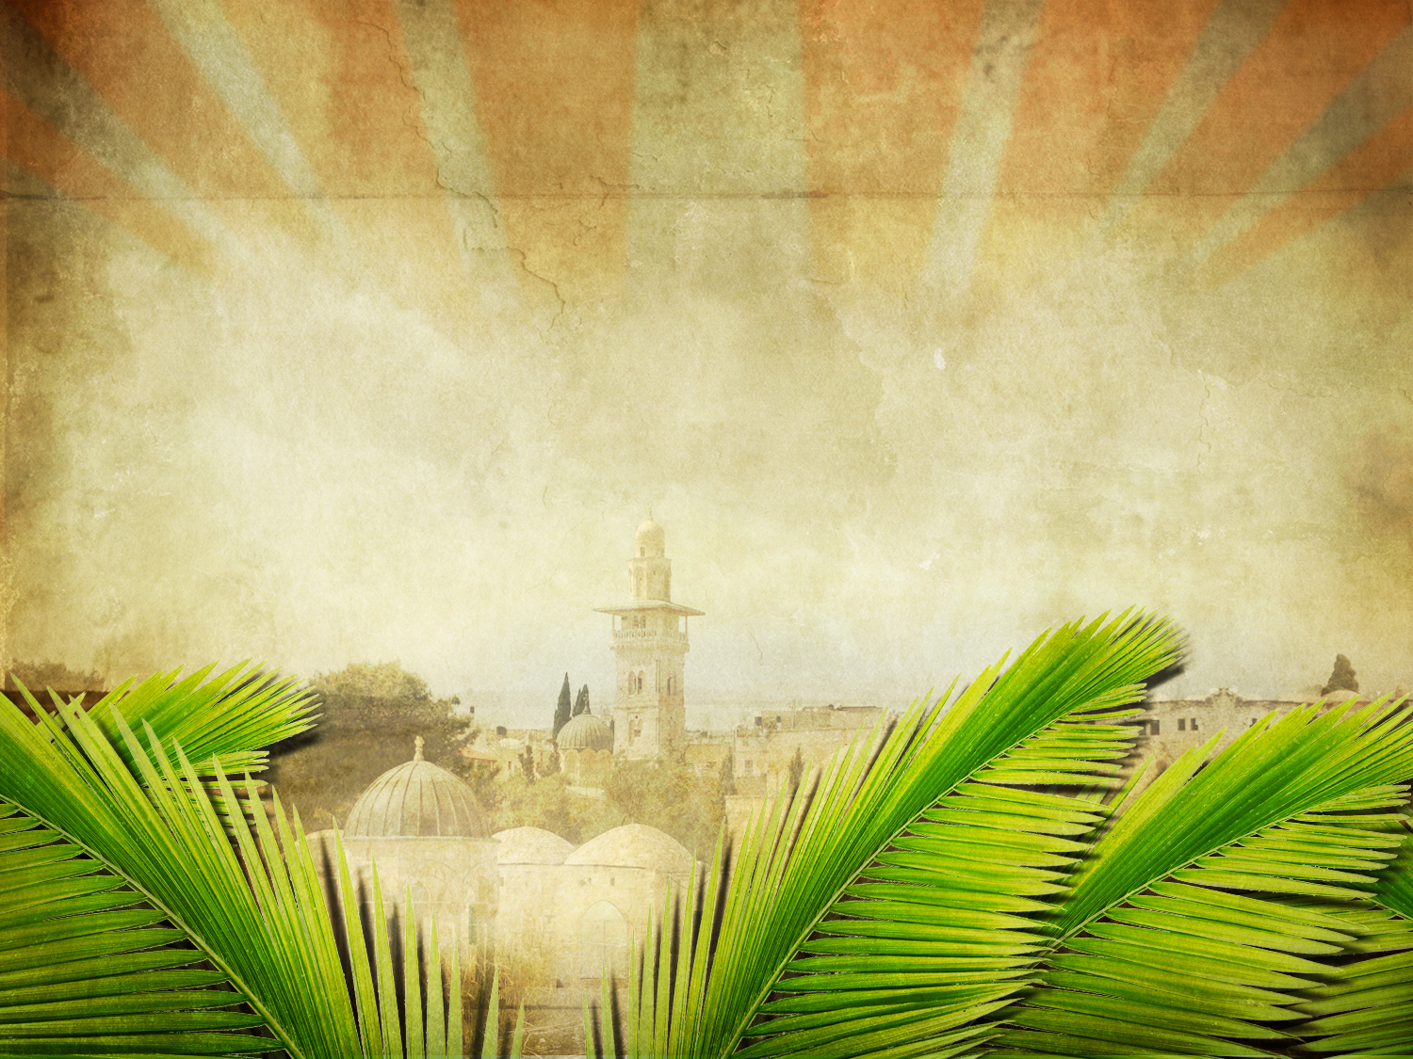
Who is This Jesus?
Matthew 21:1-17-

Slide 11
⁹ 有许多犹太人知道耶稣在那里，就来了，不但是为耶稣的缘故，也是要看他从死里所复活的拉撒路。¹⁰ 但祭司长商议连拉撒路也要杀了；¹¹ 因有好些犹太人为拉撒路的缘故，回去信了耶稣。

Slide 13
⁹ 锡安的民哪，应当大大喜乐；
耶路撒冷的民哪，应当欢呼。
看哪，你的王来到你这里！
他是公义的，并且施行拯救，
谦谦和和地骑着驴，
就是骑着驴的驹子。

Slide 15
⁹ …和散那归于大卫的子孙！
奉主名来的是应当称颂的！
高高在上和散那！

Slide 16
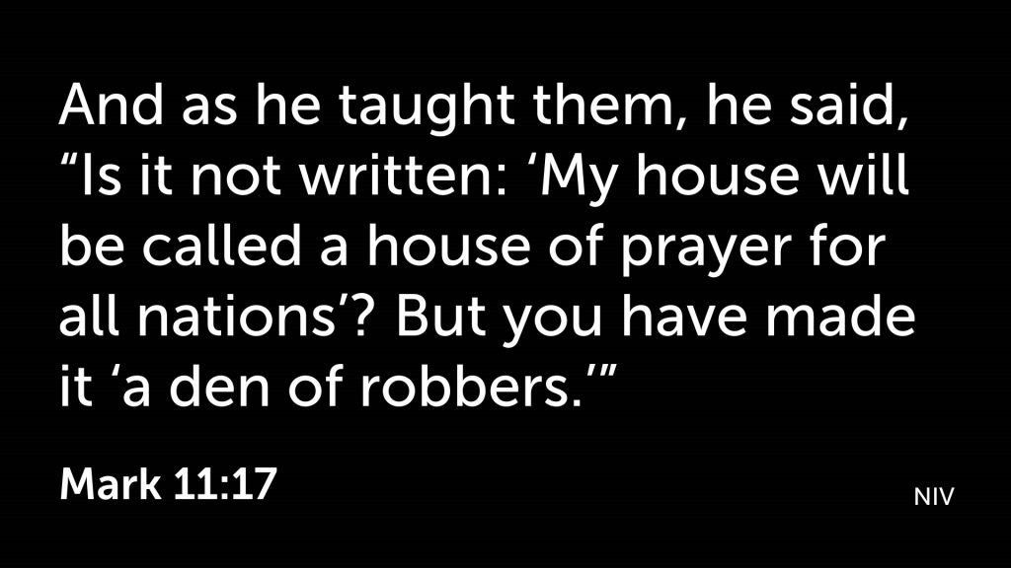

Slide 17
¹⁷ 便教训他们说：「经上不是记着说：
我的殿必称为万国祷告的殿吗？
你们倒使它成为贼窝了。」

Slide 19
¹⁴ 在殿里有瞎子、瘸子到耶稣跟前，他就治好了他们。¹⁵ 祭司长和文士看见耶稣所行的奇事，又见小孩子在殿里喊着说：「和散那归于大卫的子孙！」就甚恼怒

Slide 21
¹⁹ 那日（就是七日的第一日）晚上，门徒所在的地方，因怕犹太人，门都关了。耶稣来，站在当中，对他们说：「愿你们平安！」²⁰ 说了这话，就把手和肋旁指给他们看。门徒看见主，就喜乐了。

Slide 25
¹¹ 我观看，见天开了。有一匹白马，骑在马上的称为诚信真实，他审判，争战，都按着公义。¹² 他的眼睛如火焰，他头上戴着许多冠冕；又有写着的名字，除了他自己没有人知道。¹³ 他穿着溅了血的衣服；他的名称为 神之道。¹⁴ 在天上的众军骑着白马，穿着细麻衣，又白又洁，跟随他。¹⁵ 有利剑从他口中出来，可以击杀列国。他必用铁杖辖管他们，并要踹全能 神烈怒的酒榨。¹⁶ 在他衣服和大腿上有名写着说：「万王之王，万主之主。」

