Slide 1
馬太福音 Matthew 13:44-46, 51-53
⁴⁴ “The kingdom of heaven is like treasure hidden in a field. When a man found it, he hid it again, and then in his joy went and sold all he had and bought that field. ⁴⁵ “Again, the kingdom of heaven is like a merchant looking for fine pearls. ⁴⁶ When he found one of great value, he went away and sold everything he had and bought it.
⁴⁴ 「天國好像寶貝藏在地裏，人遇見了就把它藏起來，歡歡喜喜地去變賣一切所有的，買這塊地。⁴⁵ 天國又好像買賣人尋找好珠子，⁴⁶ 遇見一顆重價的珠子，就去變賣他一切所有的，買了這顆珠子。

Slide 2
⁵¹ “Have you understood all these things?” Jesus asked. “Yes,” they replied. ⁵² He said to them, “Therefore every teacher of the law who has become a disciple in the kingdom of heaven is like the owner of a house who brings out of his storeroom new treasures as well as old.”⁵³ When Jesus had finished these parables, he moved on from there.
⁵¹ 耶穌說：「這一切的話你們都明白了嗎？」他們說：「我們明白了。」⁵² 他說：「凡文士受教作天國的門徒，就像一個家主從他庫裏拿出新舊的東西來。」
⁵³ 耶穌說完了這些比喻，就離開那裏

Slide 3
我的寶貝 My Precious
馬太福音 Matthew 13:44-46, 51-53
Notes:
https://en.wikipedia.org/wiki/Fall_of_Mosul

Slide 5
Matthew 13:14, 16
¹⁴ 在他們身上，正應了以賽亞的預言，說： 你們聽是 要 聽見，卻不明白 … ¹⁶ 「但你們的眼睛是有福的，因為看見了；你們的耳朵也是有福的，因為聽見了。
¹⁴ In them is fulfilled the prophecy of Isaiah: “ ‘You will be ever hearing but never understanding…¹⁶ But blessed are your eyes because they see, and your ears because they hear.

Slide 6
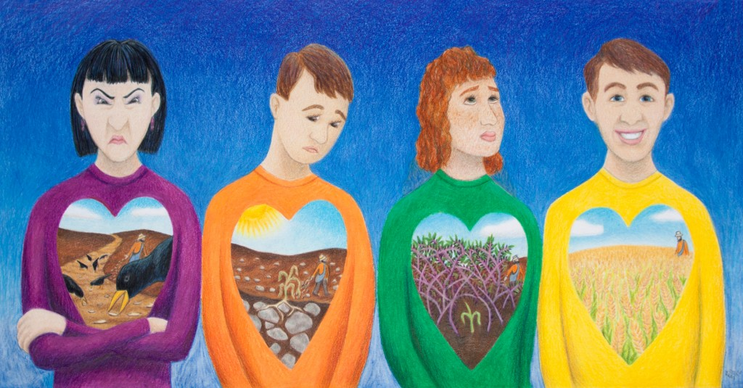
撒種的比喻 The Parable of the Sower 13:3-9

Slide 7
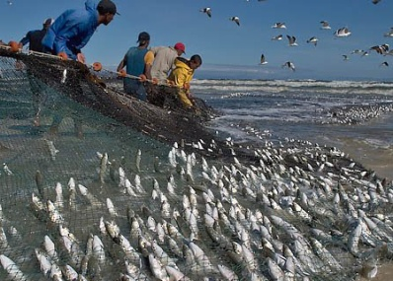
第一對比喻 1st Pair of Parables
麥子與稗子 The wheat and the tares 13:24-30
撒網 The net 13:47-50

Slide 8
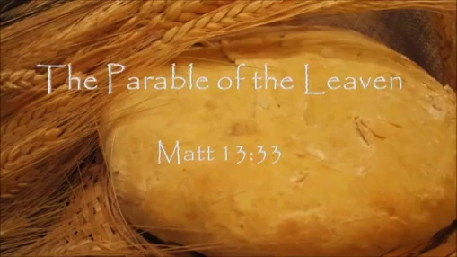
第二對比喻 2nd Pair of Parables
芥菜種 The mustard seed 13:31-32
麵酵 The leaven 13:33

Slide 9
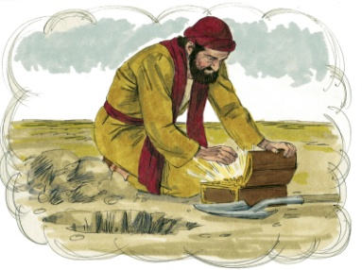
第三對比喻 3rd Pair of Parables
地裡的寶藏 The hidden treasure 13:44
重價的珍珠 The costly pearl 13:45-46

Slide 10
天國的子民知道天國的價值
Kingdom’s people recognize Kingdom’s value

Slide 11
Matthew 13:44
⁴⁴ 「天國好像寶貝藏在地裏，人遇見了就把它藏起來
⁴⁴ “The kingdom of heaven is like treasure hidden in a field. When a man found it, he hid it again

Slide 12
我知道天國對你的價值 I know how you value the Kingdom
從你追求天國之心 From your desire to search the Kingdom

Slide 13
Acts 17:11
¹¹ 這地方的人賢於帖撒羅尼迦的人，甘心領受這道，天天考查聖經，要曉得這道是與不是。
¹¹ Now the Berean Jews were of more noble character than those in Thessalonica, for they received the message with great eagerness and examined the Scriptures every day to see if what Paul said was true.

Slide 14
Proverbs 2:1–5 ¹ 我兒，你若領受我的言語， 存記我的命令， … ⁴ 尋找它，如尋找銀子， 搜求它，如搜求隱藏的珍寶， ⁵ 你就明白敬畏耶和華， 得以認識上帝。
¹ My son, if you accept my words and store up my commands within you … ⁴ and if you look for it as for silver and search for it as for hidden treasure, ⁵ then you will understand the fear of the Lord and find the knowledge of God.

Slide 15
我知道天國對你的價值 I know how you value the Kingdom
從你追求天國之心 From your desire to search the Kingdom
從你發現天國的喜樂 From your joy of discovering the Kingdom

Slide 16
Matthew 13:44
⁴⁴ 「天國好像寶貝藏在地裏，人遇見了就把它藏起來，歡歡喜喜地去變賣一切所有的，買這塊地。
⁴⁴ “The kingdom of heaven is like treasure hidden in a field. When a man found it, he hid it again, and then in his joy went and sold all he had and bought that field.

Slide 17
神的揀選 ≠ 宿命論 God’s Election ≠ Fatalism

Slide 18
我知道天國對你的價值 I know how you value the Kingdom
從你追求天國之心 From your desire to search the Kingdom
從你發現天國的喜樂 From your joy of discovering the Kingdom
從你為天國的犧牲 From your sacrifice for the Kingdom

Slide 19
Matthew 13:44
⁴⁴ 「天國好像寶貝藏在地裏，人遇見了就把它藏起來，歡歡喜喜地去變賣一切所有的，買這塊地。
⁴⁴ “The kingdom of heaven is like treasure hidden in a field. When a man found it, he hid it again, and then in his joy went and sold all he had and bought that field.

Slide 20
Matthew 13:45–46
⁴⁵ 天國又好像買賣人尋找好珠子，⁴⁶ 遇見一顆重價的珠子，就去變賣他一切所有的，買了這顆珠子。
⁴⁵ “Again, the kingdom of heaven is like a merchant looking for fine pearls. ⁴⁶ When he found one of great value, he went away and sold everything he had and bought it.

Slide 21
Philippians 3:7
⁷ 只是我先前以為與我有益的，我現在因基督都當作有損的。
⁷ But whatever were gains to me I now consider loss for the sake of Christ.

Slide 22
Philippians 3:8
⁸ 不但如此，我也將萬事當作有損的，因我以認識我主基督耶穌為至寶。我為他已經丟棄萬事，看作糞土，為要得著基督；
⁸ What is more, I consider everything a loss because of the surpassing worth of knowing Christ Jesus my Lord, for whose sake I have lost all things. I consider them garbage, that I may gain Christ

Slide 23
Philippians 3:9
⁹ 並且得以在他裏面，不是有自己因律法而得的義，乃是有信基督的義，就是因信上帝而來的義，
⁹ and be found in him, not having a righteousness of my own that comes from the law, but that which is through faith in Christ—the righteousness that comes from God on the basis of faith.

Slide 24
天國的子民知道天國的價值
Kingdom’s people recognize Kingdom’s value

Slide 25
我知道天國對你的價值 I know how you value the Kingdom
從你追求天國之心 From your desire to search the Kingdom
從你發現天國的喜樂 From your joy of discovering the Kingdom
從你為天國的犧牲 From your sacrifice for the Kingdom

