Slide 1
天國的預告 The Preview of God’s Kingdom
馬太福音 Matthew 13:24–30, 36-43, 47-50
Notes:
https://en.wikipedia.org/wiki/Fall_of_Mosul

Slide 3
Hebrews 11:16
¹⁶ 他們卻羨慕一個更美的家鄉，就是在天上的。所以上帝被稱為他們的上帝，並不以為恥
¹⁶ Instead, they were longing for a better country—a heavenly one. Therefore God is not ashamed to be called their God

Slide 5
馬太福音 Matthew 13:24–30, 36-43, 47-50
²⁴ 耶穌又設個比喻對他們說：「天國好像人撒好種在田裏，²⁵ 及至人睡覺的時候，有仇敵來，將稗子撒在麥子裏就走了。²⁶ 到長苗吐穗的時候，稗子也顯出來。²⁷ 田主的僕人來告訴他說：
²⁴ Jesus told them another parable: “The kingdom of heaven is like a man who sowed good seed in his field. ²⁵ But while everyone was sleeping, his enemy came and sowed weeds among the wheat, and went away. ²⁶ When the wheat sprouted and formed heads, then the weeds also appeared. ²⁷ “The owner’s servants

Slide 6
『主啊，你不是撒好種在田裏嗎？從哪裏來的稗子呢？』²⁸ 主人說：『這是仇敵做的。』僕人說：『你要我們去薅出來嗎？』²⁹ 主人說：『不必，恐怕薅稗子，連麥子也拔出來。³⁰ 容這兩樣一齊長，等著收割。
came to him and said, ‘Sir, didn’t you sow good seed in your field? Where then did the weeds come from?’ ²⁸ “ ‘An enemy did this,’ he replied. “The servants asked him, ‘Do you want us to go and pull them up?’ ²⁹ “ ‘No,’ he answered, ‘because while you are pulling the weeds, you may uproot the wheat with them. ³⁰ Let both grow together until the harvest.

Slide 7
當收割的時候，我要對收割的人說，先將稗子薅出來，捆成捆，留著燒；惟有麥子要收在倉裏。』」
³⁶ 當下，耶穌離開眾人，進了房子。他的門徒進前來，說：「請把田間稗子的比喻講給我們聽。」³⁷ 他回答說：「那撒好
At that time I will tell the harvesters: First collect the weeds and tie them in bundles to be burned; then gather the wheat and bring it into my barn.’ ”
³⁶ Then he left the crowd and went into the house. His disciples came to him and said, “Explain to us the parable of the weeds in the field.” ³⁷ He answered, “The one who sowed

Slide 8
種的就是人子；³⁸ 田地就是世界；好種就是天國之子；稗子就是那惡者之子；³⁹ 撒稗子的仇敵就是魔鬼；收割的時候就是世界的末了；收割的人就是天使。⁴⁰ 將稗子薅出來用火焚燒，世界的末了也要如此。⁴¹ 人子要差遣使者，把
the good seed is the Son of Man. ³⁸ The field is the world, and the good seed stands for the people of the kingdom. The weeds are the people of the evil one, ³⁹ and the enemy who sows them is the devil. The harvest is the end of the age, and the harvesters are angels. ⁴⁰ “As the weeds are pulled up and burned in the fire, so it will be at the end of the age. ⁴¹ The Son of Man will send out

Slide 9
一切叫人跌倒的和作惡的，從他國裏挑出來，⁴² 丟在火爐裏；在那裏必要哀哭切齒了。⁴³ 那時，義人在他們父的國裏，要發出光來，像太陽一樣。有耳可聽的，就應當聽！」
his angels, and they will weed out of his kingdom everything that causes sin and all who do evil. ⁴² They will throw them into the blazing furnace, where there will be weeping and gnashing of teeth. ⁴³ Then the righteous will shine like the sun in the kingdom of their Father. Whoever has ears, let them hear.

Slide 10
Psalm 93:1
¹ 耶和華作王！ 他以威嚴為衣穿上； 耶和華以能力為衣，以能力束腰， 世界就堅定，不得動搖。
¹ The Lord reigns, he is robed in majesty; the Lord is robed in majesty and armed with strength; indeed, the world is established, firm and secure.

Slide 11
1. 天國前期受仇敵攻擊 (24-28) Early Stage of God’s Kingdom Is Under Attack
Matthew 13:25
²⁵ 及至人睡覺的時候，有仇敵來，將稗子撒在麥子裏就走了。
²⁵ But while everyone was sleeping, his enemy came and sowed weeds among the wheat, and went away.

Slide 12
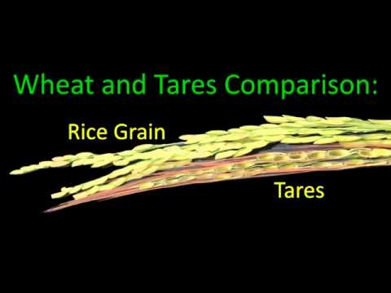
稗子 Weed (Tares)
「假麥」 Fake wheat

Slide 13
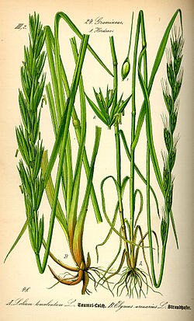
稗子 Weed (Tares)
「假麥」 Fake wheat
毒麥 poison darnel

Slide 14
Matthew 13:41
⁴¹ 人子要差遣使者，把一切叫人跌倒的和作惡的，從他國裏挑出來，
⁴¹ The Son of Man will send his angels, and they will gather out of his kingdom all causes of sin and all law-breakers,

Slide 15
Numbers 11:4
⁴ 他們中間的閒雜人大起貪慾的心；以色列人又哭號說：「誰給我們肉吃呢？
⁴ The rabble with them began to crave other food, and again the Israelites started wailing and said, “If only we had meat to eat!

Slide 16
Matthew 13:41
⁴¹ 人子要差遣使者，把一切叫人跌倒的和作惡的，從他國裏挑出來，
⁴¹ The Son of Man will send his angels, and they will gather out of his kingdom all causes of sin and all law-breakers,

Slide 17
Jude 4
⁴ 因為有些人偷著進來…將我們上帝的恩變作放縱情慾的機會，並且不認獨一的主宰－我們主耶穌基督。
⁴ For certain individuals ... have secretly slipped in among you… who pervert the grace of our God into a license for immorality and deny Jesus Christ our only Sovereign and Lord.

Slide 18
2. 為了神的子民, 神暫時容忍仇敵存在 God Tolerates His Enemies Temporarily For His People (28-30a)

Slide 19
Matthew 13:28–29
²⁸ … 僕人說：『你要我們去薅出來嗎？』²⁹ 主人說：『不必，恐怕薅稗子，連麥子也拔出來。
²⁸ … “The servants asked him, ‘Do you want us to go and pull them up?’ ²⁹ “ ‘No,’ he answered, ‘because while you are pulling the weeds, you may uproot the wheat with them.

Slide 20
2 Peter 3:9
⁹ 主所應許的尚未成就，有人以為他是耽延，其實不是耽延，乃是寬容你們，不願有一人沉淪，乃願人人都悔改。
⁹ The Lord is not slow in keeping his promise, as some understand slowness. Instead he is patient with you, not wanting anyone to perish, but everyone to come to repentance.

Slide 21
2 Peter 3:11–12
¹¹ 這一切既然都要這樣融化，你們應當怎樣為人，過著聖潔和敬虔的生活，¹² 等候並催促神的日子降臨呢？ (CNVT)
¹¹ Since everything will be destroyed in this way, what kind of people ought you to be? You ought to live holy and godly lives ¹² as you look forward to the day of God and speed its coming. (NIV)

Slide 22
3. 天國實現之前必有全地的審判 Worldwide Judgment comes before the Kingdom
Matthew 13:30
³⁰ 容這兩樣一齊長，等著收割。當收割的時候，我要對收割的人說，先將稗子薅出來，捆成捆，留著燒；惟有麥子要收在倉裏。』」
³⁰ Let both grow together until the harvest. At that time I will tell the harvesters: First collect the weeds and tie them in bundles to be burned; then gather the wheat and bring it into my barn.’ ”

Slide 23
Matthew 13:41–43 人子要差遣使者，把一切叫人跌倒的和作惡的，從他國裏挑出來，⁴² 丟在火爐裏；在那裏必要哀哭切齒了。⁴³ 那時，義人在他們父的國裏，要發出光來，像太陽一樣。有耳可聽的，就應當聽！」
⁴¹ The Son of Man will send out his angels, and they will weed out of his kingdom everything that causes sin and all who do evil. ⁴² They will throw them into the blazing furnace, where there will be weeping and gnashing of teeth. ⁴³ Then the righteous will shine like the sun in the kingdom of their Father. Whoever has ears, let them hear.

Slide 24
⁴⁷ 天國又好像網撒在海裏，聚攏各樣水族，
⁴⁸ 網既滿了，人就拉上岸來，坐下，揀好的收在器具裏，將不好的丟棄了。⁴⁹ 世界的末了也要這樣。天使要出來，從義人中把惡人分別出來，⁵⁰ 丟在火爐裏；在那裏必要哀哭切齒了。」
⁴⁷ “Once again, the kingdom of heaven is like a net that was let down into the lake and caught all kinds of fish. ⁴⁸ When it was full, the fishermen pulled it up on the shore. Then they sat down and collected the good fish in baskets, but threw the bad away. ⁴⁹ This is how it will be at the end of the age. The angels will come and separate the wicked from the righteous ⁵⁰ and throw them into the blazing furnace, where there will be weeping and gnashing of teeth.

Slide 26
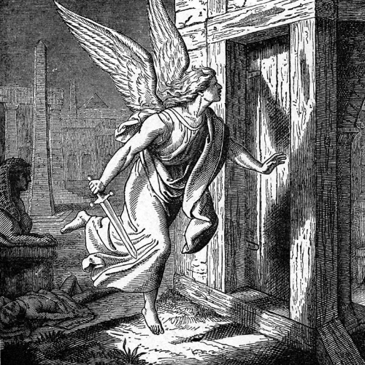
John 1:29
²⁹ 「看哪，上帝的羔羊，除去世人罪孽的！
²⁹ “Look, the Lamb of God, who takes away the sin of the world!

