Slide 1
馬太福音 Matthew 13:31-35
³¹ 他又設個比喻對他們說：「天國好像一粒芥菜種，有人拿去種在田裏。³² 這原是百種裏最小的，等到長起來，卻比各樣的菜都大，且成了樹，天上的飛鳥來宿在它的枝上。」
³¹ He told them another parable: “The kingdom of heaven is like a mustard seed, which a man took and planted in his field. ³² Though it is the smallest of all seeds, yet when it grows, it is the largest of garden plants and becomes a tree, so that the birds come and perch in its branches.”

Slide 2
³³ 他又對他們講個比喻說：「天國好像麵酵，有婦人拿來，藏在三斗麵裏，直等全團都發起來。」 ³⁴ 這都是耶穌用比喻對眾人說的話；若不用比喻，就不對他們說甚麼。³⁵ 這是要應驗先知的話，說：
³³ He told them still another parable: “The kingdom of heaven is like yeast that a woman took and mixed into about sixty pounds of flour until it worked all through the dough.” ³⁴ Jesus spoke all these things to the crowd in parables; he did not say anything to them without using a parable. ³⁵ So was fulfilled what was spoken through the prophet:

Slide 3
我要開口用比喻， 把創世以來所隱藏的事發明出來。
“I will open my mouth in parables, I will utter things hidden since the creation of the world.”

Slide 4
意想不到的天國 The Unexpectedness of the Kingdom
馬太福音 Matthew 13:31-35
Notes:
https://en.wikipedia.org/wiki/Fall_of_Mosul

Slide 5
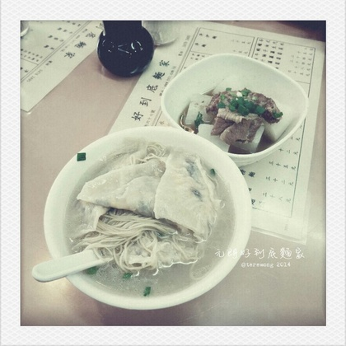

Slide 7
Romans 8:18
¹⁸ 我想，現在的苦楚若比起將來要顯於我們的榮耀就不足介意了。
¹⁸ I consider that our present sufferings are not worth comparing with the glory that will be revealed in us.

Slide 9
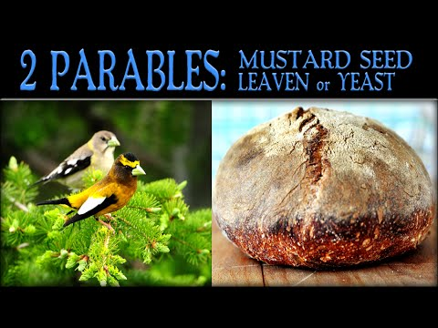

Slide 10
意想不到的天國 The Unexpectedness of the Kingdom
天國的開始是非常渺小 The beginning of the Kingdom is insignificant

Slide 11
Matthew 13:31–32
³¹ 他又設個比喻對他們說：「天國好像一粒芥菜種，有人拿去種在田裏。³² 這原是百種裏最小的…
³¹ He told them another parable: “The kingdom of heaven is like a mustard seed, which a man took and planted in his field. ³² Though it is the smallest of all seeds…

Slide 12
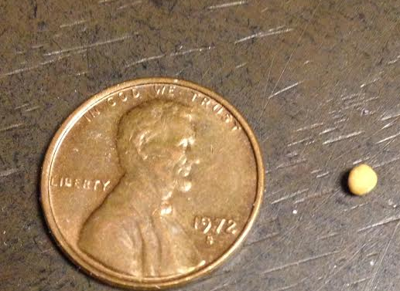
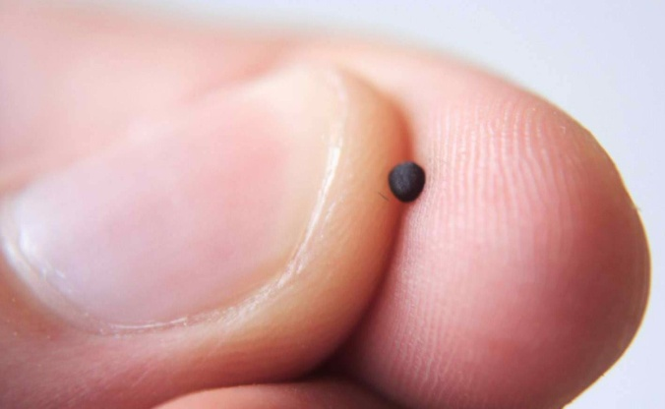

Slide 13
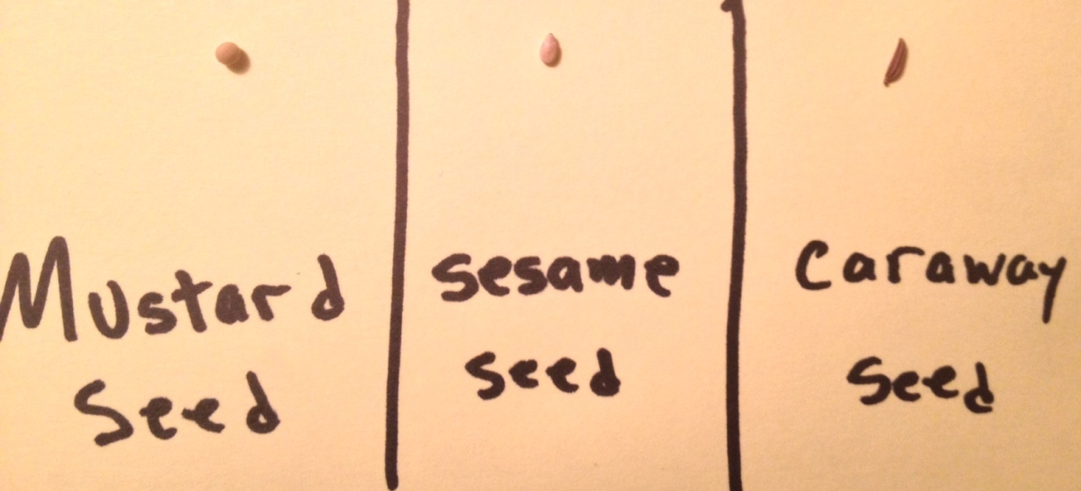

Slide 14
1. 天國的開始是非常渺小 The beginning of the Kingdom is insignificant
社會地位上 In term of social status
Matthew 13:55
⁵⁵ 這不是木匠的兒子嗎？
⁵⁵ “Isn’t this the carpenter’s son?

Slide 15
Matthew 27:29
²⁹ 用荊棘編做冠冕，戴在他頭上，拿一根葦子放在他右手裏，跪在他面前，戲弄他，說：「恭喜，猶太人的王啊！」
²⁹ and then twisted together a crown of thorns and set it on his head. They put a staff in his right hand. Then they knelt in front of him and mocked him. “Hail, king of the Jews!” they said.

Slide 16
Luke 23:39
³⁹ 那同釘的兩個犯人有一個譏笑他，說：「你不是基督嗎？可以救自己和我們吧！」
³⁹ One of the criminals who hung there hurled insults at him: “Aren’t you the Messiah? Save yourself and us!”

Slide 17
John 15:20
²⁰ …『僕人不能大於主人。』他們若逼迫了我，也要逼迫你們；
²⁰ … ‘A servant is not greater than his master.’ If they persecuted me, they will persecute you also.

Slide 18
Matthew 13:33
³³ 他又對他們講個比喻說：「天國好像麵酵，有婦人拿來，藏在三斗麵裏，直等全團都發起來。」
³³ He told them another parable. “The kingdom of heaven is like leaven that a woman took and hid in three measures of flour, till it was all leavened.” (ESV)

Slide 19
1. 天國的開始是非常渺小 The beginning of the Kingdom is insignificant
社會地位上 In term of social status
人數上 In term of number

Slide 22
意想不到的天國 The Unexpectedness of the Kingdom
天國的開始是非常渺小 The beginning of the Kingdom is insignificant
天國不斷生長和發展 The Kingdom continuously grows and expands

Slide 23
Matthew 13:32
³² 它是種子中最小的，但長大了，卻比其他的蔬菜都大，成為一棵樹，甚至天空的飛鳥也來在它的枝頭搭窩。」 (CNVT)
³² Though it is the smallest of all seeds, yet when it grows, it is the largest of garden plants and becomes a tree, so that the birds come and perch in its branches.”

Slide 25
Matthew 16:18
¹⁸ 我還告訴你，你是彼得，我要把我的教會建造在這磐石上；陰間的權柄不能勝過他。
¹⁸ And I tell you that you are Peter, and on this rock I will build my church, and the gates of Hades will not overcome it.

Slide 26
Matthew 13:33
³³ 他又對他們講個比喻說：「天國好像麵酵，有婦人拿來，藏在三斗麵裏，直等全團都發起來。」
³³ He told them another parable. “The kingdom of heaven is like leaven that a woman took and hid in three measures of flour, till it was all leavened.” (ESV)

Slide 27
意想不到的天國 The Unexpectedness of the Kingdom
天國的開始是非常渺小 The beginning of the Kingdom is insignificant
天國不斷生長和發展 The Kingdom continuously grows and expands
天國最終覆蓋萬有 The Kingdom eventually covers the whole earth

Slide 28
Matthew 13:32
³² 這原是百種裏最小的，等到長起來，卻比各樣的菜都大，且成了樹，天上的飛鳥來宿在它的枝上。」
³² Though it is the smallest of all seeds, yet when it grows, it is the largest of garden plants and becomes a tree, so that the birds come and perch in its branches.”

Slide 29
Daniel 4:21–22
²¹ 葉子華美…天空的飛鳥宿在枝上。 ²² 「王啊，這漸長又堅固的樹就是你。你的威勢漸長及天，你的權柄管到地極。
²¹ with beautiful leaves … and having nesting places in its branches for the birds—²² Your Majesty, you are that tree! You have become great and strong; your greatness has grown until it reaches the sky, and your dominion extends to distant parts of the earth.

Slide 30
拍住上 Striving Together
Revelation 14:4 這些人未曾沾染婦女，他們原是童身。羔羊無論往哪裏去，他們都跟隨他。他們是從人間買來的，作初熟的果子歸與上帝和羔羊。
⁴ These are those who did not defile themselves with women, for they remained virgins. They follow the Lamb wherever he goes. They were purchased from among mankind and offered as firstfruits to God and the Lamb.

