Slide 1
士師記 Judges 3:1–11
¹ 耶和華留下這幾族，為要試驗那不曾知道與迦南爭戰之事的以色列人，² 好叫以色列的後代又知道又學習未曾曉得的戰事。³ 所留下的就是非利士的五個首領和一切迦南人、西頓人，並住黎巴嫩山的希未人，
¹ These are the nations the Lord left to test all those Israelites who had not experienced any of the wars in Canaan ² (he did this only to teach warfare to the descendants of the Israelites who had not had previous battle experience): ³ the five rulers of the Philistines, all the Canaanites, the Sidonians, and the Hivites living in

Slide 2
從巴力•黑們山直到哈馬口。⁴ 留下這幾族，為要試驗以色列人，知道他們肯聽從耶和華藉摩西吩咐他們列祖的誡命不肯。⁵ 以色列人竟住在迦南人、赫人、亞摩利人、比利洗人、希未人、耶布斯人中間，⁶ 娶他們的女兒為妻，將自己的女兒嫁給他們
the Lebanon mountains from Mount Baal Hermon to Lebo Hamath. ⁴ They were left to test the Israelites to see whether they would obey the Lord’s commands, which he had given their ancestors through Moses. ⁵ The Israelites lived among the Canaanites, Hittites, Amorites, Perizzites, Hivites and Jebusites. ⁶ They took their daughters in marriage and gave their own daughters to their

Slide 3
的兒子，並事奉他們的神。 ⁷ 以色列人行耶和華眼中看為惡的事，忘記耶和華－他們的上帝，去事奉諸巴力和亞舍拉，⁸ 所以耶和華的怒氣向以色列人發作，就把他們交在美索不達米亞王古珊•利薩田的手中。以色列人服事古珊•利薩田八年。
sons, and served their gods. ⁷ The Israelites did evil in the eyes of the Lord; they forgot the Lord their God and served the Baals and the Asherahs. ⁸ The anger of the Lord burned against Israel so that he sold them into the hands of Cushan-Rishathaim king of Aram Naharaim, to whom the Israelites were subject for eight years.

Slide 4
⁹ 以色列人呼求耶和華的時候，耶和華就為他們興起一位拯救者救他們，就是迦勒兄弟基納斯的兒子俄陀聶。¹⁰ 耶和華的靈降在他身上，他就作了以色列的士師，出去爭戰。耶和華將美索不達米亞王古珊•利薩田交在他手中，他便勝了古珊•利薩田。
⁹ But when they cried out to the Lord, he raised up for them a deliverer, Othniel son of Kenaz, Caleb’s younger brother, who saved them. ¹⁰ The Spirit of the Lord came on him, so that he became Israel’s judge and went to war. The Lord gave Cushan-Rishathaim king of Aram into the hands of Othniel, who overpowered him.

Slide 5
¹¹ 於是國中太平四十年。基納斯的兒子俄陀聶死了。
¹¹ So the land had peace for forty years, until Othniel son of Kenaz died.

Slide 6
人生就是一個考驗 Life is a Test
士師記 Judges 3:1-11
Notes:
https://en.wikipedia.org/wiki/Fall_of_Mosul

Slide 7
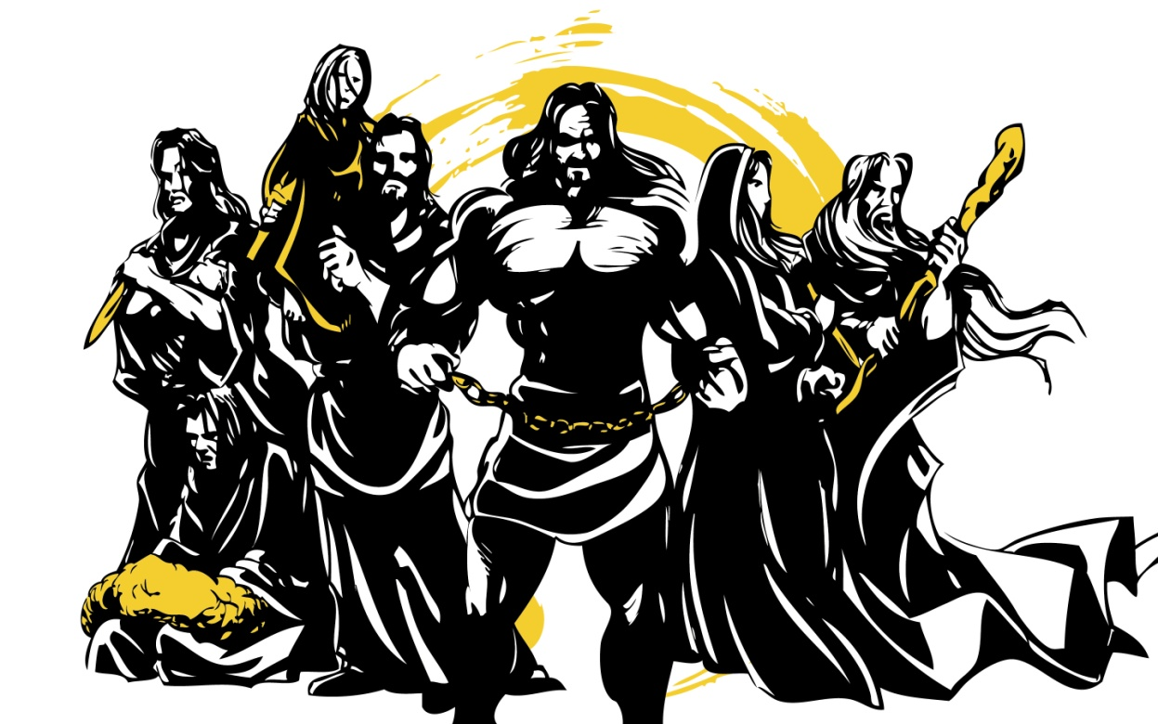
士師記 Judges

Slide 8
半心人 Half-hearted People
順服但不完全 Obey but not completely 1:1-19
得勝但不持久 Prevail but not persistently 1: 21
後悔但不改變 Regret but no change 2:6-19

Slide 9
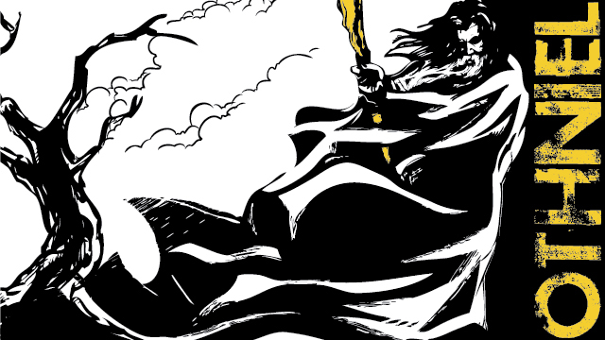
俄陀聶

Slide 10
1. 人生就是一個考驗 Life is a Test 3:1-4
Judges 3:1–3 耶和華留下這幾族，為要試驗那不曾知道與迦南爭戰之事的以色列人，^{… 3} 所留下的就是非利士的五個首領和一切迦南人、西頓人，並住黎巴嫩山的希未人…
¹ These are the nations the Lord left to test all those Israelites who had not experienced any of the wars in Canaan ^{… 3} the five rulers of the Philistines, all the Canaanites, the Sidonians, and the Hivites …

Slide 11
Judges 3:2
² 好叫以色列的後代又知道又學習未曾曉得的戰事。
² (he did this only to teach warfare to the descendants of the Israelites who had not had previous battle experience):

Slide 12
電腦程式除錯 Debug a program

Slide 13
Judges 3:4
⁴ 留下這幾族，為要試驗以色列人，知道他們肯聽從耶和華藉摩西吩咐他們列祖的誡命不肯。
⁴ They were left to test the Israelites to see whether they would obey the Lord’s commands, which he had given their ancestors through Moses.

Slide 14
2. 在試驗下的半心人 5-8 Half-Hearted People under Trials
Judges 3:7
⁷ 以色列人行耶和華眼中看為惡的事，忘記耶和華－他們的上帝，去事奉諸巴力和亞舍拉，
⁷ The Israelites did evil in the eyes of the Lord; they forgot the Lord their God and served the Baals and the Asherahs.

Slide 15
2. 在試驗下的半心人 5-8 Half-Hearted People under Trials
Judges 3:5–6 ⁵ 以色列人竟住在迦南人、赫人、亞摩利人、比利洗人、希未人、耶布斯人中間，⁶ 娶他們的女兒為妻，將自己的女兒嫁給他們的兒子，並事奉他們的神。
⁵ The Israelites lived among the Canaanites, Hittites, Amorites, Perizzites, Hivites and Jebusites. ⁶ They took their daughters in marriage and gave their own daughters to their sons, and served their gods.

Slide 16
Judges 3:8
⁸ 所以耶和華的怒氣向以色列人發作，就把他們交在美索不達米亞王古珊•利薩田的手中。以色列人服事古珊•利薩田八年。
⁸ The anger of the Lord burned against Israel so that he sold them into the hands of Cushan-Rishathaim king of Aram Naharaim, to whom the Israelites were subject for eight years.

Slide 17
美索不達米亞王古珊•利薩田 Cushan-Rishathaim king of Aram Naharaim
美索不達米亞 = 敘利亞和伊拉克 Aram Naharaim = Syria and Iraq
古珊•利薩田 = 雙重邪惡的古珊 Cushan-Rishathaim = Cushan of double evil

Slide 18
Joshua 24:16
¹⁶ 百姓回答說：「我們斷不敢離棄耶和華去事奉別神；
¹⁶ Then the people answered, “Far be it from us to forsake the Lord to serve other gods!

Slide 19
Joshua 24:19–20 ¹⁹ 約書亞對百姓說：「你們不能事奉耶和華；因為他是聖潔的上帝，是忌邪的上帝，必不赦免你們的過犯罪惡。²⁰ 你們若離棄耶和華去事奉外邦神，耶和華在降福之後，必轉而降禍與你們，把你們滅絕。」
¹⁹ Joshua said to the people, “You are not able to serve the Lord. He is a holy God; he is a jealous God. He will not forgive your rebellion and your sins. ²⁰ If you forsake the Lord and serve foreign gods, he will turn and bring disaster on you and make an end of you, after he has been good to you.”

Slide 20
3. 在試驗下的全心人 9-11 Whole-Hearted People under Trials
Judges 3:9
⁹ 以色列人呼求耶和華的時候，耶和華就為他們興起一位拯救者救他們，就是迦勒兄弟基納斯的兒子俄陀聶。
⁹ But when they cried out to the Lord, he raised up for them a deliverer, Othniel son of Kenaz, Caleb’s younger brother, who saved them.

Slide 21
迦勒 Caleb
Numbers 14:6–8 ⁶ 窺探地的人中，嫩的兒子約書亞和耶孚尼的兒子迦勒…說：「…⁸ 耶和華若喜悅我們，就必將我們領進那地，把地賜給我們；那地原是流奶與蜜之地。
⁶ Joshua son of Nun and Caleb son of Jephunneh, who were among those who had explored the land, …said “… ⁸ If the Lord is pleased with us, he will lead us into that land, a land flowing with milk and honey, and will give it to us.

Slide 22
Joshua 14:10–12 ¹⁰ … 看哪，現今我八十五歲了，¹¹ 我還是強壯，… ¹² 求你將耶和華那日應許我的這山地給我；那裏有亞衲族人，並寬大堅固的城，你也曾聽見了。或者耶和華照他所應許的與我同在，我就把他們趕出去。」
¹⁰ “… So here I am today, eighty-five years old! ¹¹ I am still as strong today …¹² Now give me this hill country that the Lord promised me that day. You yourself heard then that the Anakites were there and their cities were large and fortified, but, the Lord helping me, I will drive them out just as he said.”

Slide 23
Joshua 15:14–19
¹⁴ 迦勒就從那裏趕出亞衲族的三個族長，就是示篩、亞希幔、撻買；¹⁵ 又從那裏上去，攻擊底璧的居民。（這底璧從前名叫基列•西弗。）¹⁶ 迦勒說：「誰能攻打基列•西弗將城奪取，我就把我女兒押撒給他為妻。」
Joshua 15:14–19
¹⁴ From Hebron Caleb drove out the three Anakites—Sheshai, Ahiman and Talmai, the sons of Anak. ¹⁵ From there he marched against the people living in Debir (formerly called Kiriath Sepher). ¹⁶ And Caleb said, “I will give my daughter Aksah in marriage to the man who attacks and captures Kiriath Sepher.”

Slide 24
¹⁷ 迦勒兄弟基納斯的兒子俄陀聶奪取了那城，迦勒就把女兒押撒給他為妻。
¹⁷ Othniel son of Kenaz, Caleb’s brother, took it; so Caleb gave his daughter Aksah to him in marriage.

Slide 25
Judges 3:9–11
⁹ 以色列人呼求耶和華的時候，耶和華就為他們興起一位拯救者救他們，就是迦勒兄弟基納斯的兒子俄陀聶。¹⁰ 耶和華的靈降在他身上，他就作了以色列的士師，出去爭戰。
Judges 3:9–11
⁹ But when they cried out to the Lord, he raised up for them a deliverer, Othniel son of Kenaz, Caleb’s younger brother, who saved them. ¹⁰ The Spirit of the Lord came on him, so that he became Israel’s judge and went to war.

Slide 26
耶和華將美索不達米亞王古珊•利薩田交在他手中，他便勝了古珊•利薩田。¹¹ 於是國中太平四十年。基納斯的兒子俄陀聶死了。
The Lord gave Cushan-Rishathaim king of Aram into the hands of Othniel, who overpowered him. ¹¹ So the land had peace for forty years, until Othniel son of Kenaz died.

