Slide 1
馬太福音 Matthew 14:12-22
¹² John’s disciples came and took his body and buried it. Then they went and told Jesus. ¹³ When Jesus heard what had happened, he withdrew by boat privately to a solitary place. Hearing of this, the crowds followed him on foot from the towns. ¹⁴ When Jesus landed and saw a large crowd, he had compassion on them and healed their sick.
¹² 約翰的門徒來，把屍首領去埋葬了，就去告訴耶穌。 ¹³ 耶穌聽見了，就上船從那裏獨自退到野地裏去。眾人聽見，就從各城裏步行跟隨他。¹⁴ 耶穌出來，見有許多的人，就憐憫他們，治好了他們的病人。

Slide 2
¹⁵ As evening approached, the disciples came to him and said, “This is a remote place, and it’s already getting late. Send the crowds away, so they can go to the villages and buy themselves some food.” ¹⁶ Jesus replied, “They do not need to go away. You give them something to eat.” ¹⁷ “We have here only five loaves of bread and two fish,” they
¹⁵ 天將晚的時候，門徒進前來，說：「這是野地，時候已經過了，請叫眾人散開，他們好往村子裏去，自己買吃的。」¹⁶ 耶穌說：「不用他們去，你們給他們吃吧！」¹⁷ 門徒說：「我們這裏只有五個餅，兩條魚。」

Slide 3
answered. ¹⁸ “Bring them here to me,” he said. ¹⁹ And he directed the people to sit down on the grass. Taking the five loaves and the two fish and looking up to heaven, he gave thanks and broke the loaves. Then he gave them to the disciples, and the disciples gave them to the people. ²⁰ They all ate and were satisfied, and the disciples picked up twelve
¹⁸ 耶穌說：「拿過來給我。」¹⁹ 於是吩咐眾人坐在草地上，就拿著這五個餅，兩條魚，望著天祝福，擘開餅，遞給門徒，門徒又遞給眾人。²⁰ 他們都吃，並且吃飽了，把剩下的零碎收拾起來，裝滿了十二個籃子。

Slide 4
basketfuls of broken pieces that were left over. ²¹ The number of those who ate was about five thousand men, besides women and children. ²² Immediately Jesus made the disciples get into the boat and go on ahead of him to the other side, while he dismissed the crowd.
²¹ 吃的人，除了婦女孩子，約有五千。²² 耶穌隨即催門徒上船，先渡到那邊去，等他叫眾人散開。

Slide 5
你的愿望是什么？ What is Your Wish?
馬太福音 Matthew 14:12-21
Notes:
https://en.wikipedia.org/wiki/Fall_of_Mosul

Slide 8
Matthew 1:21 ²¹ 她將要生一個兒子，你要給他起名叫耶穌，因他要將自己的百姓從罪惡裏救出來。」
²¹ She will give birth to a son, and you are to give him the name Jesus, because he will save his people from their sins.”

Slide 9
Luke 2:49
⁴⁹ 耶穌說：「為甚麼找我呢？豈不知我應當以我父的事為念嗎？」
⁴⁹ And He said to them, “Why did you seek Me? Did you not know that I must be about My Father’s business?” (NKJV)

Slide 13
五餅二魚餵飽五千人 5 Loaves and 2 Fish Feed 5000
學習憐憫人 Learn to have compassion on people
學習事奉神 Learn to serve God

Slide 14
 | 馬太Matthew | 馬可Mark | 路加Luke | 約翰John
差派十二門徒Sending of 12 | 10:1-11:1 | 6:7-13 | 9:1-6
約翰被殺 John’s Death | 14:1-12 | 6:14-29 | 9:7-9
五餅二魚 Feeding 5000 | 14:13-21 | 6:30-44 | 9:10-17 | 6:1-15

Slide 15
1. 學習憐憫人 Learn to Have Compassion on People
Mark 6:30
³⁰ 使徒聚集到耶穌那裏，將一切所做的事、所傳的道全告訴他。
³⁰ The apostles gathered around Jesus and reported to him all they had done and taught.

Slide 16
Mark 6:31
³¹ 他就說：「你們來，同我暗暗地到曠野地方去歇一歇。」這是因為來往的人多，他們連吃飯也沒有工夫。
³¹ Then, because so many people were coming and going that they did not even have a chance to eat, he said to them, “Come with me by yourselves to a quiet place and get some rest.”

Slide 17
Matthew 14:13–14
¹³ 耶穌聽見了，就上船從那裏獨自退到野地裏去。眾人聽見，就從各城裏步行跟隨他。¹⁴ 耶穌出來，見有許多的人，就憐憫他們，治好了他們的病人。
¹³ When Jesus heard what had happened, he withdrew by boat privately to a solitary place. Hearing of this, the crowds followed him on foot from the towns. ¹⁴ When Jesus landed and saw a large crowd, he had compassion on them and healed their sick.

Slide 18
Matthew 14:13–14
¹³ 耶穌聽見了，就上船從那裏獨自退到野地裏去。眾人聽見，就從各城裏步行跟隨他。¹⁴ 耶穌出來，見有許多的人，就憐憫他們，治好了他們的病人。
¹³ When Jesus heard what had happened, he withdrew by boat privately to a solitary place. Hearing of this, the crowds followed him on foot from the towns. ¹⁴ When Jesus landed and saw a large crowd, he had compassion on them and healed their sick.

Slide 19
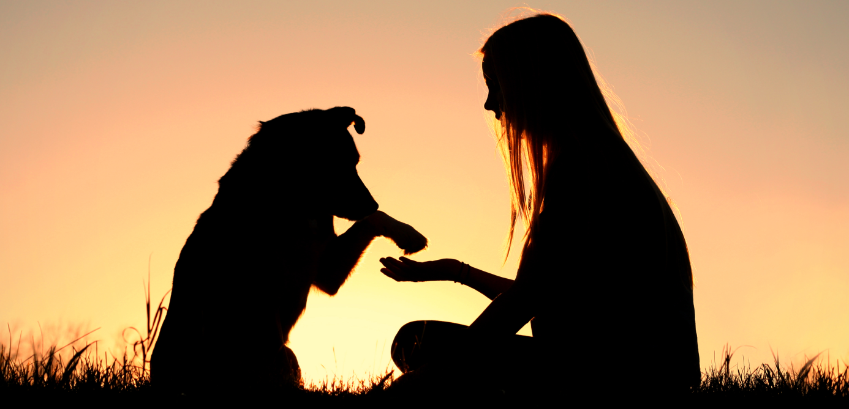

Slide 20
John 6:60, 66
⁶⁰ 他的門徒中有好些人聽見了，就說：「這話甚難，誰能聽呢？」 … ⁶⁶ 從此，他門徒中多有退去的，不再和他同行。
⁶⁰ On hearing it, many of his disciples said, “This is a hard teaching. Who can accept it?” … ⁶⁶ From this time many of his disciples turned back and no longer followed him.

Slide 21
2. 學習事奉神 Learn to serve God
Matthew 14:15 ¹⁵ 天將晚的時候，門徒進前來，說：「這是野地，時候已經過了，請叫眾人散開，他們好往村子裏去，自己買吃的。」
¹⁵ As evening approached, the disciples came to him and said, “This is a remote place, and it’s already getting late. Send the crowds away, so they can go to the villages and buy themselves some food.”

Slide 22
Matthew 14:21
²¹ 吃的人，除了婦女孩子，約有五千。
²¹ The number of those who ate was about five thousand men, besides women and children.

Slide 23
John 6:5–6
⁵ 耶穌舉目看見許多人來，就對腓力說：「我們從哪裏買餅叫這些人吃呢？」（⁶ 他說這話是要試驗腓力；他自己原知道要怎樣行。）
⁵ When Jesus looked up and saw a great crowd coming toward him, he said to Philip, “Where shall we buy bread for these people to eat?” ⁶ He asked this only to test him, for he already had in mind what he was going to do.

Slide 24
John 6:7
⁷ 腓力回答說：「就是二十兩銀子的餅，叫他們各人吃一點也是不夠的。」
⁷ Philip answered him, “It would take more than half a year’s wages to buy enough bread for each one to have a bite!”

Slide 25
2. 學習事奉神 Learn to serve God
不靠人, 只靠神 Don’t rely on men but on God

Slide 26
2. 學習事奉神 Learn to serve God
不靠人, 只靠神 Don’t rely on men but on God
把自己交託神 Put yourself in God’s hand

Slide 27
John 6:8–9
⁸ 有一個門徒，就是西門•彼得的兄弟安得烈，對耶穌說：⁹ 「在這裏有一個孩童，帶著五個大麥餅、兩條魚，只是分給這許多人還算甚麼呢？」
⁸ Another of his disciples, Andrew, Simon Peter’s brother, spoke up, ⁹ “Here is a boy with five small barley loaves and two small fish, but how far will they go among so many?”

Slide 28
Matthew 14:18
¹⁸ 耶穌說：「拿過來給我。」
¹⁸ “Bring them here to me,” he said.

Slide 29
2. 學習事奉神 Learn to serve God
不靠人, 只靠神 Don’t rely on men but on God
把自己交託神 Put yourself in God’s hand
包括人的勞苦 Involve our labor

Slide 30
Matthew 14:19
¹⁹ 於是吩咐眾人坐在草地上，就拿著這五個餅，兩條魚，望著天祝福，擘開餅，遞給門徒，門徒又遞給眾人。
¹⁹ And he directed the people to sit down on the grass. Taking the five loaves and the two fish and looking up to heaven, he gave thanks and broke the loaves. Then he gave them to the disciples, and the disciples gave them to the people.

Slide 31
Matthew 14:20
²⁰ 他們都吃，並且吃飽了，把剩下的零碎收拾起來，裝滿了十二個籃子。
²⁰ They all ate and were satisfied, and the disciples picked up twelve basketfuls of broken pieces that were left over.

Slide 32
2. 學習事奉神 Learn to serve God
不靠人, 只靠神 Don’t rely on men but on God
把自己交託神 Put yourself in God’s hand
包括人的勞苦 Involve our labor
不是為了自己 Not for my own benefit

Slide 33
John 6:12
¹² 他們吃飽了，耶穌對門徒說：「把剩下的零碎收拾起來，免得有糟蹋的。」
¹² When they had all had enough to eat, he said to his disciples, “Gather the pieces that are left over. Let nothing be wasted.”

Slide 34
John 6:14
¹⁴ 眾人看見耶穌所行的神蹟，就說：「這真是那要到世間來的先知！」
¹⁴ After the people saw the sign Jesus performed, they began to say, “Surely this is the Prophet who is to come into the world.”

Slide 35
Matthew 14:22
²² 耶穌隨即催門徒上船，先渡到那邊去，等他叫眾人散開。
²² Immediately Jesus made the disciples get into the boat and go on ahead of him to the other side, while he dismissed the crowd.

