Slide 1
士師記 Judges 3:12–31
¹² Again the Israelites did evil in the eyes of the Lord, and because they did this evil the Lord gave Eglon king of Moab power over Israel. ¹³ Getting the Ammonites and Amalekites to join him, Eglon came and attacked Israel, and they took possession of the City of Palms. ¹⁴ The Israelites were subject to Eglon king of Moab for eighteen years.
¹² 以色列人又行耶和華眼中看為惡的事，耶和華就使摩押王伊磯倫強盛，攻擊以色列人。¹³ 伊磯倫招聚亞捫人和亞瑪力人，去攻打以色列人，佔據棕樹城。¹⁴ 於是以色列人服事摩押王伊磯倫十八年。

Slide 2
¹⁵ Again the Israelites cried out to the Lord, and he gave them a deliverer—Ehud, a left-handed man, the son of Gera the Benjamite. The Israelites sent him with tribute to Eglon king of Moab. ¹⁶ Now Ehud had made a double-edged sword about a cubit long, which he strapped to his right thigh under his clothing. ¹⁷ He presented the tribute to Eglon
¹⁵ 以色列人呼求耶和華的時候，耶和華就為他們興起一位拯救者，就是便雅憫人基拉的兒子以笏；他是左手便利的。以色列人託他送禮物給摩押王伊磯倫。¹⁶ 以笏打了一把兩刃的劍，長一肘，帶在右腿上衣服裏面。¹⁷ 他將禮物獻給摩押王伊磯倫

Slide 3
king of Moab, who was a very fat man. ¹⁸ After Ehud had presented the tribute, he sent on their way those who had carried it. ¹⁹ But on reaching the stone images near Gilgal he himself went back to Eglon and said, “Your Majesty, I have a secret message for you.” The king said to his attendants, “Leave us!” And they all left. ²⁰ Ehud then approached him while
（原來伊磯倫極其肥胖）；¹⁸ 以笏獻完禮物，便將抬禮物的人打發走了，¹⁹ 自己卻從靠近吉甲鑿石之地回來，說：「王啊，我有一件機密事奏告你。」王說：「迴避吧！」於是左右侍立的人都退去了。²⁰ 以笏來到王面前；

Slide 4
he was sitting alone in the upper room of his palace and said, “I have a message from God for you.” As the king rose from his seat, ²¹ Ehud reached with his left hand, drew the sword from his right thigh and plunged it into the king’s belly. ²² Even the handle sank in after the blade, and his bowels discharged. Ehud did not pull the sword out, and the fat closed in over it.
王獨自一人坐在涼樓上。以笏說：「我奉上帝的命報告你一件事。」王就從座位上站起來。²¹ 以笏便伸左手，從右腿上拔出劍來，刺入王的肚腹，²² 連劍把都刺進去了。劍被肥肉夾住，他沒有從王的肚腹拔出來，且穿通了後身。

Slide 5
²³ Then Ehud went out to the porch; he shut the doors of the upper room behind him and locked them. ²⁴ After he had gone, the servants came and found the doors of the upper room locked. They said, “He must be relieving himself in the inner room of the palace.” ²⁵ They waited to the point of embarrassment, but when he did not open the doors of the room,
²³ 以笏就出到遊廊，將樓門盡都關鎖。 ²⁴ 以笏出來之後，王的僕人到了，看見樓門關鎖，就說：「他必是在樓上大解。」²⁵ 他們等煩了，見仍不開樓門，

Slide 6
they took a key and unlocked them. There they saw their lord fallen to the floor, dead. ²⁶ While they waited, Ehud got away. He passed by the stone images and escaped to Seirah. ²⁷ When he arrived there, he blew a trumpet in the hill country of Ephraim, and the Israelites went down with him from the hills, with him leading them. ²⁸ “Follow me,” he ordered, “for the Lord has given
就拿鑰匙開了，不料，他們的主人已死，倒在地上。 ²⁶ 他們耽延的時候，以笏就逃跑了，經過鑿石之地，逃到西伊拉；²⁷ 到了，就在以法蓮山地吹角。以色列人隨著他下了山地，他在前頭引路，²⁸ 對他們說：「你們隨我來，

Slide 7
Moab, your enemy, into your hands.” So they followed him down and took possession of the fords of the Jordan that led to Moab; they allowed no one to cross over. ²⁹ At that time they struck down about ten thousand Moabites, all vigorous and strong; not one escaped. ³⁰ That day Moab was made subject to Israel, and the land had peace for eighty years. ³¹ After Ehud came
因為耶和華已經把你們的仇敵摩押人交在你們手中。」於是他們跟著他下去，把守約旦河的渡口，不容摩押一人過去。²⁹ 那時擊殺了摩押人約有一萬，都是強壯的勇士，沒有一人逃脫。³⁰ 這樣，摩押就被以色列人制伏了。國中太平八十年。 ³¹ 以笏之後，

Slide 8
Shamgar son of Anath, who struck down six hundred Philistines with an oxgoad. He too saved Israel.
有亞拿的兒子珊迦，他用趕牛的棍子打死六百非利士人。他也救了以色列人。

Slide 9
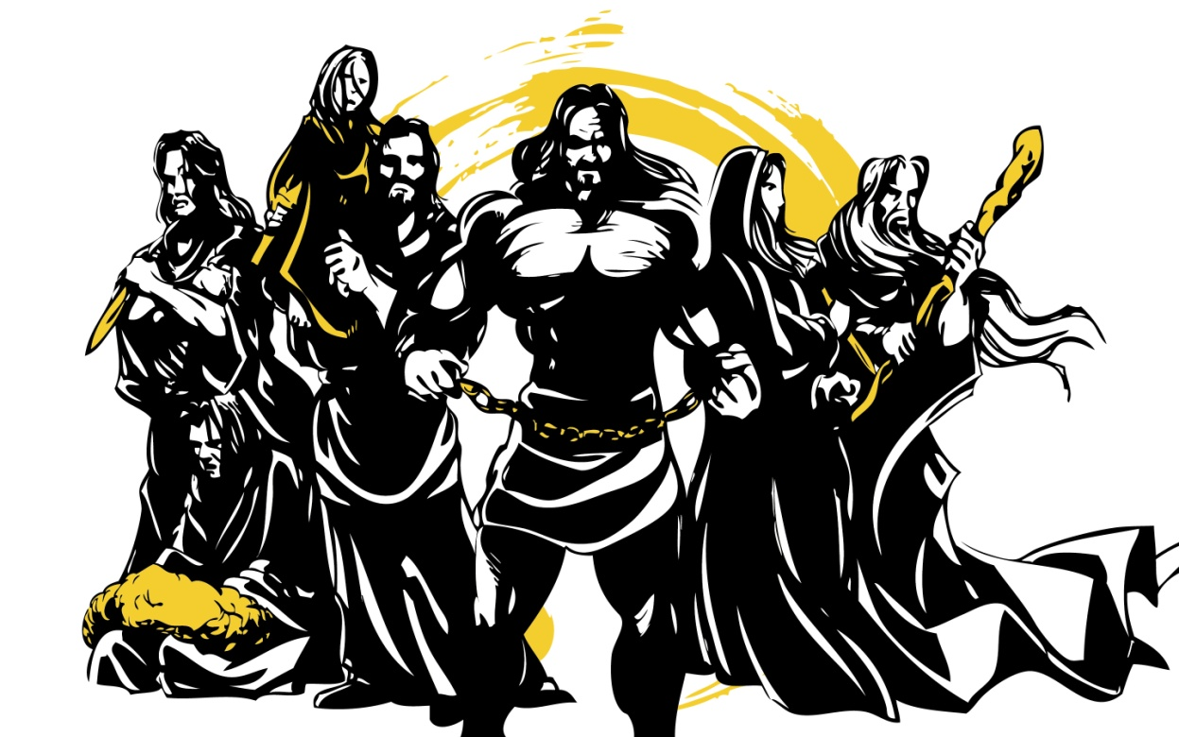
士師記 Judges

Slide 10
Judges 21:25
²⁵ 那時，以色列中沒有王，各人任意而行。
²⁵ In those days Israel had no king; everyone did as they saw fit.

Slide 11
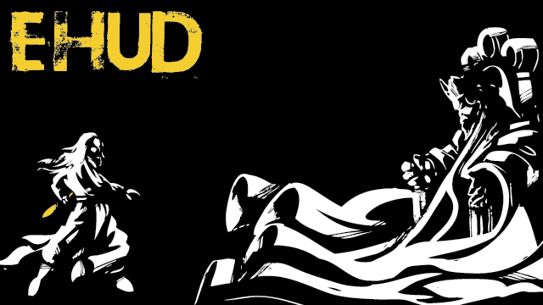
以笏

Slide 12
獨臂刀大戰小肥牛 The One-Armed Swordsman against The Little Fat Calf
士師記 Judges 3:12-31
Notes:
https://en.wikipedia.org/wiki/Fall_of_Mosul

Slide 13
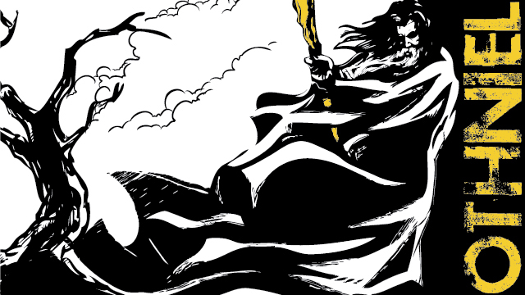
俄陀聶

Slide 14
Judges 3:12
¹² 以色列人又行耶和華眼中看為惡的事
¹² Again the Israelites did evil in the eyes of the Lord

Slide 15
1. 半心人的特點 Traits of a Half-Hearted Person
忘恩負義 Betrayal of the Benefactor

Slide 16
Hebrews 10:25
²⁵ 你們不可停止聚會，好像那些停止慣了的人，倒要彼此勸勉，既知道那日子臨近，就更當如此。
²⁵ not giving up meeting together, as some are in the habit of doing, but encouraging one another—and all the more as you see the Day approaching.

Slide 17
Judges 3:12
¹² 以色列人又行耶和華眼中看為惡的事，耶和華就使摩押王伊磯倫強盛，攻擊以色列人。
¹² Again the Israelites did evil in the eyes of the Lord, and because they did this evil the Lord gave Eglon king of Moab power over Israel.

Slide 18
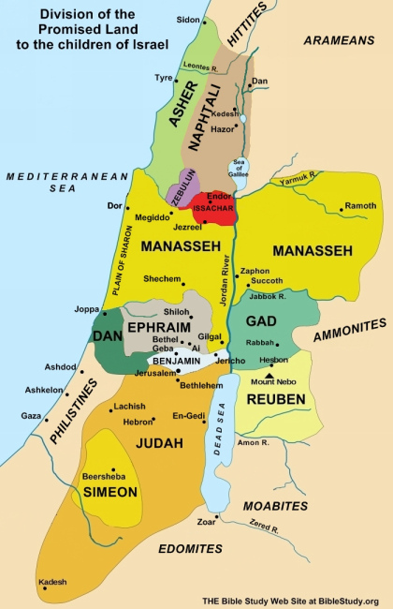
Judges 3:13
¹³ 伊磯倫招聚亞捫人和亞瑪力人，去攻打以色列人，佔據棕樹城。
¹³ Getting the Ammonites and Amalekites to join him, Eglon came and attacked Israel, and they took possession of the City of Palms.
亞捫
摩押
摩押

Slide 19
Judges 3:14
¹⁴ 於是以色列人服事摩押王伊磯倫十八年。
¹⁴ The Israelites were subject to Eglon king of Moab for eighteen years.

Slide 20
1. 半心人的特點 Traits of a Half-Hearted Person
忘恩負義 Betrayal of the benefactor
苟且偷安 Content with temporary ease

Slide 21
Judges 3:15
¹⁵ 以色列人呼求耶和華的時候，耶和華就為他們興起一位拯救者，就是便雅憫人基拉的兒子以笏；他是左手便利的。以色列人託他送禮物給摩押王伊磯倫。
¹⁵ Again the Israelites cried out to the Lord, and he gave them a deliverer—Ehud, a left-handed man, the son of Gera the Benjamite. The Israelites sent him with tribute to Eglon king of Moab.

Slide 22
以笏 Ehud
便雅憫人 = 「右手之子」 Benjaminite = “Son of my right hand”
左手便利 = 「右手有障礙」 a left-handed man = “bound/restricted in the right hand”
以笏 = 「榮耀在哪裏？」 Ehud = “Where is the splendor/majesty?”

Slide 23
2. 全心人的特點 Traits of a Whole-Hearted Person
相信神的安排是最好 Believe God’s plan is the best plan

Slide 24
John 9:2–3
² 門徒問耶穌說：「拉比，這人生來是瞎眼的，是誰犯了罪？是這人呢？是他父母呢？」³ 耶穌回答說：「也不是這人犯了罪，也不是他父母犯了罪，是要在他身上顯出上帝的作為來。
² His disciples asked him, “Rabbi, who sinned, this man or his parents, that he was born blind?” ³ “Neither this man nor his parents sinned,” said Jesus, “but this happened so that the works of God might be displayed in him.

Slide 25
2 Corinthians 12:9
⁹ 他對我說：「我的恩典夠你用的，因為我的能力是在人的軟弱上顯得完全。」所以，我更喜歡誇自己的軟弱，好叫基督的能力覆庇我。
⁹ But he said to me, “My grace is sufficient for you, for my power is made perfect in weakness.” Therefore I will boast all the more gladly about my weaknesses, so that Christ’s power may rest on me.

Slide 26
2. 全心人的特點 Traits of a Whole-Hearted Person
相信神的安排是最好 Believe God’s plan is the best plan
願意為神犧牲生命 Willing to sacrifice his life for God

Slide 27
Judges 3:15–16
¹⁵ … 以色列人託他送禮物給摩押王伊磯倫。¹⁶ 以笏打了一把兩刃的劍，長一肘，帶在右腿上衣服裏面。
¹⁵ … The Israelites sent him with tribute to Eglon king of Moab. ¹⁶ Now Ehud had made a double-edged sword about a cubit long, which he strapped to his right thigh under his clothing.

Slide 28
3. 一位控制歷史的神 A God Who Controls the History
Judges 3:17-18
¹⁷ 他將禮物獻給摩押王伊磯倫（原來伊磯倫極其肥胖）； ¹⁸ 以笏獻完禮物，便將抬禮物的人打發走了，
¹⁷ He presented the tribute to Eglon king of Moab, who was a very fat man. ¹⁸ After Ehud had presented the tribute, he sent on their way those who had carried it.

Slide 29
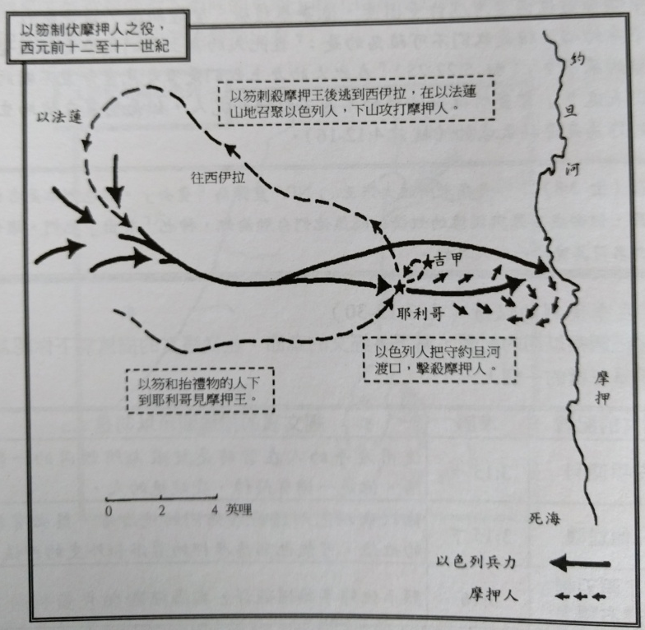
Judges 3:19
¹⁹ 自己卻從靠近吉甲鑿石之地回來
¹⁹ But on reaching the stone images near Gilgal he himself went back to Eglon

Slide 30
Judges 3:19
¹⁹ … 說：「王啊，我有一件機密事奏告你。」王說：「迴避吧！」於是左右侍立的人都退去了。
¹⁹ … said, “Your Majesty, I have a secret message for you.” The king said to his attendants, “Leave us!” And they all left.

Slide 31
Judges 3:20-21 以笏來到王面前；王獨自一人坐在涼樓上。以笏說：「我奉上帝的命報告你一件事。」王就從座位上站起來。 ²¹ 以笏便伸左手，從右腿上拔出劍來，刺入王的肚腹，
²⁰ Ehud then approached him while he was sitting alone in the upper room of his palace and said, “I have a message from God for you.” As the king rose from his seat, ²¹ Ehud reached with his left hand, drew the sword from his right thigh and plunged it into the king’s belly.

Slide 32
Judges 3:22
²² 連刀柄也跟刀身進去﹔脂肪把刀身夾住﹔他沒有把刀從王肚子里拔出來﹔連糞也流出來了。 (呂振中譯本)
²² And the hilt also went in after the blade, and the fat closed over the blade, for he did not pull the sword out of his belly; and the dung came out. (ESV)

Slide 33
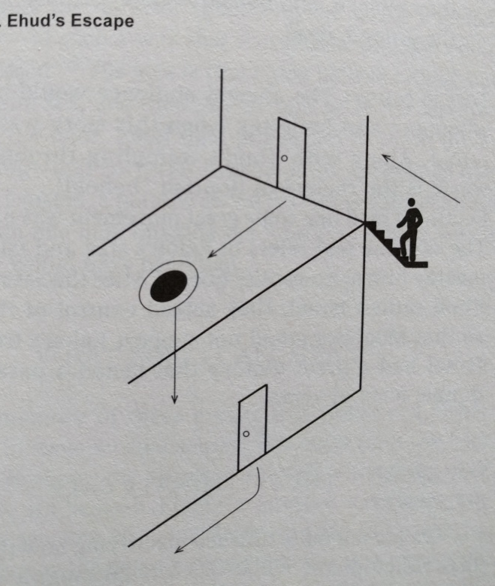
Judges 3:23
²³ 以笏就出到遊廊，將樓門盡都關鎖。
²³ Then Ehud went out to the porch; he shut the doors of the upper room behind him and locked them.
Notes:
George M. Schwab, Right in Their Own Eyes, p.53

Slide 34
Judges 3:24
²⁴ 以笏出來之後，王的僕人到了，看見樓門關鎖，就說：「他必是在樓上大解。」
²⁴ After he had gone, the servants came and found the doors of the upper room locked. They said, “He must be relieving himself in the inner room of the palace.”

Slide 35
Judges 3:25-26
²⁵ 他們等煩了，見仍不開樓門，就拿鑰匙開了，不料，他們的主人已死，倒在地上。 ²⁶ 他們耽延的時候，以笏就逃跑了，經過鑿石之地，逃到西伊拉；
²⁵ They waited to the point of embarrassment, but when he did not open the doors of the room, they took a key and unlocked them. There they saw their lord fallen to the floor, dead. ²⁶ While they waited, Ehud got away. He passed by the stone images and escaped to Seirah.

Slide 36
Judges 3:28–29 ²⁸ 對他們說：「你們隨我來，因為耶和華已經把你們的仇敵摩押人交在你們手中。」於是他們跟著他下去，把守約旦河的渡口，不容摩押一人過去。²⁹ 那時擊殺了摩押人約有一萬，都是強壯的勇士，沒有一人逃脫。
²⁸ “Follow me,” he ordered, “for the Lord has given Moab, your enemy, into your hands.” So they followed him down and took possession of the fords of the Jordan that led to Moab; they allowed no one to cross over. ²⁹ At that time they struck down about ten thousand Moabites, all vigorous and strong; not one escaped.

Slide 37
Judges 3:30
³⁰ 這樣，摩押就被以色列人制伏了。國中太平八十年。
³⁰ That day Moab was made subject to Israel, and the land had peace for eighty years.

Slide 38
Nahum 1:7
⁷ 耶和華本為善， 在患難的日子為人的保障， 並且認得那些投靠他的人。
⁷ The Lord is good, a refuge in times of trouble. He cares for those who trust in him,

