Slide 1
馬太福音 Matthew 15:1-20
¹ Then some Pharisees and teachers of the law came to Jesus from Jerusalem and asked, ² “Why do your disciples break the tradition of the elders? They don’t wash their hands before they eat!” ³ Jesus replied, “And why do you break the command of God for the sake of your tradition? ⁴ For God said, ‘Honor your father
¹ 那時，有法利賽人和文士從耶路撒冷來見耶穌，說：² 「你的門徒為甚麼犯古人的遺傳呢？因為吃飯的時候，他們不洗手。」³ 耶穌回答說：「你們為甚麼因著你們的遺傳犯上帝的誡命呢？⁴ 上帝說：『當

Slide 2
and mother’ and ‘Anyone who curses their father or mother is to be put to death.’ ⁵ But you say that if anyone declares that what might have been used to help their father or mother is ‘devoted to God,’ ⁶ they are not to ‘honor their father or mother’ with it. Thus you nullify the word of God for the sake of your tradition. ⁷ You hypocrites! Isaiah was right when
孝敬父母』；又說：『咒罵父母的，必治死他。』⁵ 你們倒說：『無論何人對父母說：我所當奉給你的已經作了供獻，⁶ 他就可以不孝敬父母。』這就是你們藉著遺傳，廢了上帝的誡命。⁷ 假冒為善的人哪，以賽亞指著你們說的預言是

Slide 3
he prophesied about you: ⁸ “ ‘These people honor me with their lips, but their hearts are far from me. ⁹ They worship me in vain; their teachings are merely human rules.’” ¹⁰ Jesus called the crowd to him and said, “Listen and understand. ¹¹ What goes into someone’s mouth does not defile them, but what comes out of their mouth, that is what defiles them.”
不錯的。他說： ⁸ 這百姓用嘴唇尊敬我， 心卻遠離我； ⁹ 他們將人的吩咐當作道理教導人， 所以拜我也是枉然。」 ¹⁰ 耶穌就叫了眾人來，對他們說：「你們要聽，也要明白。¹¹ 入口的不能污穢人，出口的乃能污穢人。」

Slide 4
¹² Then the disciples came to him and asked, “Do you know that the Pharisees were offended when they heard this?” ¹³ He replied, “Every plant that my heavenly Father has not planted will be pulled up by the roots. ¹⁴ Leave them; they are blind guides. If the blind lead the blind, both will fall into a pit.” ¹⁵ Peter said, “Explain
¹² 當時，門徒進前來對他說：「法利賽人聽見這話，不服，你知道嗎？」¹³ 耶穌回答說：「凡栽種的物，若不是我天父栽種的，必要拔出來。¹⁴ 任憑他們吧！他們是瞎眼領路的；若是瞎子領瞎子，兩個人都要掉在坑裏。」¹⁵ 彼得對耶穌說：「請將這

Slide 5
the parable to us.” ¹⁶ “Are you still so dull?” Jesus asked them. ¹⁷ “Don’t you see that whatever enters the mouth goes into the stomach and then out of the body? ¹⁸ But the things that come out of a person’s mouth come from the heart, and these defile them. ¹⁹ For out of the heart come evil thoughts—murder, adultery, sexual immorality, theft, false testimony, slander.
比喻講給我們聽。」¹⁶ 耶穌說：「你們到如今還不明白嗎？¹⁷ 豈不知凡入口的，是運到肚子裏，又落在茅廁裏嗎？¹⁸ 惟獨出口的，是從心裏發出來的，這才污穢人。¹⁹ 因為從心裏發出來的，有惡念、凶殺、姦淫、苟合、偷盜、妄證、謗讟。

Slide 6
²⁰ These are what defile a person; but eating with unwashed hands does not defile them.”
²⁰ 這都是污穢人的；至於不洗手吃飯，那卻不污穢人。」

Slide 7
枉然的虔誠 Worthless Piety
馬太福音 Matthew 15:1-20
Notes:
https://en.wikipedia.org/wiki/Fall_of_Mosul

Slide 8
Notes:
https://www.hk01.com/article/39950

Slide 9
Notes:
http://hk.apple.nextmedia.com/news/art/20170503/20009199

Slide 10
誰是真神? Who is the true God?
什麼是真虔誠？What is true piety?

Slide 11
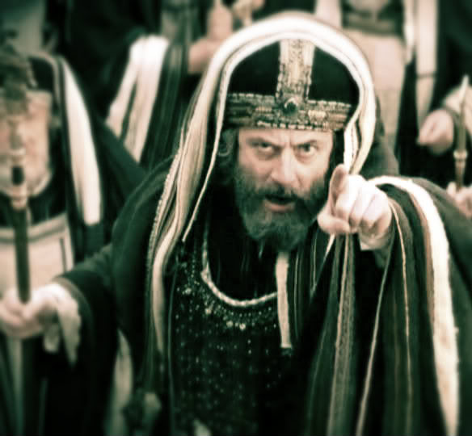
Matthew 15:1
¹ 那時，有法利賽人和文士從耶路撒冷來見耶穌，說：
¹ Then some Pharisees and teachers of the law came to Jesus from Jerusalem and asked,

Slide 12
Matthew 15:2
² 「你的門徒為甚麼犯古人的遺傳呢？因為吃飯的時候，他們不洗手。」
² “Why do your disciples break the tradition of the elders? They don’t wash their hands before they eat!”

Slide 13
Notes:
http://www.chabad.org/1504405

Slide 14
Mark 7:3–4 ³ 原來法利賽人和猶太人都拘守古人的遺傳，若不仔細洗手就不吃飯；⁴ 從市上來，若不洗浴也不吃飯；還有好些別的規矩，他們歷代拘守，就是洗杯、罐、銅器等物。
³ The Pharisees and all the Jews do not eat unless they give their hands a ceremonial washing, holding to the tradition of the elders. ⁴ When they come from the marketplace they do not eat unless they wash. And they observe many other traditions, such as the washing of cups, pitchers and kettles.

Slide 15
Matthew 15:9, 13-14
⁹ 他們…拜我也是枉然。…¹³ 若不是我天父栽種的，必要拔出來。¹⁴ 任憑他們吧！他們是瞎眼領路的；若是瞎子領瞎子，兩個人都要掉在坑裏。」
⁹ They worship me in vain… ¹³ Every plant that my heavenly Father has not planted will be pulled up by the roots. ¹⁴ Leave them; they are blind guides. If the blind lead the blind, both will fall into a pit.”

Slide 16
1.枉然的虔誠 Worthless Piety
將人的吩咐當作神的道理 Human rules replace God’s teaching Matthew 15:3 耶穌回答說：「你們為什麼因著你們的遺傳犯上帝的誡命呢？ Jesus replied, “ And why do you break the command of God for the sake of your tradition?

Slide 17
Matthew 15:4–6 ⁴ 上帝說：『當孝敬父母』；又說：『咒罵父母的，必治死他。』⁵ 你們倒說：『無論何人對父母說：我所當奉給你的已經作了供獻，⁶ 他就可以不孝敬父母。』這就是你們藉著遺傳，廢了上帝的誡命。
⁴ For God said, ‘Honor your father and mother’ and ‘Anyone who curses their father or mother is to be put to death.’ ⁵ But you say that if anyone declares that what might have been used to help their father or mother is ‘devoted to God,’ ⁶ they are not to ‘honor their father or mother’ with it. Thus you nullify the word of God for the sake of your tradition.

Slide 18
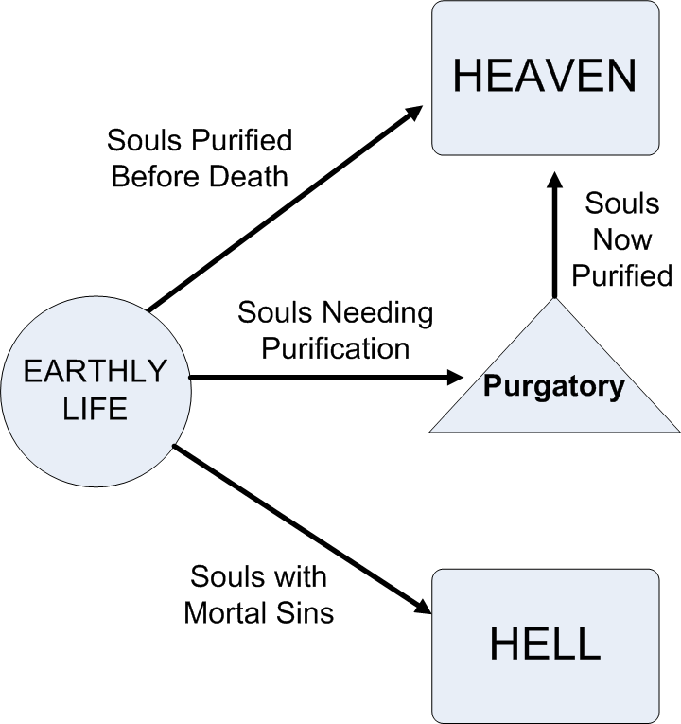
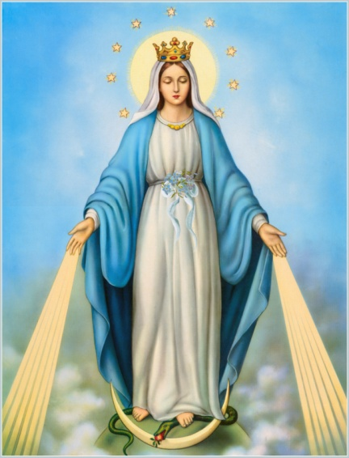
煉獄Purgatory
聖母無染原罪
Immaculate Conception

Slide 19
1.枉然的虔誠 Worthless Piety
將人的吩咐當作神的道理 Human rules replace God’s teaching
用嘴唇尊敬神，心卻遠離神 Honor God with lips but not their hearts

Slide 20
Matthew 15:7–8
⁷ 假冒為善的人哪，以賽亞指著你們說的預言是不錯的。他說： ⁸ 這百姓用嘴唇尊敬我， 心卻遠離我；
⁷ You hypocrites! Isaiah was right when he prophesied about you: ⁸ “ ‘These people honor me with their lips, but their hearts are far from me.

Slide 21
Matthew 15:10–11
¹⁰ 耶穌就叫了眾人來，對他們說：「你們要聽，也要明白。¹¹ 入口的不能污穢人，出口的乃能污穢人。」
¹⁰ Jesus called the crowd to him and said, “Listen and understand. ¹¹ What goes into someone’s mouth does not defile them, but what comes out of their mouth, that is what defiles them.”

Slide 22
Matthew 15:17–18
¹⁷ 豈不知凡入口的，是運到肚子裏，又落在茅廁裏嗎？¹⁸ 惟獨出口的，是從心裏發出來的，這才污穢人。
¹⁷ “Don’t you see that whatever enters the mouth goes into the stomach and then out of the body? ¹⁸ But the things that come out of a person’s mouth come from the heart, and these defile them.

Slide 23
Matthew 15:19–20
¹⁹ 因為從心裏發出來的，有惡念、凶殺、姦淫、苟合、偷盜、妄證、謗讟。²⁰ 這都是污穢人的；至於不洗手吃飯，那卻不污穢人。」
¹⁹ For out of the heart come evil thoughts—murder, adultery, sexual immorality, theft, false testimony, slander. ²⁰ These are what defile a person; but eating with unwashed hands does not defile them.”

Slide 24
Mark 7:19
¹⁹ 因為不是入他的心，乃是入他的肚腹，又落到茅廁裏（ 這是說，各樣的食物都是潔淨的）」；
¹⁹ For it doesn’t go into their heart but into their stomach, and then out of the body.” (In saying this, Jesus declared all foods clean.)

Slide 25
2. 真正的虔誠 True Piety
人所說的話反映人的虔誠 Our words reflect our piety

Slide 26
James 3:2
² 原來我們在許多事上都有過失；若有人在話語上沒有過失，他就是完全人，也能勒住自己的全身。
² We all stumble in many ways. Anyone who is never at fault in what they say is perfect, able to keep their whole body in check.

Slide 27
2. 真正的虔誠 True Piety
人所說的話反映人的虔誠 Our words reflect our piety
神審判人所講的話 God judges our words

Slide 29
Matthew 12:36–37
³⁶ 我又告訴你們，凡人所說的閒話，當審判的日子，必要句句供出來；³⁷ 因為要憑你的話定你為義，也要憑你的話定你有罪。」
³⁶ But I tell you that everyone will have to give account on the day of judgment for every empty word they have spoken. ³⁷ For by your words you will be acquitted, and by your words you will be condemned.”

Slide 30
2. 真正的虔誠 True Piety
人所說的話反映人的虔誠 Our words reflect our piety
神審判人所講的話 God judges our words
只有清潔的心才能帶來真正的虔誠 Only a clean heart can bring out true piety

Slide 31
Matthew 15:18
¹⁸ 惟獨出口的，是從心裏發出來的，這才污穢人。
¹⁸ But the things that come out of a person’s mouth come from the heart, and these defile them.

Slide 32
Psalm 51:10
¹⁰ 上帝啊，求你為我造清潔的心， 使我裏面重新有正直的靈。
¹⁰ Create in me a pure heart, O God, and renew a steadfast spirit within me.

Slide 33
2 Corinthians 5:17
¹⁷ 若有人在基督裏，他就是新造的人，舊事已過，都變成新的了。
¹⁷ Therefore, if anyone is in Christ, the new creation has come: The old has gone, the new is here!

