Slide 1
士師記 Judges 4:1-24
¹ Again the Israelites did evil in the eyes of the Lord, now that Ehud was dead. ² So the Lord sold them into the hands of Jabin king of Canaan, who reigned in Hazor. Sisera, the commander of his army, was based in Harosheth Haggoyim. ³ Because he had nine hundred chariots fitted with iron and had cruelly oppressed the Israelites for twenty years,
¹ 以笏死後，以色列人又行耶和華眼中看為惡的事，² 耶和華就把他們付與在夏瑣作王的迦南王耶賓手中；他的將軍是西西拉，住在外邦人的夏羅設。³ 耶賓王有鐵車九百輛。他大大欺壓以色列人二十年，

Slide 2
they cried to the Lord for help. ⁴ Now Deborah, a prophet, the wife of Lappidoth, was leading Israel at that time. ⁵ She held court under the Palm of Deborah between Ramah and Bethel in the hill country of Ephraim, and the Israelites went up to her to have their disputes decided. ⁶ She sent for Barak son of Abinoam from Kedesh in Naphtali and said to
以色列人就呼求耶和華。 ⁴ 有一位女先知名叫底波拉，是拉比多的妻，當時作以色列的士師。⁵ 她住在以法蓮山地拉瑪和伯特利中間，在底波拉的棕樹下。以色列人都上她那裏去聽判斷。⁶ 她打發人從拿弗他利的基低斯將亞比挪菴的兒子巴拉召了來，對他說

Slide 3
him, “The Lord, the God of Israel, commands you: ‘Go, take with you ten thousand men of Naphtali and Zebulun and lead them up to Mount Tabor. ⁷ I will lead Sisera, the commander of Jabin’s army, with his chariots and his troops to the Kishon River and give him into your hands.’ ” ⁸ Barak said to her, “If you go with me, I will go; but if you don’t go with me, I won’t
：「耶和華－以色列的上帝吩咐你說：『你率領一萬拿弗他利和西布倫人上他泊山去。⁷ 我必使耶賓的將軍西西拉率領他的車輛和全軍往基順河，到你那裏去；我必將他交在你手中。』」⁸ 巴拉說：「你若同我去，我就去；你若不同我去，我就不去。」

Slide 4
⁹ 底波拉說：「我必與你同去，只是你在所行的路上得不著榮耀，因為耶和華要將西西拉交在一個婦人手裏。」於是底波拉起來，與巴拉一同往基低斯去了。¹⁰ 巴拉就招聚西布倫人和拿弗他利人到基低斯，跟他上去的有一萬人。底波拉也同他上去。
go.” ⁹ “Certainly I will go with you,” said Deborah. “But because of the course you are taking, the honor will not be yours, for the Lord will deliver Sisera into the hands of a woman.” So Deborah went with Barak to Kedesh. ¹⁰ There Barak summoned Zebulun and Naphtali, and ten thousand men went up under his command. Deborah also went up with him.

Slide 5
¹¹ Now Heber the Kenite had left the other Kenites, the descendants of Hobab, Moses’ brother-in-law, and pitched his tent by the great tree in Zaanannim near Kedesh. ¹² When they told Sisera that Barak son of Abinoam had gone up to Mount Tabor, ¹³ Sisera summoned from Harosheth Haggoyim to the Kishon River all his men and his nine hundred chariots fitted with iron.
¹¹ 摩西岳父何巴的後裔，基尼人希百曾離開基尼族，到靠近基低斯、撒拿音的橡樹旁支搭帳棚。 ¹² 有人告訴西西拉說：「亞比挪菴的兒子巴拉已經上他泊山了。」¹³ 西西拉就聚集所有的鐵車九百輛和跟隨他的全軍，從外邦人的夏羅設出來，到了基順河。

Slide 6
¹⁴ Then Deborah said to Barak, “Go! This is the day the Lord has given Sisera into your hands. Has not the Lord gone ahead of you?” So Barak went down Mount Tabor, with ten thousand men following him. ¹⁵ At Barak’s advance, the Lord routed Sisera and all his chariots and army by the sword, and Sisera got down from his chariot and fled on foot.
¹⁴ 底波拉對巴拉說：「你起來，今日就是耶和華將西西拉交在你手的日子。耶和華豈不在你前頭行嗎？」於是巴拉下了他泊山，跟隨他有一萬人。¹⁵ 耶和華使西西拉和他一切車輛全軍潰亂，在巴拉面前被刀殺敗；西西拉下車步行逃跑。

Slide 7
¹⁶ Barak pursued the chariots and army as far as Harosheth Haggoyim, and all Sisera’s troops fell by the sword; not a man was left. ¹⁷ Sisera, meanwhile, fled on foot to the tent of Jael, the wife of Heber the Kenite, because there was an alliance between Jabin king of Hazor and the family of Heber the Kenite. ¹⁸ Jael went out to meet Sisera and said to him, “Come, my
¹⁶ 巴拉追趕車輛、軍隊，直到外邦人的夏羅設。西西拉的全軍都倒在刀下，沒有留下一人。 ¹⁷ 只有西西拉步行逃跑，到了基尼人希百之妻雅億的帳棚，因為夏瑣王耶賓與基尼人希百家和好。¹⁸ 雅億出來迎接西西拉，對他說：「請我

Slide 8
lord, come right in. Don’t be afraid.” So he entered her tent, and she covered him with a blanket. ¹⁹ “I’m thirsty,” he said. “Please give me some water.” She opened a skin of milk, gave him a drink, and covered him up. ²⁰ “Stand in the doorway of the tent,” he told her. “If someone comes by and asks you, ‘Is anyone in there?’
主進來，不要懼怕」；西西拉就進了她的帳棚。雅億用被將他遮蓋。¹⁹ 西西拉對雅億說：「我渴了，求你給我一點水喝。」雅億就打開皮袋，給他奶子喝，仍舊把他遮蓋。²⁰ 西西拉又對雅億說：「請你站在帳棚門口，若有人來問你說：『有人在這裏沒有？』

Slide 9
say ‘No.’ ” ²¹ But Jael, Heber’s wife, picked up a tent peg and a hammer and went quietly to him while he lay fast asleep, exhausted. She drove the peg through his temple into the ground, and he died. ²² Just then Barak came by in pursuit of Sisera, and Jael went out to meet him. “Come,” she said, “I will show you
『有人在這裏沒有？』你就說：『沒有。』」²¹ 西西拉疲乏沉睡。希百的妻雅億取了帳棚的橛子，手裏拿著錘子，輕悄悄地到他旁邊，將橛子從他鬢邊釘進去，釘入地裏。西西拉就死了。²² 巴拉追趕西西拉的時候，雅億出來迎接他說：「來吧，我將你所尋找

Slide 10
the man you’re looking for.” So he went in with her, and there lay Sisera with the tent peg through his temple—dead. ²³ On that day God subdued Jabin king of Canaan before the Israelites. ²⁴ And the hand of the Israelites pressed harder and harder against Jabin king of Canaan until they destroyed him.
的人給你看。」他就進入帳棚，看見西西拉已經死了，倒在地上，橛子還在他鬢中。 ²³ 這樣，上帝使迦南王耶賓被以色列人制伏了。²⁴ 從此以色列人的手越發有力，勝了迦南王耶賓，直到將他滅絕了。

Slide 11
故態復萌 Relapse into Your Old Way
士師記 Judges 4-5
Notes:
https://en.wikipedia.org/wiki/Fall_of_Mosul

Slide 12
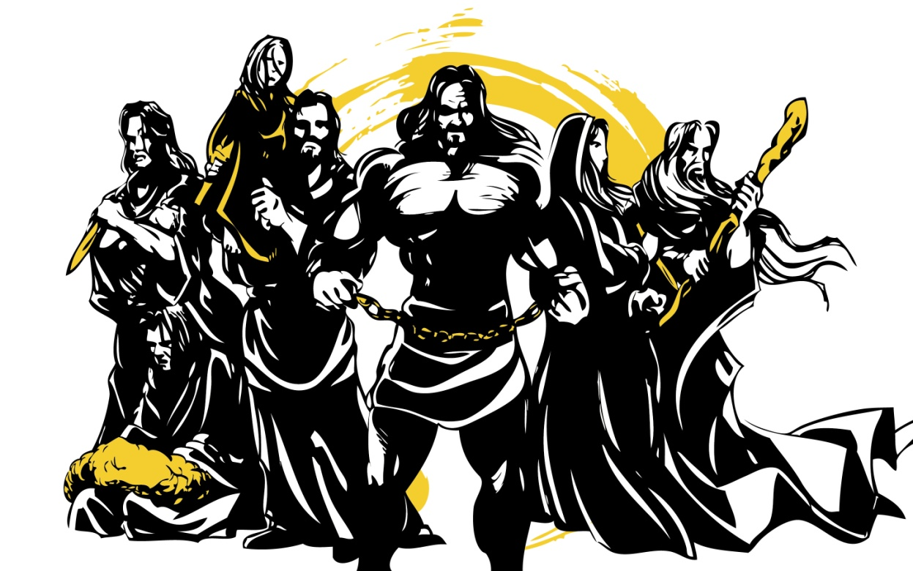
士師記 Judges

Slide 13
士師 Judge | 受欺壓Oppressed | 太平 Peace
俄陀聶 Othniel | 八年 8 yrs | 四十年 40 yrs
以笏 Ehud | 十八年 18 yrs | 八十年 80 yrs
底波拉 Deborah | 二十年 20 yrs | 四十年 40 yrs

Slide 14
1 Corinthians 10:11
¹¹ 他們遭遇這些事都要作為鑑戒，並且寫在經上，正是警戒我們這末世的人。
¹¹ These things happened to them as examples and were written down as warnings for us, on whom the culmination of the ages has come.

Slide 15
出勝過故態復萌的秘訣 Steps to conquer relapses
承認陷入困境 Admit my crisis

Slide 16
Job 36:15
¹⁵ 上帝藉著困苦救拔困苦人， 趁他們受欺壓開通他們的耳朵。
¹⁵ But those who suffer he delivers in their suffering; he speaks to them in their affliction.

Slide 18
Job 36:13
¹³ 那些心裡不敬虔的人積存怒氣， 神捆綁他們，他們竟不呼求。 (CNVT)
¹³ “The godless in heart harbor resentment; even when he fetters them, they do not cry for help.

Slide 19
士師 Judge | 欺壓者 Oppressed by
俄陀聶 Othniel | 美索不達米亞王 King of Aram Naharaim
以笏 Ehud | 摩押王 King of Moab
底波拉 Deborah | 迦南王 King of Canaan

Slide 20
Judges 4:2-3 ² 耶和華就把他們付與在夏瑣作王的迦南王耶賓手中；… ³ 耶賓王有鐵車九百輛。他大大欺壓以色列人二十年，以色列人就呼求耶和華。
² So the Lord sold them into the hands of Jabin king of Canaan, who reigned in Hazor. … ³ Because he had nine hundred chariots fitted with iron and had cruelly oppressed the Israelites for twenty years, they cried to the Lord for help.

Slide 21
Judges 5:6–8 (CNVT) ⁶ 在亞拿的兒子珊迦的時候， 在雅億的日子，大道無人行走， 行路的人繞道而行。 ⁷ 以色列中的農村消失了，消失了， …那時四萬以色列人中， 竟不見有一面盾牌、一枝長矛。
⁶ “In the days of Shamgar son of Anath, in the days of Jael, the highways were abandoned; travelers took to winding paths. ⁷ Villagers in Israel would not fight; they held back … but not a shield or spear was seen among forty thousand in Israel.

Slide 22
出勝過故態復萌的秘訣 Steps to conquer relapses
承認陷入困境 Admit my crisis
承認得罪神 Admit my sin against God

Slide 23
Judges 5:8
⁸ 以色列人選擇新神， 爭戰的事就臨到城門。
⁸ When they chose new gods, war came to the city gates, (NIV84)

Slide 24
Judges 4:6–7 ⁶ …「耶和華－以色列的上帝吩咐你說：『你率領一萬拿弗他利和西布倫人上他泊山去。⁷ 我必使耶賓的將軍西西拉率領他的車輛和全軍往基順河，到你那裏去；我必將他交在你手中。』」
… “The Lord, the God of Israel, commands you: ‘Go, take with you ten thousand men of Naphtali and Zebulun and lead them up to Mount Tabor. ⁷ I will lead Sisera, the commander of Jabin’s army, with his chariots and his troops to the Kishon River and give him into your hands.’ ”

Slide 25
Judges 4:8
⁸ 巴拉說：「你若同我去，我就去；你若不同我去，我就不去。」
⁸ Barak said to her, “If you go with me, I will go; but if you don’t go with me, I won’t go.”

Slide 26
出勝過故態復萌的秘訣 Steps to conquer relapses
承認陷入困境 Admit my crisis
承認得罪神 Admit my sin against God
順從聖靈而行 Walk by the Holy Spirit

Slide 27
Galatians 5:16
¹⁶ 我說，你們當順著聖靈而行，就不放縱肉體的情慾了。
¹⁶ So I say, walk by the Spirit, and you will not gratify the desires of the flesh.

Slide 28
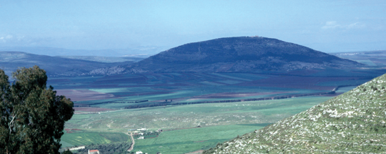
他泊山 Mount Tabor

Slide 29
Judges 4:14
¹⁴ 底波拉對巴拉說：「你起來，今日就是耶和華將西西拉交在你手的日子。耶和華豈不在你前頭行嗎？」於是巴拉下了他泊山，跟隨他有一萬人。
¹⁴ Then Deborah said to Barak, “Go! This is the day the Lord has given Sisera into your hands. Has not the Lord gone ahead of you?” So Barak went down Mount Tabor, with ten thousand men following him.

Slide 30
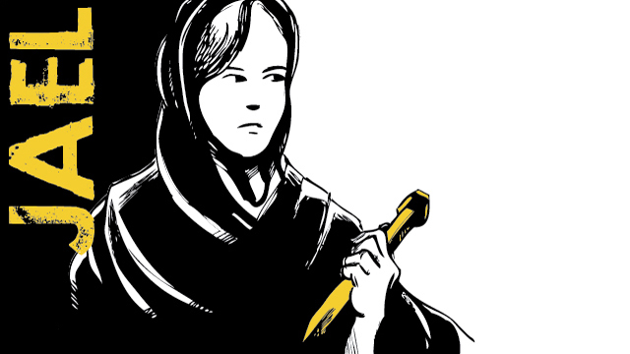
雅億

Slide 31
Judges 4:15 耶和華使西西拉和他一切車輛全軍潰亂，在巴拉面前被刀殺敗；西西拉下車步行逃跑。
¹⁵ At Barak’s advance, the Lord routed Sisera and all his chariots and army by the sword, and Sisera got down from his chariot and fled on foot.
Mt. Tabor

Slide 32
Judges 5:4–5
⁴ 耶和華啊，你從西珥出來， 由以東地行走。 那時地震天漏， 雲也落雨。 ⁵ 山見耶和華的面就震動， 西奈山見耶和華－以色列上帝的面也是如此。
⁴ “When you, Lord, went out from Seir, when you marched from the land of Edom, the earth shook, the heavens poured, the clouds poured down water. ⁵ The mountains quaked before the Lord, the One of Sinai, before the Lord, the God of Israel.

Slide 33
Judges 5:21–22
²¹ 基順古河把敵人沖沒； … ²² 那時壯馬馳驅， 踢跳，奔騰。
²¹ The river Kishon swept them away, the age-old river, the river Kishon. …²² Then thundered the horses’ hooves— galloping, galloping go his mighty steeds.
Zaanannm

Slide 34
Judges 5:2
² 因為以色列中有軍長率領， 百姓也甘心犧牲自己， 你們應當頌讚耶和華！
² “When the princes in Israel take the lead, when the people willingly offer themselves— praise the Lord!

Slide 35
Judges 5:14
¹⁴ 有根本在亞瑪力人的地， 從以法蓮下來的； 便雅憫在民中跟隨你。 有掌權的從瑪吉下來； 有持杖檢點民數的從西布倫下來；
¹⁴ Some came from Ephraim, whose roots were in Amalek; Benjamin was with the people who followed you. From Makir captains came down, from Zebulun those who bear a commander’s staff.

Slide 36
Judges 5:15, 18
¹⁵ 以薩迦的首領與底波拉同來； 以薩迦怎樣，巴拉也怎樣。… ¹⁸ 西布倫人是拚命敢死的； 拿弗他利人在田野的高處也是如此。
¹⁵ The princes of Issachar were with Deborah; yes, Issachar was with Barak, sent under his command into the valley…¹⁸ The people of Zebulun risked their very lives; so did Naphtali on the terraced fields.

Slide 37
Judges 5:16
¹⁶ 你為何坐在羊圈內 聽群中吹笛的聲音呢？ 在呂便的溪水旁有心中設大謀的。
¹⁶ Why did you stay among the sheep pens to hear the whistling for the flocks? In the districts of Reuben there was much searching of heart.

Slide 38
Judges 5:17
¹⁷ 基列人安居在約旦河外。 但人為何等在船上？ 亞設人在海口靜坐， 在港口安居。
¹⁷ Gilead stayed beyond the Jordan. And Dan, why did he linger by the ships? Asher remained on the coast and stayed in his coves.

Slide 39
Judges 5:23
²³ 耶和華的使者說： 應當咒詛米羅斯， 大大咒詛其中的居民； 因為他們不來幫助耶和華， 不來幫助耶和華攻擊勇士。
²³ ‘Curse Meroz,’ said the angel of the Lord. ‘Curse its people bitterly, because they did not come to help the Lord, to help the Lord against the mighty.’

