Slide 1
馬太福音 Matthew 16:21-28
²¹ From that time on Jesus began to explain to his disciples that he must go to Jerusalem and suffer many things at the hands of the elders, the chief priests and the teachers of the law, and that he must be killed and on the third day be raised to life. ²² Peter took him aside and began to rebuke him. “Never, Lord!” he said. “This shall never happen to you!”
²¹ 從此，耶穌才指示門徒，他必須上耶路撒冷去，受長老、祭司長、文士許多的苦，並且被殺，第三日復活。²² 彼得就拉著他，勸他說：「主啊，萬不可如此！這事必不臨到你身上。」

Slide 2
²³ 耶穌轉過來，對彼得說：「撒但，退我後邊去吧！你是絆我腳的；因為你不體貼上帝的意思，只體貼人的意思。」²⁴ 於是耶穌對門徒說：「若有人要跟從我，就當捨己，背起他的十字架來跟從我。²⁵ 因為，凡要救自己生命的，必喪掉生命；
²³ Jesus turned and said to Peter, “Get behind me, Satan! You are a stumbling block to me; you do not have in mind the concerns of God, but merely human concerns.” ²⁴ Then Jesus said to his disciples, “Whoever wants to be my disciple must deny themselves and take up their cross and follow me. ²⁵ For whoever wants to save their life will lose it,

Slide 3
凡為我喪掉生命的，必得著生命。²⁶ 人若賺得全世界，賠上自己的生命，有甚麼益處呢？人還能拿甚麼換生命呢？²⁷ 人子要在他父的榮耀裏，同著眾使者降臨；那時候，他要照各人的行為報應各人。²⁸ 我實在告訴你們，站在這裏的，有人在沒嘗死味以
but whoever loses their life for me will find it. ²⁶ What good will it be for someone to gain the whole world, yet forfeit their soul? Or what can anyone give in exchange for their soul? ²⁷ For the Son of Man is going to come in his Father’s glory with his angels, and then he will reward each person according to what they have done. ²⁸ “Truly I tell you, some who are standing here will not taste death

Slide 4
前必看見人子降臨在他的國裏。」
before they see the Son of Man coming in his kingdom.”

Slide 5
股票人生 Life as a Stock Market
馬太福音 Matthew 16:21-28
Notes:
https://en.wikipedia.org/wiki/Fall_of_Mosul

Slide 6
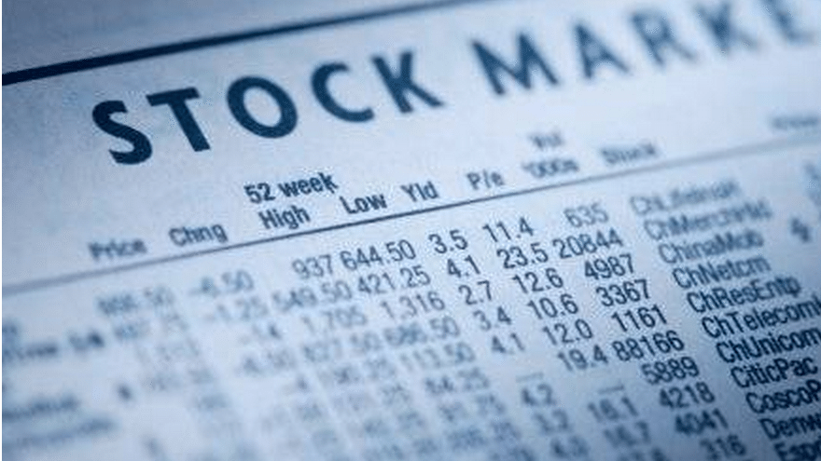

Slide 7
捨己 Deny Yourself
捨己的必要 The necessity of denying yourself
捨己的困難 The difficulty of denying yourself
捨己的智慧 The wisdom of denying yourself

Slide 8
1. 捨己的必要 The necessity of denying yourself
Matthew 16:21 ²¹ 從此，耶穌才指示門徒，他必須上耶路撒冷去，受長老、祭司長、文士許多的苦，並且被殺，第三日復活。
²¹ From that time on Jesus began to explain to his disciples that he must go to Jerusalem and suffer many things at the hands of the elders, the chief priests and the teachers of the law, and that he must be killed and on the third day be raised to life.

Slide 9
John 16:1
¹ 「我已將這些事告訴你們，使你們不至於跌倒。
¹ “All this I have told you so that you will not fall away.

Slide 10
Matthew 16:24
²⁴ 於是耶穌對門徒說：「若有人要跟從我，就當捨己，背起他的十字架來跟從我。
²⁴ Then Jesus said to his disciples, “Whoever wants to be my disciple must deny themselves and take up their cross and follow me.

Slide 11
Galatians 6:14
¹⁴ 但我斷不以別的誇口，只誇我們主耶穌基督的十字架；因這十字架，就我而論，世界已經釘在十字架上；就世界而論，我已經釘在十字架上。
¹⁴ May I never boast except in the cross of our Lord Jesus Christ, through which the world has been crucified to me, and I to the world.

Slide 12
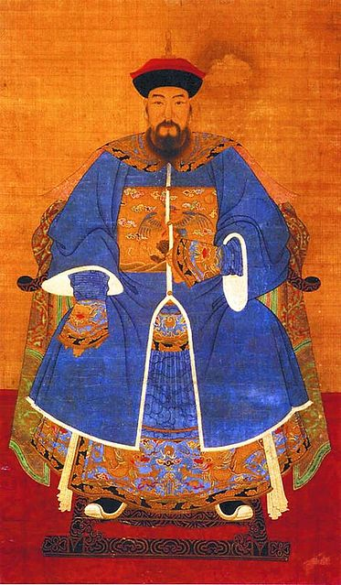
出賣明朝， 投降滿清的 洪承疇 Hong Chengchou, who betrayed Ming Dynasty and defected to Qing Dynasty

Slide 13
2. 捨己的困難 The difficulty of denying yourself
Matthew 16:22–23 ²² 彼得就拉著他，勸他說：「主啊，萬不可如此！這事必不臨到你身上。」²³ 耶穌轉過來，對彼得說：「撒但，退我後邊去吧！你是絆我腳的；因為你不體貼上帝的意思，只體貼人的意思。」
²² Peter took him aside and began to rebuke him. “Never, Lord!” he said. “This shall never happen to you!” ²³ Jesus turned and said to Peter, “Get behind me, Satan! You are a stumbling block to me; you do not have in mind the concerns of God, but merely human concerns.”

Slide 14
當愛開始成為神的那一刻，愛開始成為一個惡魔
“Love begins to be a demon the moment when he begins to be a god.”
(The Four Loves, C. S.Lewis)

Slide 15
3. 捨己的智慧 The wisdom of denying yourself
Matthew 16:25
²⁵ 因為，凡要救自己生命的，必喪掉生命；凡為我喪掉生命的，必得著生命。
²⁵ For whoever wants to save their life will lose it, but whoever loses their life for me will find it.

Slide 16
生命是弔詭 Life is a paradox
Matthew 16:25
²⁵ 因為，凡要救自己生命的，必喪掉生命；凡為我喪掉生命的，必得著生命。
²⁵ For whoever wants to save their life will lose it, but whoever loses their life for me will find it.

Slide 17
Matthew 16:26
²⁶ 人若賺得全世界，賠上自己的生命，有甚麼益處呢？人還能拿甚麼換生命呢？
²⁶ What good will it be for someone to gain the whole world, yet forfeit their soul? Or what can anyone give in exchange for their soul?

Slide 18
Matthew 16:27
²⁷ 人子要在他父的榮耀裏，同著眾使者降臨；那時候，他要照各人的行為報應各人。
²⁷ For the Son of Man is going to come in his Father’s glory with his angels, and then he will reward each person according to what they have done.

Slide 19
Matthew 16:28
²⁸ 我實在告訴你們，站在這裏的，有人在沒嘗死味以前必看見人子降臨在他的國裏。」
²⁸ “Truly I tell you, some who are standing here will not taste death before they see the Son of Man coming in his kingdom.”

Slide 20
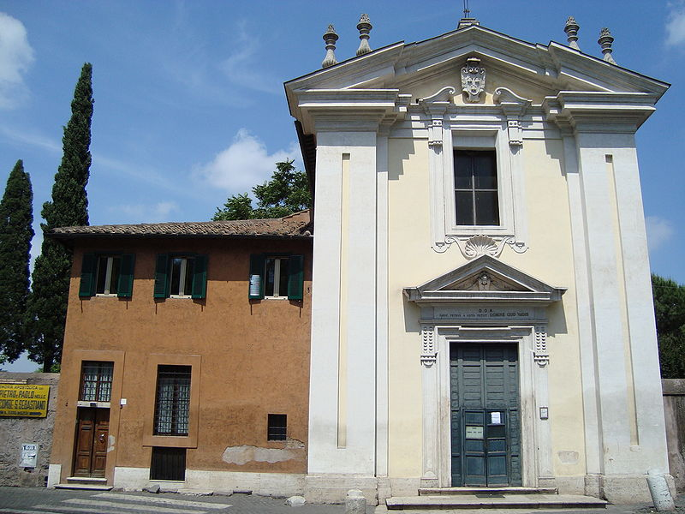
Church of Domine Quo Vadis
Notes:
https://en.wikipedia.org/wiki/Church_of_Domine_Quo_Vadis

