Slide 1
馬太福音 Matthew 15:29-31,16:1-12
²⁹ Jesus left there and went along the Sea of Galilee. Then he went up on a mountainside and sat down. ³⁰ Great crowds came to him, bringing the lame, the blind, the crippled, the mute and many others, and laid them at his feet; and he healed them. ³¹ The people were amazed when they saw the mute speaking,
²⁹ 耶穌離開那地方，來到靠近加利利的海邊，就上山坐下。³⁰ 有許多人到他那裏，帶著瘸子、瞎子、啞巴、有殘疾的，和好些別的病人，都放在他腳前；他就治好了他們。³¹ 甚至眾人都希奇；因為看見啞巴說話，

Slide 2
殘疾的痊癒，瘸子行走，瞎子看見，他們就歸榮耀給以色列的上帝。... ¹ 法利賽人和撒都該人來試探耶穌，請他從天上顯個神蹟給他們看。² 耶穌回答說：「晚上天發紅，你們就說：『天必要晴。』³ 早晨天發紅，又發黑，你們就說：『今日必有風
the crippled made well, the lame walking and the blind seeing. And they praised the God of Israel…
¹ The Pharisees and Sadducees came to Jesus and tested him by asking him to show them a sign from heaven. ² He replied, “When evening comes, you say, ‘It will be fair weather, for the sky is red,’ ³ and in the morning, ‘Today it will be stormy,

Slide 3
for the sky is red and overcast.’ You know how to interpret the appearance of the sky, but you cannot interpret the signs of the times. ⁴ A wicked and adulterous generation looks for a sign, but none will be given it except the sign of Jonah.” Jesus then left them and went away. ⁵ When they went across the lake, the disciples forgot to take bread. ⁶ “Be careful,”
雨。』你們知道分辨天上的氣色，倒不能分辨這時候的神蹟。⁴ 一個邪惡淫亂的世代求神蹟，除了約拿的神蹟以外，再沒有神蹟給他看。」耶穌就離開他們去了。 ⁵ 門徒渡到那邊去，忘了帶餅。⁶ 耶穌對他們說：「你們要謹慎，

Slide 4
Jesus said to them. “Be on your guard against the yeast of the Pharisees and Sadducees.” ⁷ They discussed this among themselves and said, “It is because we didn’t bring any bread.” ⁸ Aware of their discussion, Jesus asked, “You of little faith, why are you talking among yourselves about having no bread? ⁹ Do you still not
防備法利賽人和撒都該人的酵。」 ⁷ 門徒彼此議論說：「這是因為我們沒有帶餅吧。」⁸ 耶穌看出來，就說：「你們這小信的人，為甚麼因為沒有餅彼此議論呢？⁹ 你們還不明白嗎？

Slide 5
understand? Don’t you remember the five loaves for the five thousand, and how many basketfuls you gathered? ¹⁰ Or the seven loaves for the four thousand, and how many basketfuls you gathered? ¹¹ How is it you don’t understand that I was not talking to you about bread? But be on your guard against the yeast of the Pharisees
不記得那五個餅分給五千人、又收拾了多少籃子的零碎嗎？¹⁰ 也不記得那七個餅分給四千人、又收拾了多少筐子的零碎嗎？¹¹ 我對你們說：『要防備法利賽人和撒都該人的酵』，這話不是指著餅說的，你們怎

Slide 6
and Sadducees.” ¹² Then they understood that he was not telling them to guard against the yeast
used in bread, but against the teaching of the Pharisees and Sadducees.
麼不明白呢？」¹² 門徒這才曉得他說的不是叫他們防備餅的酵，
乃是防備法利賽人和撒都該人的教訓。

Slide 7
不信、小信，還是滿有信心？ No Faith, Little Faith or Full of Faith?
馬太福音 Matthew 15:29-16:12
Notes:
https://en.wikipedia.org/wiki/Fall_of_Mosul

Slide 8
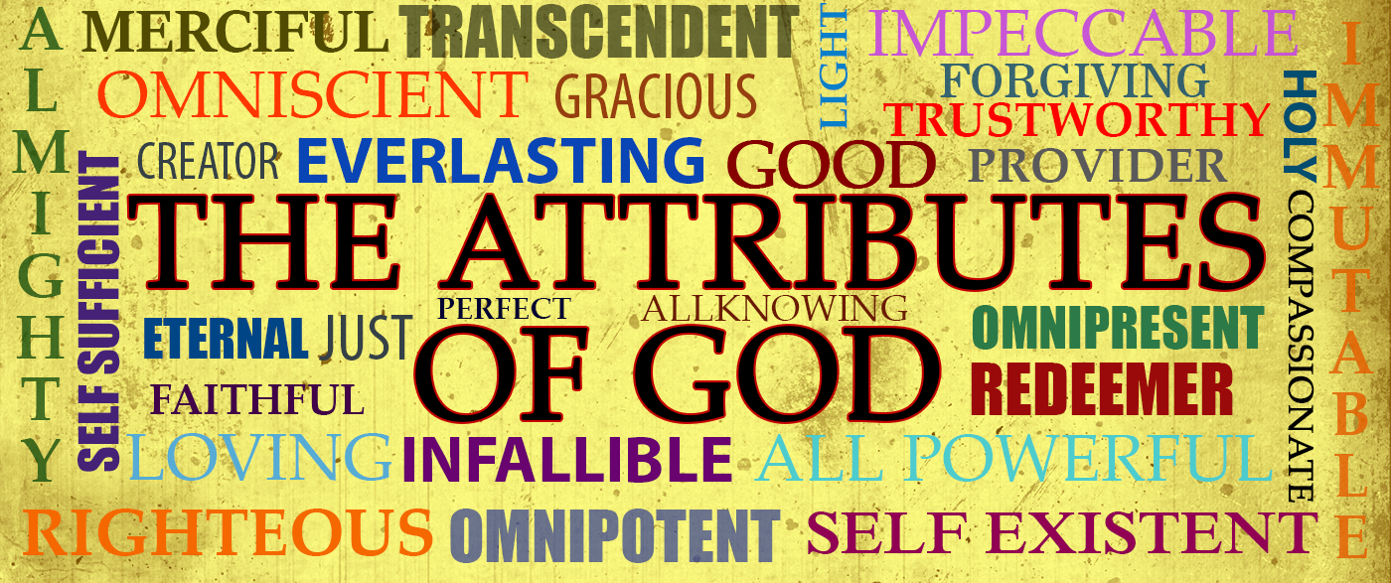

Slide 9
永不改變
Hebrews 13:8
⁸ 耶穌基督昨日、今日、一直到永遠，是一樣的。
⁸ Jesus Christ is the same yesterday and today and forever.

Slide 10
 | 馬太福音 Matthew
治好許多人 Healing many | 15:29-31
餵飽四千人 Feeding 4000 | 15:32-39
求耶穌顯神蹟 Ask Jesus for a sign | 16:1-4
防備法利賽人的酵 Beware of the leaven of Pharisees | 16:5-12

Slide 11
Matthew 15:30 ³⁰ 有許多人到他那裏，帶著瘸子、瞎子、啞巴、有殘疾的，和好些別的病人，都放在他腳前；他就治好了他們。
³⁰ Great crowds came to him, bringing the lame, the blind, the crippled, the mute and many others, and laid them at his feet; and he healed them.
Matthew 16:4
⁴ 一個邪惡淫亂的世代求神蹟，除了約拿的神蹟以外，再沒有神蹟給他看。」耶穌就離開他們去了。
⁴ A wicked and adulterous generation looks for a sign, but none will be given it except the sign of Jonah.” Jesus then left them and went away.

Slide 12
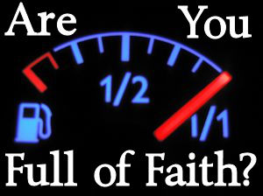
你是不信、小信，還是滿有信心？

Slide 13
1. 對耶穌不信的人 Have no faith in Jesus (16:1-4)
Matthew 16:1
¹ 法利賽人和撒都該人來試探耶穌，請他從天上顯個神蹟給他們看。
¹ The Pharisees and Sadducees came to Jesus and tested him by asking him to show them a sign from heaven.

Slide 14
馬太福音 Matthew 15:30
³⁰ 有許多人到他那裏，帶著瘸子、瞎子、啞巴、有殘疾的，和好些別的病人，都放在他腳前；他就治好了他們。³¹ 甚至眾人都希奇；因為看見啞巴說話，
³⁰ Great crowds came to him, bringing the lame, the blind, the crippled, the mute and many others, and laid them at his feet; and he healed them.

Slide 15
Matthew 16:2–3 ² 耶穌回答說：「晚上天發紅，你們就說：『天必要晴。』³ 早晨天發紅，又發黑，你們就說：『今日必有風雨。』你們知道分辨天上的氣色，倒不能分辨這時候的神蹟。
² He replied, “When evening comes, you say, ‘It will be fair weather, for the sky is red,’ ³ and in the morning, ‘Today it will be stormy, for the sky is red and overcast.’ You know how to interpret the appearance of the sky, but you cannot interpret the signs of the times.

Slide 16
Matthew 16:4
⁴ 一個邪惡淫亂的世代求神蹟，除了約拿的神蹟以外，再沒有神蹟給他看。」耶穌就離開他們去了。
⁴ A wicked and adulterous generation looks for a sign, but none will be given it except the sign of Jonah.” Jesus then left them and went away.

Slide 17
海鬣蜥 Marine iguana

Slide 18
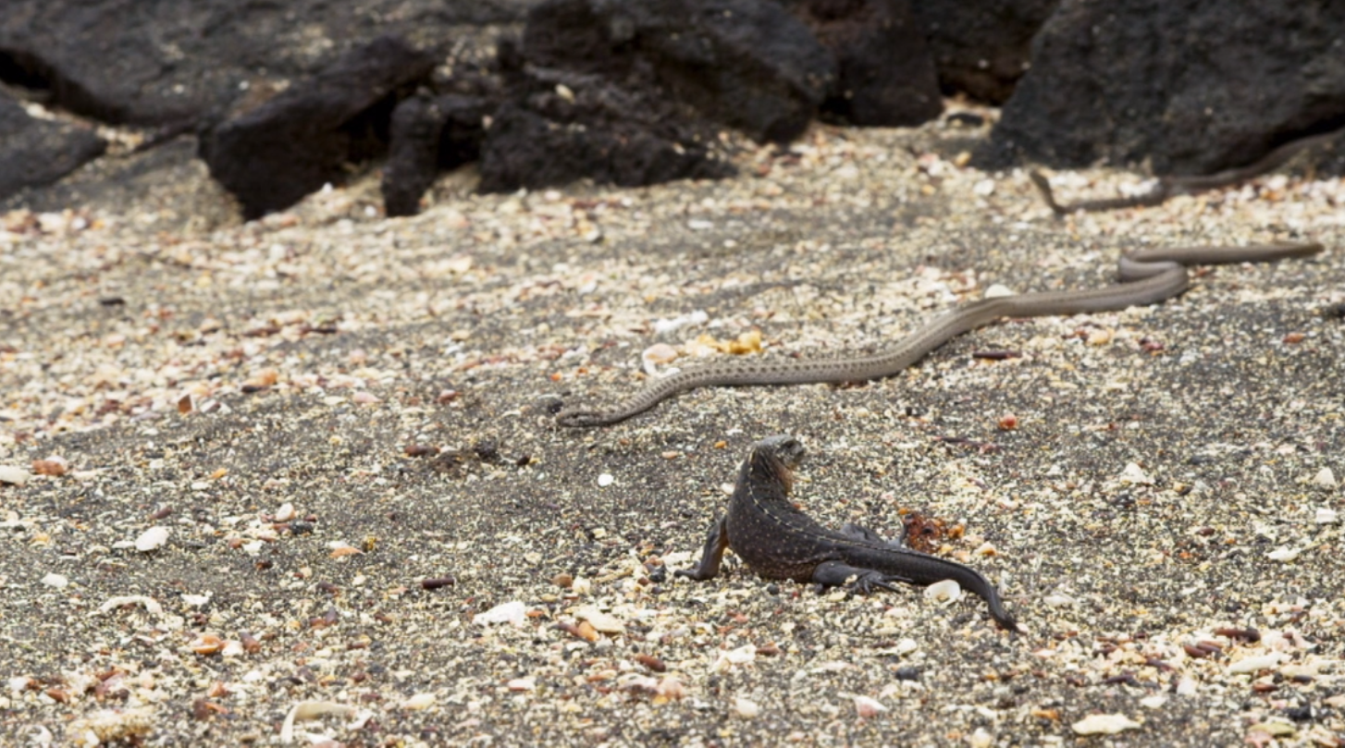

Slide 19
Romans 1:20
²⁰ 自從造天地以來，上帝的永能和神性是明明可知的，雖是眼不能見，但藉著所造之物就可以曉得，叫人無可推諉。
²⁰ For since the creation of the world God’s invisible qualities—his eternal power and divine nature—have been clearly seen, being understood from what has been made, so that people are without excuse.

Slide 20
Romans 1:28
²⁸ 他們既然故意不認識上帝，上帝就任憑他們存邪僻的心，行那些不合理的事；
²⁸ Furthermore, just as they did not think it worthwhile to retain the knowledge of God, so God gave them over to a depraved mind, so that they do what ought not to be done.

Slide 21
Matthew 16:4
⁴ 一個邪惡淫亂的世代求神蹟，除了約拿的神蹟以外，再沒有神蹟給他看。」耶穌就離開他們去了。
⁴ A wicked and adulterous generation looks for a sign, but none will be given it except the sign of Jonah.” Jesus then left them and went away.

Slide 22
2. 對耶穌小信的人 Have Little faith in Jesus (16:5-12)
Matthew 16:5–6
⁵ 門徒渡到那邊去，忘了帶餅。⁶ 耶穌對他們說：「你們要謹慎，防備法利賽人和撒都該人的酵。」
⁵ When they went across the lake, the disciples forgot to take bread. ⁶ “Be careful,” Jesus said to them. “Be on your guard against the yeast of the Pharisees and Sadducees.”

Slide 23
Matthew 16:7–8
⁷ 門徒彼此議論說：「這是因為我們沒有帶餅吧。」⁸ 耶穌看出來，就說：「你們這小信的人，為甚麼因為沒有餅彼此議論呢？
⁷ They discussed this among themselves and said, “It is because we didn’t bring any bread.” ⁸ Aware of their discussion, Jesus asked, “You of little faith, why are you talking among yourselves about having no bread?

Slide 24
Matthew 16:12
¹² 門徒這才曉得他說的不是叫他們防備餅的酵，乃是防備法利賽人和撒都該人的教訓。
¹² Then they understood that he was not telling them to guard against the yeast used in bread, but against the teaching of the Pharisees and Sadducees.

Slide 25
Matthew 16:9–10
⁹ 你們還不明白嗎？不記得那五個餅分給五千人、又收拾了多少籃子的零碎嗎？¹⁰ 也不記得那七個餅分給四千人、又收拾了多少筐子的零碎嗎？
⁹ Do you still not understand? Don’t you remember the five loaves for the five thousand, and how many basketfuls you gathered? ¹⁰ Or the seven loaves for the four thousand, and how many basketfuls you gathered?

Slide 26
Matthew 15:32–33 ³² 耶穌叫門徒來，說：「我憐憫這眾人；因為他們同我在這裏已經三天，也沒有吃的了。我不願意叫他們餓著回去，恐怕在路上困乏。」³³ 門徒說：「我們在這野地，哪裏有這麼多的餅叫這許多人吃飽呢？」
³² Jesus called his disciples to him and said, “I have compassion for these people; they have already been with me three days and have nothing to eat. I do not want to send them away hungry, or they may collapse on the way.” ³³ His disciples answered, “Where could we get enough bread in this remote place to feed such a crowd?”

Slide 28
Galatians 5:22
²² 聖靈所結的果子，就是仁愛、喜樂、和平、忍耐、恩慈、良善、信實、
²² But the fruit of the Spirit is love, joy, peace, forbearance, kindness, goodness, faithfulness,

Slide 29
Galatians 5:6
⁶ … 惟獨使人生發仁愛的信心才有功效。
⁶ … The only thing that counts is faith expressing itself through love.

Slide 30
Galatians 3:5
⁵ 那賜給你們聖靈，又在你們中間行異能的，是因你們行律法呢？是因你們聽信福音呢？
⁵ So again I ask, does God give you his Spirit and work miracles among you by the works of the law, or by your believing what you heard?

Slide 31
Romans 10:17
¹⁷ 可見，信道是從聽道來的，聽道是從基督的話來的。
¹⁷ Consequently, faith comes from hearing the message, and the message is heard through the word about Christ.

Slide 32
3. 對神滿有信心的人 Full of Faith in God
Matthew 8:20
²⁰ 耶穌說：「狐狸有洞，天空的飛鳥有窩，人子卻沒有枕頭的地方。」
²⁰ Jesus replied, “Foxes have dens and birds have nests, but the Son of Man has no place to lay his head.”

Slide 33
Matthew 6:34
³⁴ 所以，不要為明天憂慮，因為明天自有明天的憂慮；一天的難處一天當就夠了。」
³⁴ Therefore do not worry about tomorrow, for tomorrow will worry about itself. Each day has enough trouble of its own.

Slide 34
Matthew 6:31–33 ³¹ 所以，不要憂慮說，吃甚麼？喝甚麼？穿甚麼？³² 這都是外邦人所求的。你們需用的這一切東西，你們的天父是知道的。³³ 你們要先求他的國和他的義，這些東西都要加給你們了。
³¹ So do not worry, saying, ‘What shall we eat?’ or ‘What shall we drink?’ or ‘What shall we wear?’ ³² For the pagans run after all these things, and your heavenly Father knows that you need them. ³³ But seek first his kingdom and his righteousness, and all these things will be given to you as well.

Slide 35
John 17:20–21 (CUV)
²⁰ 「我不但為這些人祈求，也為那些因他們的話信我的人祈求，²¹ 使他們都合而為一。正如你父在我裏面，我在你裏面，使他們也在我們裏面，叫世人可以信你差了我來。
²⁰ “My prayer is not for them alone. I pray also for those who will believe in me through their message, ²¹ that all of them may be one, Father, just as you are in me and I am in you. May they also be in us so that the world may believe that you have sent me.

