Slide 1
馬太福音 Matthew 16:13-20
¹³ When Jesus came to the region of Caesarea Philippi, he asked his disciples, “Who do people say the Son of Man is?” ¹⁴ They replied, “Some say John the Baptist; others say Elijah; and still others, Jeremiah or one of the prophets.” ¹⁵ “But what about you?” he asked. “Who do you say I am?”
¹³ 耶穌到了凱撒利亞•腓立比的境內，就問門徒說：「人說我－－人子是誰？」¹⁴ 他們說：「有人說是施洗的約翰；有人說是以利亞；又有人說是耶利米或是先知裏的一位。」¹⁵ 耶穌說：「你們說我是誰？」

Slide 2
¹⁶ 西門•彼得回答說：「你是基督，是永生上帝的兒子。」¹⁷ 耶穌對他說：「西門•巴•約拿，你是有福的！因為這不是屬血肉的指示你的，乃是我在天上的父指示的。¹⁸ 我還告訴你，你是彼得，我要把我的教會建造在這磐石上；陰間的權柄不能勝過他。
¹⁶ Simon Peter answered, “You are the Messiah, the Son of the living God.” ¹⁷ Jesus replied, “Blessed are you, Simon son of Jonah, for this was not revealed to you by flesh and blood, but by my Father in heaven. ¹⁸ And I tell you that you are Peter, and on this rock I will build my church, and the gates of Hades will not overcome it.

Slide 3
¹⁹ 我要把天國的鑰匙給你，凡你在地上所捆綁的，在天上也要捆綁；凡你在地上所釋放的，在天上也要釋放。」²⁰ 當下，耶穌囑咐門徒，不可對人說他是基督。
¹⁹ I will give you the keys of the kingdom of heaven; whatever you bind on earth will be bound in heaven, and whatever you loose on earth will be loosed in heaven.” ²⁰ Then he ordered his disciples not to tell anyone that he was the Messiah.

Slide 4
帝國反擊戰
馬太福音 Matthew 16:13-20
Notes:
https://en.wikipedia.org/wiki/Fall_of_Mosul

Slide 5
1. 超乎萬有的耶穌 Jesus is above all 13-16
Matthew 16:13
¹³ 耶穌到了凱撒利亞•腓立比的境內，就問門徒說：「人說我－－人子是誰？」
¹³ When Jesus came to the region of Caesarea Philippi, he asked his disciples, “Who do people say the Son of Man is?”

Slide 6
Matthew 16:14
¹⁴ 他們說：「有人說是施洗的約翰；有人說是以利亞；又有人說是耶利米或是先知裏的一位。」
¹⁴ They replied, “Some say John the Baptist; others say Elijah; and still others, Jeremiah or one of the prophets.”

Slide 7
施洗的約翰 John the Baptist
Matthew 11:11
¹¹ 我實在告訴你們，凡婦人所生的，沒有一個興起來大過施洗約翰的；
¹¹ Truly I tell you, among those born of women there has not risen anyone greater than John the Baptist;

Slide 8
Matthew 16:15–16
¹⁵ 耶穌說：「你們說我是誰？」¹⁶ 西門•彼得回答說：「你是基督，是永生上帝的兒子。」
¹⁵ “But what about you?” he asked. “Who do you say I am?” ¹⁶ Simon Peter answered, “You are the Messiah, the Son of the living God.”

Slide 9
Matthew 16:17
¹⁷ 耶穌對他說：「西門•巴•約拿，你是有福的！因為這不是屬血肉的指示你的，乃是我在天上的父指示的。
¹⁷ Jesus replied, “Blessed are you, Simon son of Jonah, for this was not revealed to you by flesh and blood, but by my Father in heaven.

Slide 10
John 4:29
²⁹ 「你們來看！有一個人將我素來所行的一切事都給我說出來了，莫非這就是基督嗎？」…⁴² 便對婦人說：「現在我們信，不是因為你的話，是我們親自聽見了，知道這真是救世主。」
²⁹ “Come, see a man who told me everything I ever did. Could this be the Messiah?” …⁴² They said to the woman, “We no longer believe just because of what you said; now we have heard for ourselves, and we know that this man really is the Savior of the world.”

Slide 11
John 5:18
¹⁸ 所以猶太人越發想要殺他；因他不但犯了安息日，並且稱上帝為他的父，將自己和上帝當作平等。
¹⁸ For this reason they tried all the more to kill him; not only was he breaking the Sabbath, but he was even calling God his own Father, making himself equal with God.

Slide 12
John 10:30, 33
³⁰ 我與父原為一。」 … ³³ 猶太人回答說：「我們不是為善事拿石頭打你，是為你說僭妄的話；又為你是個人，反將自己當作上帝。」
³⁰ I and the Father are one.” …³³ “We are not stoning you for any good work,” they replied, “but for blasphemy, because you, a mere man, claim to be God.”

Slide 13
2. 勝過死亡的教會 Church has power over death 17-18
Matthew 16:18
¹⁸ 我還告訴你，你是彼得，我要把我的教會建造在這磐石上；陰間的權柄不能勝過他。
¹⁸ And I tell you that you are Peter, and on this rock I will build my church, and the gates of Hades will not overcome it.

Slide 14
Hebrews 2:14–15
¹⁴ 兒女既同有血肉之體，他也照樣親自成了血肉之體，特要藉著死敗壞那掌死權的，就是魔鬼，¹⁵ 並要釋放那些一生因怕死而為奴僕的人。
¹⁴ Since the children have flesh and blood, he too shared in their humanity so that by his death he might break the power of him who holds the power of death—that is, the devil—¹⁵ and free those who all their lives were held in slavery by their fear of death.

Slide 15
Hebrews 2:14–15
¹⁴ 兒女既同有血肉之體，他也照樣親自成了血肉之體，特要藉著死敗壞那掌死權的，就是魔鬼，¹⁵ 並要釋放那些一生因怕死而為奴僕的人。
¹⁴ Since the children have flesh and blood, he too shared in their humanity so that by his death he might break the power of him who holds the power of death—that is, the devil—¹⁵ and free those who all their lives were held in slavery by their fear of death.

Slide 16
1 Corinthians 12:13, 27
¹³ 我們不拘是猶太人，是希臘人，是為奴的，是自主的，都從一位聖靈受洗，成了一個身體，飲於一位聖靈。 … ²⁷ 你們就是基督的身子，並且各自作肢體。
¹³ For we were all baptized by one Spirit so as to form one body—whether Jews or Gentiles, slave or free—and we were all given the one Spirit to drink…²⁷ Now you are the body of Christ, and each one of you is a part of it.

Slide 17
2. 勝過死亡的教會 Church has power over death 17-18
Matthew 16:18
¹⁸ 我還告訴你，你是彼得，我要把我的教會建造在這磐石上；陰間的權柄不能勝過他。
¹⁸ And I tell you that you are Peter, and on this rock I will build my church, and the gates of Hades will not overcome it.

Slide 18
3. 身負重任的彼得 Peter has a key role 19-20

Slide 19
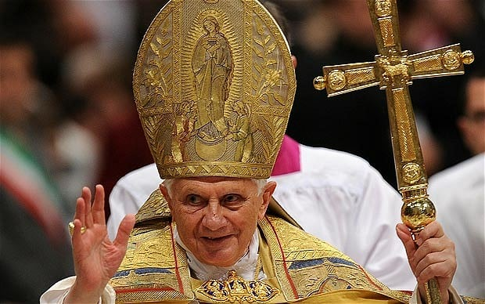
天主教 Catholic
基督教 Protestant

Slide 20
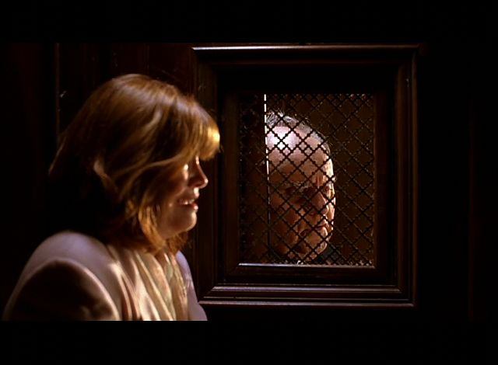
天主教 Catholic
基督教 Protestant

Slide 21
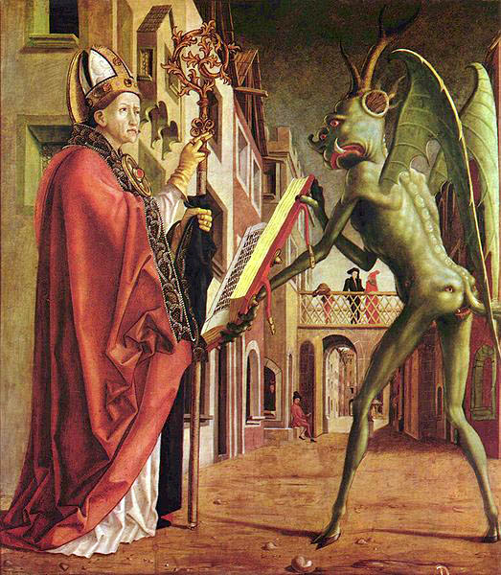
天主教 Catholic
基督教 Protestant

Slide 22
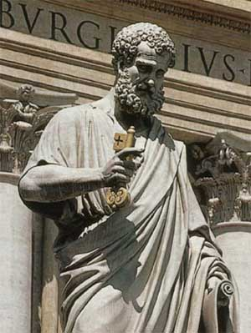
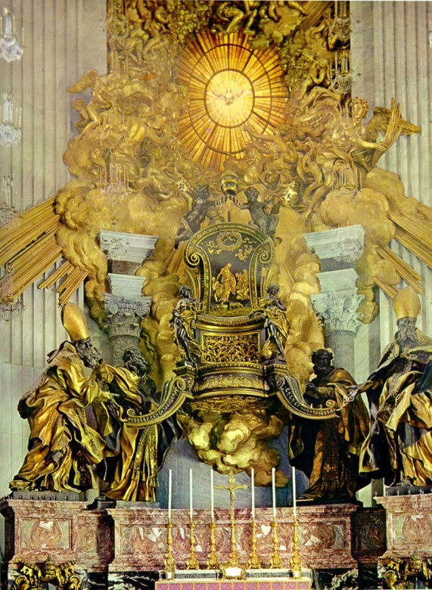
Notes:
http://stpetersbasilica.info/Altars/Cathedra/Cathedra.htm

Slide 23
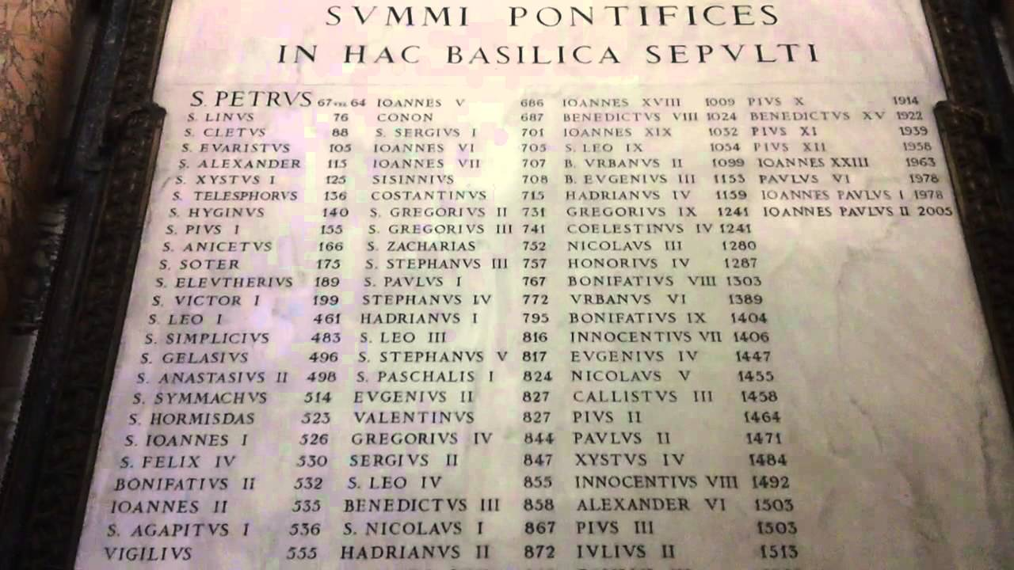

Slide 24
Matthew 16:18
¹⁸ 我還告訴你，你是彼得 πέτρος ，我要把我的教會建造在這磐石πέτρᾳ上；陰間的權柄不能勝過他。
¹⁸ And I tell you that you are Peter πέτρος, and on this rock πέτρᾳ I will build my church, and the gates of Hades will not overcome it.

Slide 25
Matthew 18:1
¹ 當時，門徒進前來，問耶穌說：「天國裏誰是最大的？」
¹ At that time the disciples came to Jesus and asked, “Who, then, is the greatest in the kingdom of heaven?”

Slide 26
1 Peter 5:1
¹ 我這作長老…勸你們中間與我同作長老的人：
¹ To the elders among you, I appeal as a fellow elder

Slide 27
3. 身負重任的彼得 Peter has a key role 19-20
Matthew 16:19
¹⁹ 我要把天國的鑰匙給你，凡你在地上所捆綁的，在天上也要捆綁；凡你在地上所釋放的，在天上也要釋放。」
¹⁹ I will give you the keys of the kingdom of heaven; whatever you bind on earth will be bound in heaven, and whatever you loose on earth will be loosed in heaven.”

