Slide 1
士師記 Judges 10:6–11:40
⁶ Again the Israelites did evil in the eyes of the Lord. They served the Baals and the Ashtoreths, and the gods of Aram, the gods of Sidon, the gods of Moab, the gods of the Ammonites and the gods of the Philistines. And because the Israelites forsook the Lord and no longer served him, ⁷ he became angry with them. He sold them into
⁶ 以色列人又行耶和華眼中看為惡的事，去事奉諸巴力和亞斯她錄，並亞蘭的神、西頓的神、摩押的神、亞捫人的神、非利士人的神，離棄耶和華，不事奉他。⁷ 耶和華的怒氣向以色列人發作，就把他們交在非

Slide 2
the hands of the Philistines and the Ammonites, … For eighteen years … ¹⁰ Then the Israelites cried out to the Lord, “We have sinned against you, forsaking our God and serving the Baals.” ¹¹ The Lord replied, “When the Egyptians, the Amorites, the Ammonites, the Philistines, ¹² the Sidonians, the Amalekites and the Maonites
利士人和亞捫人的手中。… 共有十八年。… ¹⁰ 以色列人哀求耶和華說：「我們得罪了你；因為離棄了我們上帝，去事奉諸巴力。」¹¹ 耶和華對以色列人說：「我豈沒有救過你們脫離埃及人、亞摩利人、亞捫人，和非利士人嗎？ ¹² 西頓人、亞瑪力人、馬雲人

Slide 3
oppressed you and you cried to me for help, did I not save you from their hands? ¹³ But you have forsaken me and served other gods, so I will no longer save you. ¹⁴ Go and cry out to the gods you have chosen. Let them save you when you are in trouble!” ¹⁵ But the Israelites said to the Lord, “We have sinned. Do with us whatever you think best,
也都欺壓你們；你們哀求我，我也拯救你們脫離他們的手。¹³ 你們竟離棄我，事奉別神！所以我不再救你們了。¹⁴ 你們去哀求所選擇的神；你們遭遇急難的時候，讓他救你們吧！」¹⁵ 以色列人對耶和華說：「我們犯罪了，任憑你隨意待我們吧！

Slide 4
只求你今日拯救我們。」 ¹⁶ 以色列人就除掉他們中間的外邦神，事奉耶和華。耶和華因以色列人受的苦難，就心中擔憂。 ^{… 1} 基列人耶弗他是個大能的勇士，是妓女的兒子。耶弗他是基列所生的。² 基列的妻也生了幾個兒子，他妻所生的兒子長大了，就趕逐耶弗他，說：
but please rescue us now.” ¹⁶ Then they got rid of the foreign gods among them and served the Lord. And he could bear Israel’s misery no longer… ¹ Jephthah the Gileadite was a mighty warrior. His father was Gilead; his mother was a prostitute. ² Gilead’s wife also bore him sons, and when they were grown up, they drove Jephthah away.

Slide 5
“You are not going to get any inheritance in our family,” they said, “because you are the son of another woman.” ³ So Jephthah fled from his brothers … when the Ammonites were fighting against Israel, ⁵ the elders of Gilead went to get Jephthah from the land of Tob. ⁶ “Come,” they said, “be our commander, so we can fight the Ammonites.” ^{… 11} So Jephthah went
「你不可在我們父家承受產業，因為你是妓女的兒子。」³ 耶弗他就逃避他的弟兄… ⁵ 亞捫人攻打以色列的時候，基列的長老到陀伯地去，要叫耶弗他回來；⁶ 對耶弗他說：「請你來作我們的元帥，我們好與亞捫人爭戰。」… ¹¹ 於是

Slide 6
with the elders of Gilead, and the people made him head and commander over them. And he repeated all his words before the Lord in Mizpah. ^{… 29} Then the Spirit of the Lord came on Jephthah. He crossed Gilead and Manasseh, passed through Mizpah of Gilead, and from there he advanced against the Ammonites. ³⁰ And Jephthah made a vow to the
耶弗他同基列的長老回去，百姓就立耶弗他作領袖、作元帥。耶弗他在米斯巴將自己的一切話陳明在耶和華面前。 ^{… 29} 耶和華的靈降在耶弗他身上，他就經過基列和瑪拿西，來到基列的米斯巴，又從米斯巴來到亞捫人那裏。 ³⁰ 耶弗他就向耶和華

Slide 7
Lord: “If you give the Ammonites into my hands, ³¹ whatever comes out of the door of my house to meet me when I return in triumph from the Ammonites will be the Lord’s, and I will sacrifice it as a burnt offering.” ³² Then Jephthah went over to fight the Ammonites, and the Lord gave them into his hands…
許願，說：「你若將亞捫人交在我手中，³¹ 我從亞捫人那裏平平安安回來的時候，無論甚麼人，先從我家門出來迎接我，就必歸你，我也必將他獻上為燔祭。」³² 於是耶弗他往亞捫人那裏去，與他們爭戰；耶和華將他們交在他手中…

Slide 8
³⁴ When Jephthah returned to his home in Mizpah, who should come out to meet him but his daughter, dancing to the sound of timbrels! She was an only child. Except for her he had neither son nor daughter. ³⁵ When he saw her, he tore his clothes and cried, “Oh no, my daughter! You have brought me down and I am devastated. I have made a vow to the Lord that I cannot break.”
³⁴ 耶弗他回米斯巴到了自己的家，不料，他女兒拿著鼓跳舞出來迎接他，是他獨生的，此外無兒無女。³⁵ 耶弗他看見她，就撕裂衣服，說：「哀哉！我的女兒啊，你使我甚是愁苦，叫我作難了；因為我已經向耶和華開口許願，不能挽回。」

Slide 9
^{… 39} After the two months, she returned to her father, and he did to her as he had vowed.
^{… 39} 兩月已滿，她回到父親那裏，父親就照所許的願向她行了。

Slide 10
耶弗他

Slide 11
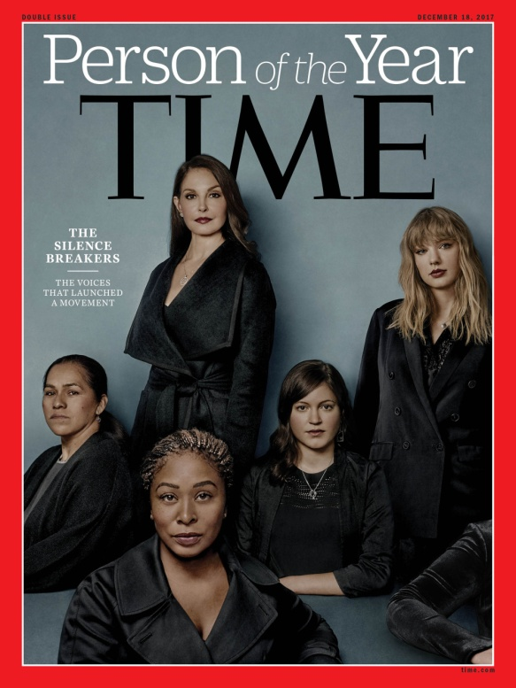
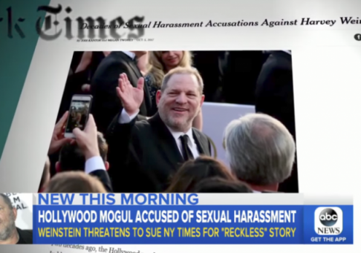
Notes:
http://time.com/time-person-of-the-year-2017-silence-breakers/
https://chicago.suntimes.com/sports/larry-nassar-a-michigan-doctor-who-assaulted-gymnasts-gets-60-years/
http://interactives.indystar.com/news/standing/OutofBalance/NassarTimeline/LSJ.html
http://www.ibtimes.com/who-harvey-weinstein-new-york-times-uncovers-history-sexual-harassment-allegations-2597890
http://www.bbc.com/news/entertainment-arts-41594672
https://www.nytimes.com/2017/12/07/us/politics/al-franken-senate-sexual-harassment.html

Slide 12
半心人的下場 The End of A Half-Hearted Person
士師記 Judges 10:6-12:7

Slide 13
1. 做半心人的原因 The Reason to Be a Half-Hearted Person
Judges 10:6 以色列人又行耶和華眼中看為惡的事，去事奉諸巴力和亞斯她錄，並亞蘭的神、西頓的神、摩押的神、亞捫人的神、非利士人的神，離棄耶和華，不事奉他。
⁶ Again the Israelites did evil in the eyes of the Lord. They served the Baals and the Ashtoreths, and the gods of Aram, the gods of Sidon, the gods of Moab, the gods of the Ammonites and the gods of the Philistines. And because the Israelites forsook the Lord and no longer served him,
，

Slide 14
Judges 10:7–8 ⁷ 耶和華的怒氣向以色列人發作，就把他們交在非利士人和亞捫人的手中。⁸ 從那年起，他們擾害欺壓約旦河那邊、住亞摩利人之基列地的以色列人，共有十八年。
⁷ he became angry with them. He sold them into the hands of the Philistines and the Ammonites, ⁸ who that year shattered and crushed them. For eighteen years they oppressed all the Israelites on the east side of the Jordan in Gilead, the land of the Amorites.

Slide 15
Judges 10:11–12
¹¹ 耶和華對以色列人說：「我豈沒有救過你們脫離埃及人、亞摩利人、亞捫人，和非利士人嗎？¹² 西頓人、亞瑪力人、馬雲人也都欺壓你們；你們哀求我，我也拯救你們脫離他們的手。
¹¹ The Lord replied, “When the Egyptians, the Amorites, the Ammonites, the Philistines, ¹² the Sidonians, the Amalekites and the Maonites oppressed you and you cried to me for help, did I not save you from their hands?

Slide 16
2. 半心人的宗教觀 The Religious View of a Half-Hearted Person
Judges 10:13–14
¹³ 你們竟離棄我，事奉別神！所以我不再救你們了。¹⁴ 你們去哀求所選擇的神；你們遭遇急難的時候，讓他救你們吧！」
¹³ But you have forsaken me and served other gods, so I will no longer save you. ¹⁴ Go and cry out to the gods you have chosen. Let them save you when you are in trouble!”

Slide 17
Psalm 51:17
¹⁷ 上帝所要的祭就是憂傷的靈； 上帝啊，憂傷痛悔的心，你必不輕看。
¹⁷ My sacrifice, O God, is a broken spirit; a broken and contrite heart you, God, will not despise.

Slide 18
Judges 10:15–16
¹⁵ 以色列人對耶和華說：「我們犯罪了，任憑你隨意待我們吧！只求你今日拯救我們。」¹⁶ 以色列人就除掉他們中間的外邦神，事奉耶和華。耶和華因以色列人受的苦難，就心中擔憂。
¹⁵ But the Israelites said to the Lord, “We have sinned. Do with us whatever you think best, but please rescue us now.” ¹⁶ Then they got rid of the foreign gods among them and served the Lord. And he could bear Israel’s misery no longer.

Slide 19
1 John 1:9
⁹ 我們若認自己的罪，上帝是信實的，是公義的，必要赦免我們的罪，洗淨我們一切的不義。
⁹ If we confess our sins, he is faithful and just and will forgive us our sins and purify us from all unrighteousness.

Slide 20
3. 半心人的下場 The End of a Half-Hearted Person
Judges 11:1
¹ 基列人耶弗他是個大能的勇士，是妓女的兒子。耶弗他是基列所生的。
¹ Jephthah the Gileadite was a mighty warrior. His father was Gilead; his mother was a prostitute.

Slide 21
Judges 11:2
² 基列的妻也生了幾個兒子：他妻所生的兒子長大了，就趕逐耶弗他，說：「你不可在我們父家承受產業，因為你是妓女的兒子。」
² Gilead’s wife also bore him sons, and when they were grown up, they drove Jephthah away. “You are not going to get any inheritance in our family,” they said, “because you are the son of another woman.”

Slide 22
Judges 11:5–6
⁵ 亞捫人攻打以色列的時候，基列的長老到陀伯地去，要叫耶弗他回來；⁶ 對耶弗他說：「請你來作我們的元帥，我們好與亞捫人爭戰。」
⁵ the elders of Gilead went to get Jephthah from the land of Tob. ⁶ “Come,” they said, “be our commander, so we can fight the Ammonites.”

Slide 23
Judges 11:9
⁹ 耶弗他對基列的長老說：「你們叫我回去，與亞捫人爭戰，耶和華把他交給我，我可以作你們的領袖嗎？」
⁹ Jephthah answered, “Suppose you take me back to fight the Ammonites and the Lord gives them to me—will I really be your head?”

Slide 24
Judges 11:29–31 ²⁹ 耶和華的靈降在耶弗他身上，…³⁰ 耶弗他就向耶和華許願，說：「你若將亞捫人交在我手中，³¹ 我從亞捫人那裏平平安安回來的時候，無論甚麼人，先從我家門出來迎接我，就必歸你，我也必將他獻上為燔祭。」
²⁹ Then the Spirit of the Lord came on Jephthah… ³⁰ And Jephthah made a vow to the Lord: “If you give the Ammonites into my hands, ³¹ whatever comes out of the door of my house to meet me when I return in triumph from the Ammonites will be the Lord’s, and I will sacrifice it as a burnt offering.”

Slide 25
Judges 11:34
³⁴ 耶弗他回米斯巴到了自己的家，不料，他女兒拿著鼓跳舞出來迎接他，是他獨生的，此外無兒無女。
³⁴ When Jephthah returned to his home in Mizpah, who should come out to meet him but his daughter, dancing to the sound of timbrels! She was an only child. Except for her he had neither son nor daughter.

Slide 26
Judges 11:35
³⁵ 耶弗他看見她，就撕裂衣服，說：「哀哉！我的女兒啊，你使我甚是愁苦，叫我作難了；因為我已經向耶和華開口許願，不能挽回。」
³⁵ When he saw her, he tore his clothes and cried, “Oh no, my daughter! You have brought me down and I am devastated. I have made a vow to the Lord that I cannot break.”

Slide 27
Judges 12:1,6 ¹ 以法蓮人聚集，到了北方，對耶弗他說：「你去與亞捫人爭戰，為甚麼沒有招我們同去呢？我們必用火燒你和你的房屋。」 …那時以法蓮人被殺的有四萬二千人。
¹ The Ephraimite forces were called out, and they crossed over to Zaphon. They said to Jephthah, “Why did you go to fight the Ammonites without calling us to go with you? We’re going to burn down your house over your head.” … Forty-two thousand Ephraimites were killed at that time.

Slide 28
Judges 12:7
⁷ 耶弗他作以色列的士師六年。基列人耶弗他死了，葬在基列的一座城裏。
⁷ Jephthah led Israel six years. Then Jephthah the Gileadite died and was buried in a town in Gilead.

