Slide 1
Luke 2:8-20
⁸ And there were shepherds living out in the fields nearby, keeping watch over their flocks at night. ⁹ An angel of the Lord appeared to them, and the glory of the Lord shone around them, and they were terrified. ¹⁰ But the angel said to them, “Do not be afraid. I bring you good news that will cause great joy for all the people.
⁸ 在伯利恆之野地裡有牧羊的人，夜間按著更次看守羊群。 ⁹ 有主的使者站在他們旁邊，主的榮光四面照著他們，牧羊的人就甚懼怕。 ¹⁰ 那天使對他們說：「不要懼怕，我報給你們大喜的信息，是關乎萬民的。

Slide 2
Luke 2:8-20
¹¹ Today in the town of David a Savior has been born to you; he is the Messiah, the Lord. ¹² This will be a sign to you: You will find a baby wrapped in cloths and lying in a manger.”
¹³ Suddenly a great company of the heavenly host appeared with the angel, praising God and saying,
¹⁴ “Glory to God in the highest heaven, and on earth peace to those on whom his favor rests.”
¹¹ 因今天在大衛的城裡，為你們生了救主，就是主基督。 ¹² 你們要看見一個嬰孩，包著布，臥在馬槽裡，那就是記號了。」 ¹³ 忽然有一大隊天兵，同那天使讚美神說： ¹⁴ 「在至高之處榮耀歸於神！在地上平安歸於他所喜悅的人！」

Slide 3
Luke 2:8-20
¹⁵ When the angels had left them and gone into heaven, the shepherds said to one another, “Let’s go to Bethlehem and see this thing that has happened, which the Lord has told us about.”
¹⁶ So they hurried off and found Mary and Joseph, and the baby, who was lying in the manger. ¹⁷ When they had seen him, they spread the word concerning what had been told them about this child,
¹⁵ 眾天使離開他們升天去了，牧羊的人彼此說：「我們往伯利恆去，看看所成的事，就是主所指示我們的。」 ¹⁶ 他們急忙去了，就尋見馬利亞和約瑟，又有那嬰孩臥在馬槽裡。 ¹⁷ 既然看見，就把天使論這孩子的話傳開了。

Slide 4
Luke 2:8-20
¹⁸ and all who heard it were amazed at what the shepherds said to them. ¹⁹ But Mary treasured up all these things and pondered them in her heart. ²⁰ The shepherds returned, glorifying and praising God for all the things they had heard and seen, which were just as they had been told.
¹⁸ 凡聽見的，就詫異牧羊之人對他們所說的話。 ¹⁹ 馬利亞卻把這一切的事存在心裡，反覆思想。 ²⁰ 牧羊的人回去了，因所聽見、所看見的一切事正如天使向他們所說的，就歸榮耀於神，讚美他。

Slide 5
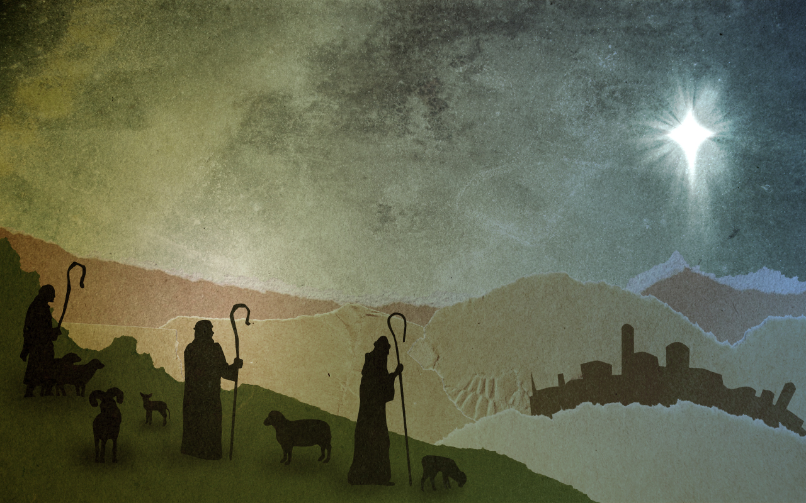
When Heaven Came Down to Earth
Luke 2:8-20

Slide 6
Luke 2:11-12
¹¹ Today in the town of David a Savior has been born to you; he is the Messiah, the Lord. ¹² This will be a sign to you: You will find a baby wrapped in cloths and lying in a manger.
¹¹ 因今天在大衛的城裡，為你們生了救主，就是主基督。 ¹² 你們要看見一個嬰孩，包著布，臥在馬槽裡，那就是記號了。」

Slide 7
Luke 2:14
¹⁴ “Glory to God in the highest heaven,
and on earth peace to those on whom his favor rests.”
「在至高之處榮耀歸於神！在地上平安歸於他所喜悅的人！」

Slide 8
2 Samuel 7:16
¹⁶ Your house and your kingdom will endure forever before me; your throne will be established forever.’
¹⁶ 你的家和你的國必在我面前永遠堅立，你的國位也必堅定直到永遠。』」

Slide 9
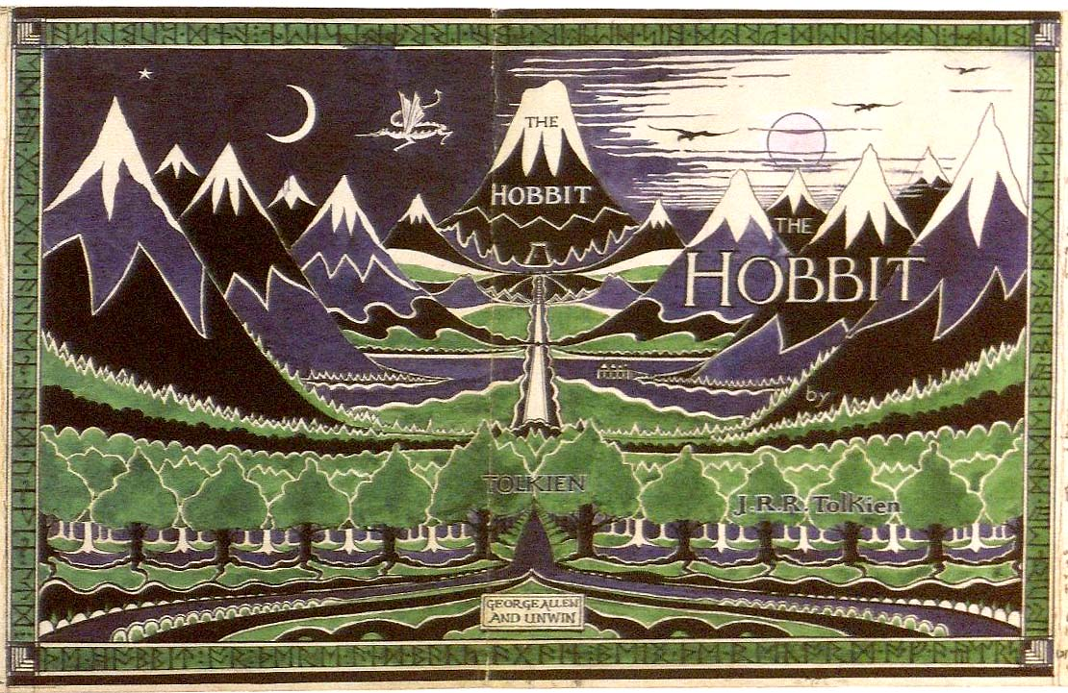

Slide 10
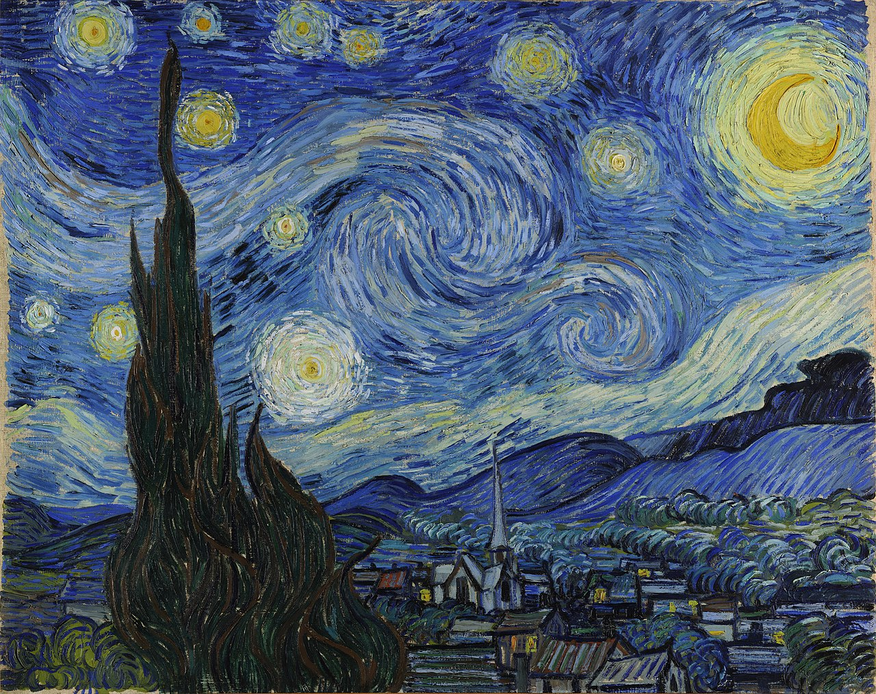

Slide 11
Luke 2:15–16
¹⁵ When the angels had left them and gone into heaven, the shepherds said to one another, “Let’s go to Bethlehem and see this thing that has happened, which the Lord has told us about.” ¹⁶ So they hurried off and found Mary and Joseph, and the baby, who was lying in the manger.
¹⁵ 眾天使離開他們升天去了，牧羊的人彼此說：「我們往伯利恆去，看看所成的事，就是主所指示我們的。」 ¹⁶ 他們急忙去了，就尋見馬利亞和約瑟，又有那嬰孩臥在馬槽裡。

Slide 12
John 3:16
^{3:16} For this is the way God loved the world: He gave his one and only Son, so that everyone who believes in him will not perish but have eternal life. (NET)
¹⁶ 「神愛世人，甚至將他的獨生子賜給他們，叫一切信他的不致滅亡，反得永生。

Slide 13
While shepherds kept their watching Over silent flocks by night Behold throughout the heavens There shone a holy light
有牧羊人在野地，
夜間看守群羊，
忽然自天上照耀，
極聖潔的亮光。

Slide 14
The shepherds feared and trembled When lo! above the earth Rang out the angel chorus That hailed our Savior's birth
牧羊人心裏戰兢，
但聞天使歌聲，
歡呼讚美聲嘹亮，
救主今夜降生。

Slide 15
Go, tell it on the mountain Over the hills and everywhere Go, tell it on the mountain That Jesus Christ is born
到各山嶺去傳揚，
越過山崗到各地方；
到各山嶺去傳揚，
說基督已降生！

Slide 16
Luke 2:20
²⁰ The shepherds returned, glorifying and praising God for all the things they had heard and seen, which were just as they had been told.
²⁰ 牧羊的人回去了，因所听见、所看见的一切事正如天使向他们所说的，就归荣耀于神，赞美他。

Slide 17
Mat 1:23
²³ “The virgin will conceive and give birth to a son, and they will call him Immanuel”(which means “God with us”).
²³ “必有童女怀孕生子，人要称他的名为以马内利。”（“以马内利”翻出来就是“神与我们同在”。）

