Slide 1
Daniel 2:20-23
“Praise be to the name of God for ever and ever;
wisdom and power are his.
²¹ He changes times and seasons;
he deposes kings and raises up others.
He gives wisdom to the wise
and knowledge to the discerning.
神的名是应当称颂的！从亘古直到永远，因为智慧能力都属乎他。21 他改变时候、日期，废王，立王，将智慧赐与智慧人，将知识赐与聪明人。

Slide 2
Daniel 2:20-23
²² He reveals deep and hidden things;
he knows what lies in darkness,
and light dwells with him.
²³ I thank and praise you, God of my ancestors:
You have given me wisdom and power,
you have made known to me what we asked of you,
you have made known to us the dream of the king.”
22 他显明深奥隐秘的事，知道暗中所有的，光明也与他同居。23 我列祖的 神啊，我感谢你，赞美你；因你将智慧才能赐给我，允准我们所求的，把王的事给我们指明。

Slide 3
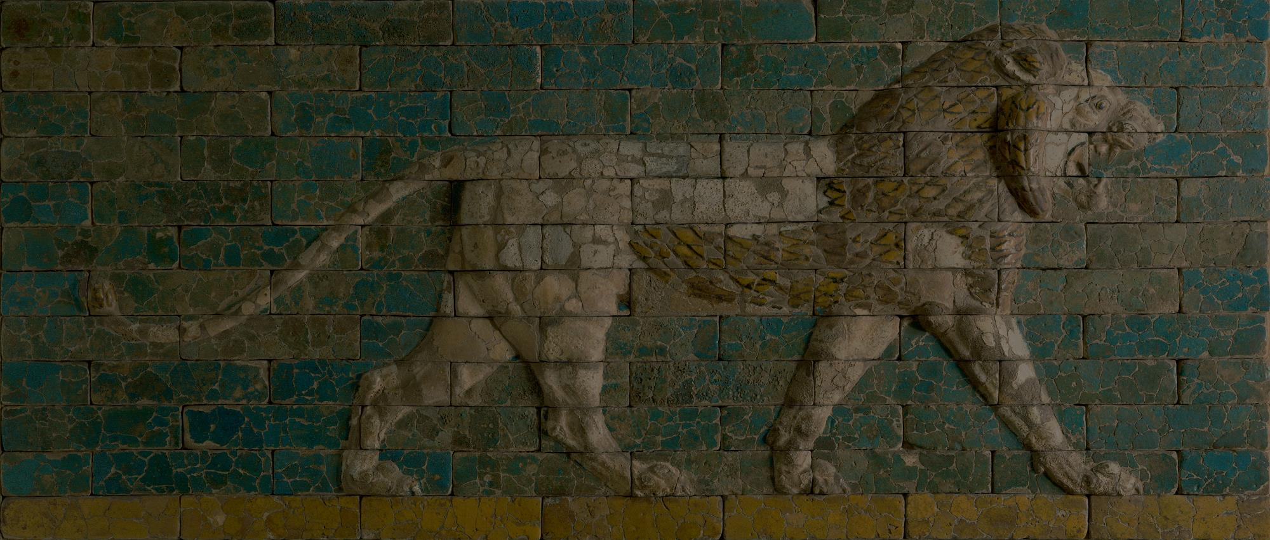
Praise God of Wisdom, Power and Revelation
Daniel 2

Slide 4
Daniel 2:10-11
¹⁰ “There is no one on earth who can do what the king asks! … ¹¹ What the king asks is too difficult. No one can reveal it to the king except the gods, and they do not live among humans.”
¹⁰ 「世上没有人能将王所问的事说出来；因为没有君王、大臣、掌权的向术士，或用法术的，或迦勒底人问过这样的事。

Slide 5
Daniel 2:20-23
“Praise be to the name of God for ever and ever; wisdom and power are his.
²¹ He changes times and seasons; he deposes kings and raises up others.
He gives wisdom to the wise and knowledge to the discerning.
²² He reveals deep and hidden things; he knows what lies in darkness,
and light dwells with him.
²³ I thank and praise you, God of my ancestors: You have given me wisdom and power, you have made known to me what we asked of you, you have made known to us the dream of the king.”
神的名是应当称颂的！从亘古直到永远，因为智慧能力都属乎他。他改变时候、日期，废王，立王，将智慧赐与智慧人，将知识赐与聪明人。他显明深奥隐秘的事，知道暗中所有的，光明也与他同居。我列祖的 神啊，我感谢你，赞美你；因你将智慧才能赐给我，允准我们所求的，把王的事给我们指明。

Slide 6
Proverbs 9:10
¹⁰ The fear of the Lord is the beginning of wisdom,
and knowledge of the Holy One is understanding.
¹⁰ 敬畏耶和华是智慧的开端；
认识至圣者便是聪明。

Slide 7
Daniel 2:27-28a
²⁷ No wise man, enchanter, magician or diviner can explain to the king the mystery he has asked about, ²⁸ but there is a God in heaven who reveals mysteries.
²⁷ 但以理在王面前回答说：「王所问的那奥秘事，哲士、用法术的、术士、观兆的都不能告诉王，²⁸ 只有一位在天上的 神能显明奥秘的事。

Slide 8
Daniel 2:31-35
³¹ “Your Majesty looked, and there before you stood a large statue—an enormous, dazzling statue, awesome in appearance. ³² The head of the statue was made of pure gold, its chest and arms of silver, its belly and thighs of bronze, ³³ its legs of iron, its feet partly of iron and partly of baked clay. ³⁴ While you were watching, a rock was cut out, but not by human hands. It struck the statue on its feet of iron and clay and smashed them. ³⁵ Then the iron, the clay, the bronze, the silver and the gold were all broken to pieces and became like chaff on a threshing floor in the summer. The wind swept them away without leaving a trace. But the rock that struck the statue became a huge mountain and filled the whole earth.

Slide 9
Daniel 2:31-35
³¹ 「王啊，你梦见一个大像，这像甚高，极其光耀，站在你面前，形状甚是可怕。³² 这像的头是精金的，胸膛和膀臂是银的，肚腹和腰是铜的，³³ 腿是铁的，脚是半铁半泥的。³⁴ 你观看，见有一块非人手凿出来的石头打在这像半铁半泥的脚上，把脚砸碎；³⁵ 于是金、银、铜、铁、泥都一同砸得粉碎，成如夏天禾场上的糠秕，被风吹散，无处可寻。打碎这像的石头变成一座大山，充满天下。

Slide 10
Daniel 2:37–38
³⁷ Your Majesty, you are the king of kings. The God of heaven has given you dominion and power and might and glory; ³⁸ in your hands he has placed all mankind and the beasts of the field and the birds in the sky. Wherever they live, he has made you ruler over them all. You are that head of gold.
³⁷ 王啊，你是诸王之王。天上的 神已将国度、权柄、能力、尊荣都赐给你。³⁸ 凡世人所住之地的走兽，并天空的飞鸟，他都交付你手，使你掌管这一切。你就是那金头。

Slide 11
Daniel 2:34–35
34 As you looked, a stone was cut out by no human hand, and it struck the image on its feet of iron and clay, and broke them in pieces. 35 Then the iron, the clay, the bronze, the silver, and the gold, all together were broken in pieces, and became like the chaff of the summer threshing floors; and the wind carried them away, so that not a trace of them could be found. But the stone that struck the image became a great mountain and filled the whole earth.
³⁴ 你观看，见有一块非人手凿出来的石头打在这像半铁半泥的脚上，把脚砸碎；³⁵ 于是金、银、铜、铁、泥都一同砸得粉碎，成如夏天禾场上的糠秕，被风吹散，无处可寻。打碎这像的石头变成一座大山，充满天下。

Slide 12
Revelation 18:2–3
² …“ ‘Fallen! Fallen is Babylon the Great!’
She has become a dwelling for demons
and a haunt for every impure spirit,
a haunt for every unclean bird,
a haunt for every unclean and detestable animal.
³ For all the nations have drunk
the maddening wine of her adulteries.
The kings of the earth committed adultery with her,
and the merchants of the earth grew rich from her excessive luxuries.”
巴比伦大城倾倒了！倾倒了！
成了鬼魔的住处
和各样污秽之灵的巢穴，
并各样污秽可憎之雀鸟的巢穴。
因为列国都被她邪淫大怒的酒倾倒了。
地上的君王与她行淫；
地上的客商因她奢华太过就发了财。

Slide 13
Revelation 19:1-4
…“Hallelujah!
Salvation and glory and power belong to our God,
² for true and just are his judgments.
He has condemned the great prostitute
who corrupted the earth by her adulteries.
He has avenged on her the blood of his servants.”
³ And again they shouted:
“Hallelujah!
The smoke from her goes up for ever and ever.”
⁴ The twenty-four elders and the four living creatures fell down and worshiped God, who was seated on the throne. And they cried:
“Amen, Hallelujah!”
…哈利路亚！
救恩、荣耀、权能都属乎我们的 神！
² 他的判断是真实公义的；
因他判断了那用淫行败坏世界的大淫妇，
并且向淫妇讨流仆人血的罪，
给他们伸冤。
³ 又说：
哈利路亚！
烧淫妇的烟往上冒，
直到永永远远。
⁴ 那二十四位长老与四活物就俯伏敬拜坐宝座的 神，说：
阿们！哈利路亚！

