Slide 1
路加福音 Luke 24:13–35
¹³ 正當那日，門徒中有兩個人往一個村子去；這村子名叫以馬忤斯，離耶路撒冷約有二十五里。¹⁴ 他們彼此談論所遇見的這一切事。¹⁵ 正談論相問的時候，耶穌親自就近他們，和他們同行；¹⁶ 只是他們的眼睛迷糊了，不認識他。
¹³ Now that same day two of them were going to a village called Emmaus, about seven miles from Jerusalem. ¹⁴ They were talking with each other about everything that had happened. ¹⁵ As they talked and discussed these things with each other, Jesus himself came up and walked along with them; ¹⁶ but they were kept from recognizing him.

Slide 2
¹⁷ 耶穌對他們說：「你們走路彼此談論的是甚麼事呢？」他們就站住，臉上帶著愁容。¹⁸ 二人中有一個名叫革流巴的回答說：「你在耶路撒冷作客，還不知道這幾天在那裏所出的事嗎？」¹⁹ 耶穌說：「甚麼事呢？」他們說：「就是拿撒勒人耶穌的事。
¹⁷ He asked them, “What are you discussing together as you walk along?” They stood still, their faces downcast. ¹⁸ One of them, named Cleopas, asked him, “Are you the only one visiting Jerusalem who does not know the things that have happened there in these days?” ¹⁹ “What things?” he asked. “About Jesus of Nazareth,” they replied.

Slide 3
他是個先知，在上帝和眾百姓面前，說話行事都有大能。²⁰ 祭司長和我們的官府竟把他解去，定了死罪，釘在十字架上。²¹ 但我們素來所盼望、要贖以色列民的就是他！不但如此，而且這事成就，現在已經三天了。²² 再者，我們中間有幾個婦女使我們
“He was a prophet, powerful in word and deed before God and all the people. ²⁰ The chief priests and our rulers handed him over to be sentenced to death, and they crucified him; ²¹ but we had hoped that he was the one who was going to redeem Israel. And what is more, it is the third day since all this took place. ²² In addition, some of our women amazed us.

Slide 4
驚奇；她們清早到了墳墓那裏，²³ 不見他的身體，就回來告訴我們，說看見了天使顯現，說他活了。²⁴ 又有我們的幾個人往墳墓那裏去，所遇見的正如婦女們所說的，只是沒有看見他。」²⁵ 耶穌對他們說：「無知的人哪，先知所說的一切話，你們的心
They went to the tomb early this morning ²³ but didn’t find his body. They came and told us that they had seen a vision of angels, who said he was alive. ²⁴ Then some of our companions went to the tomb and found it just as the women had said, but they did not see Jesus.” ²⁵ He said to them, “How foolish you are, and how slow to believe all that the

Slide 5
信得太遲鈍了。²⁶ 基督這樣受害，又進入他的榮耀，豈不是應當的嗎？」²⁷ 於是從摩西和眾先知起，凡經上所指著自己的話都給他們講解明白了。 ²⁸ 將近他們所去的村子，耶穌好像還要往前行，²⁹ 他們卻強留他，說：
prophets have spoken! ²⁶ Did not the Messiah have to suffer these things and then enter his glory?” ²⁷ And beginning with Moses and all the Prophets, he explained to them what was said in all the Scriptures concerning himself. ²⁸ As they approached the village to which they were going, Jesus continued on as if he were going farther. ²⁹ But they urged him strongly,

Slide 6
「時候晚了，日頭已經平西了，請你同我們住下吧！」耶穌就進去，要同他們住下。³⁰ 到了坐席的時候，耶穌拿起餅來，祝謝了，擘開，遞給他們。³¹ 他們的眼睛明亮了，這才認出他來。忽然耶穌不見了。³² 他們彼此說：
“Stay with us, for it is nearly evening; the day is almost over.” So he went in to stay with them. ³⁰ When he was at the table with them, he took bread, gave thanks, broke it and began to give it to them. ³¹ Then their eyes were opened and they recognized him, and he disappeared from their sight. ³² They asked each other,

Slide 7
「在路上，他和我們說話，給我們講解聖經的時候，我們的心豈不是火熱的嗎？」³³ 他們就立時起身，回耶路撒冷去，正遇見十一個使徒和他們的同人聚集在一處，³⁴ 說：「主果然復活，已經現給西門看了。」
“Were not our hearts burning within us while he talked with us on the road and opened the Scriptures to us?” ³³ They got up and returned at once to Jerusalem. There they found the Eleven and those with them, assembled together ³⁴ and saying, “It is true! The Lord has risen and has appeared to Simon.”

Slide 8
³⁵ 兩個人就把路上所遇見，和擘餅的時候怎麼被他們認出來的事，都述說了一遍。
³⁵ Then the two told what had happened on the way, and how Jesus was recognized by them when he broke the bread.

Slide 9
陌生客．同路人 Emmaus Stranger
路加福音 Luke 24:13–35
Notes:
https://en.wikipedia.org/wiki/Fall_of_Mosul

Slide 10
復活節

Slide 11
1. 復活：難以置信的事件 Resurrection : An Incredible Event
路加是一個可靠的作者 Luke is a credible writer

Slide 12
Luke 1:1–4 ¹ 提阿非羅大人哪，有好些人提筆作書，述說在我們中間所成就的事，是照傳道的人從起初親眼看見又傳給我們的。³ 這些事我既從起頭都詳細考察了，就定意要按著次序寫給你，⁴ 使你知道所學之道都是確實的。
¹ Many have undertaken to draw up an account of the things that have been fulfilled among us, ² just as they were handed down to us by those who from the first were eyewitnesses and servants of the word. ³ With this in mind, since I myself have carefully investigated everything from the beginning, I too decided to write an orderly account for you, most excellent Theophilus, ⁴ so that you may know the certainty of the things you have been taught.

Slide 13
1. 復活：難以置信的事件 Resurrection : An Incredible Event
路加是一個可靠的作者 Luke is a credible writer
寫書日期與事情發生的日期是非常接近 The book date is very close to the event date

Slide 14
1. 復活：難以置信的事件 Resurrection : An Incredible Event
路加是一個可靠的作者 Luke is a credible writer
寫書日期與事情發生的日期是非常接近 The book date is very close to the event date
路加記載事件的細節 Luke recorded the details of the incident

Slide 15
Luke 24:13–18 ¹³ 正當那日，門徒中有兩個人往一個村子去；這村子名叫以馬忤斯，離耶路撒冷約有二十五里。^{… 15} 正談論相問的時候，耶穌親自就近他們，和他們同行；¹⁶ 只是他們的眼睛迷糊了，不認識他。^{… 18} 二人中有一個名叫革流巴
¹³ Now that same day two of them were going to a village called Emmaus, about seven miles from Jerusalem… ¹⁵ As they talked and discussed these things with each other, Jesus himself came up and walked along with them; ¹⁶ but they were kept from recognizing him… ¹⁸ One of them, named Cleopas

Slide 16
Luke 24:19–24 ¹⁹ … 他們說：「就是拿撒勒人耶穌的事。… ²⁰ 祭司長和我們的官府竟把他解去，定了死罪，釘在十字架上。… 而且這事成就，現在已經三天了。
¹⁹ … “About Jesus of Nazareth,” they replied… ²⁰ The chief priests and our rulers handed him over to be sentenced to death, and they crucified him; … it is the third day since all this took place.

Slide 17
²² 再者，我們中間有幾個婦女使我們驚奇；她們清早到了墳墓那裏，²³ 不見他的身體，就回來告訴我們，說看見了天使顯現，說他活了。²⁴ 又有我們的幾個人往墳墓那裏去，所遇見的正如婦女們所說的，只是沒有看見他。」
²² In addition, some of our women amazed us. They went to the tomb early this morning ²³ but didn’t find his body. They came and told us that they had seen a vision of angels, who said he was alive. ²⁴ Then some of our companions went to the tomb and found it just as the women had said, but they did not see Jesus.”

Slide 18
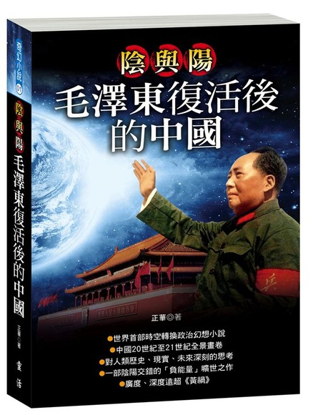
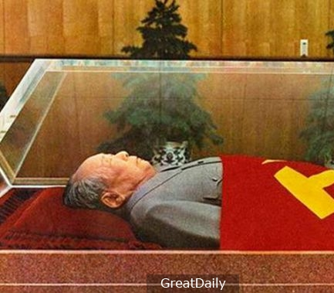

Slide 19
1. 復活：難以置信的事件 Resurrection : An Incredible Event
路加是一個可靠的作者 Luke is a credible writer
寫書日期與事情發生的日期是非常接近 The book date is very close to the event date
路加記載事件的細節 Luke recorded the details of the incident
當時連耶穌的門徒也不相信耶穌復活了 Even Jesus’ disciples did not believe in His resurrection

Slide 20
Luke 24:25–27 ²⁵ 耶穌對他們說：「無知的人哪，先知所說的一切話，你們的心信得太遲鈍了。²⁶ 基督這樣受害，又進入他的榮耀，豈不是應當的嗎？」²⁷ 於是從摩西和眾先知起，凡經上所指著自己的話都給他們講解明白了。
²⁵ He said to them, “How foolish you are, and how slow to believe all that the prophets have spoken! ²⁶ Did not the Messiah have to suffer these things and then enter his glory?” ²⁷ And beginning with Moses and all the Prophets, he explained to them what was said in all the Scriptures concerning himself.

Slide 21
Luke 24:32
³² 他們彼此說：「在路上，他和我們說話，給我們講解聖經的時候，我們的心豈不是火熱的嗎？」
³² They asked each other, “Were not our hearts burning within us while he talked with us on the road and opened the Scriptures to us?”

Slide 22
Luke 24:31
³¹ 他們的眼睛明亮了，這才認出他來。忽然耶穌不見了。
³¹ Then their eyes were opened and they recognized him, and he disappeared from their sight.

Slide 23
2. 預言：燃點信心的方法 Prophecy : A Way to Ignite Our Faith
受死的日期的預言 Prophecy about the date of Christ’s death
但以理「七十個七」的預言 Daniel’s 70 weeks of years
(但以理書 Daniel 9:25-27)

Slide 24
Daniel 9:24–27 ²⁴ 「為你本國之民和你聖城，已經定了七十個七。要止住罪過，除淨罪惡，贖盡罪孽，引進永義，封住異象和預言，並膏至聖者。
²⁴ “Seventy ‘sevens’ are decreed for your people and your holy city to finish transgression, to put an end to sin, to atone for wickedness, to bring in everlasting righteousness, to seal up vision and prophecy and to anoint the Most Holy Place.

Slide 25
²⁵ 你當知道，當明白，從出令重新建造耶路撒冷，直到有受膏君的時候，必有七個七和六十二個七。正在艱難的時候，耶路撒冷城連街帶濠都必重新建造。²⁶ 過了六十二個七，那受膏者必被剪除，一無所有…
²⁵ “Know and understand this: From the time the word goes out to restore and rebuild Jerusalem until the Anointed One, the ruler, comes, there will be seven ‘sevens,’ and sixty-two ‘sevens.’ It will be rebuilt with streets and a trench, but in times of trouble. ²⁶ After the sixty-two ‘sevens,’ the Anointed One will be put to death and will have nothing…

Slide 26
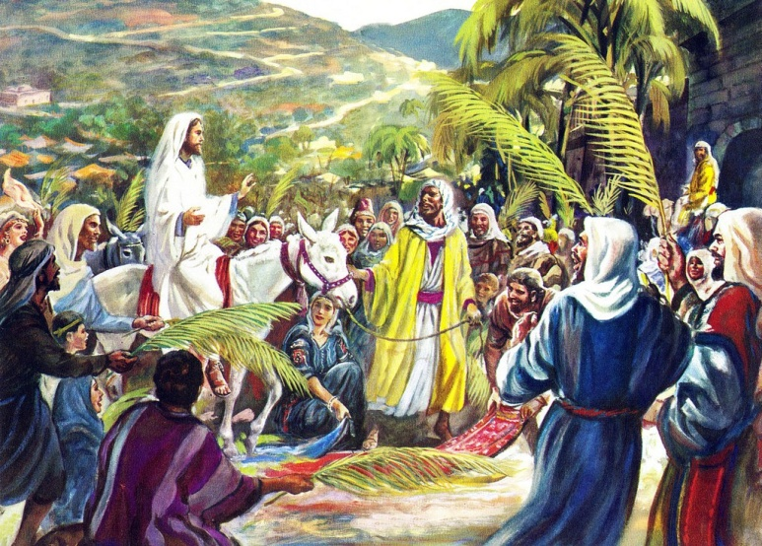
基督凱旋入耶路撒冷 Triumphant entry into Jerusalem

Slide 27
Jewish Calendar (360 days per year) | Gregorian Calendar (365 days a year)
(7×7) + (62×7) years = 483 years | 444 B.C. to A.D. 33 = 476 years
483 years×360 days = 173,880 days | 476 years×365 days = 173,740 days
 | + 116 days in leap years
 | + 24 days (March 5–March 30)
173,880 days | 173,880 days

Slide 28
基督是騎驢凱旋入耶路撒冷 (亞 Zech 9:9) Christ to arrive riding a donkey
他的朋友出賣他 (詩 Psa 41:9) Christ to be betrayed by a friend
出賣的價錢就是30塊銀子 (亞 Zech 11:12) Christ to be sold for 30 pieces of silver

Slide 29
2. 預言：燃點信心的方法 Prophecy : A Way to Ignite Our Faith
受死的日期的預言 Prophecy about the date of Christ’s death
被殺過程的預言 Prophecy about how Christ died
詩篇 Psalm 22

Slide 30
Psalm 22:1
¹ 我的上帝，我的上帝！為甚麼離棄我？ 為甚麼遠離不救我？不聽我唉哼的言語？
¹ My God, my God, why have you forsaken me? Why are you so far from saving me, so far from my cries of anguish?
Matthew 27:46
⁴⁶ 約在申初，耶穌大聲喊著說：…「我的上帝！我的上帝！為甚麼離棄我？」
⁴⁶ About three in the afternoon Jesus cried out in a loud voice, … “My God, my God, why have you forsaken me?”.

Slide 31
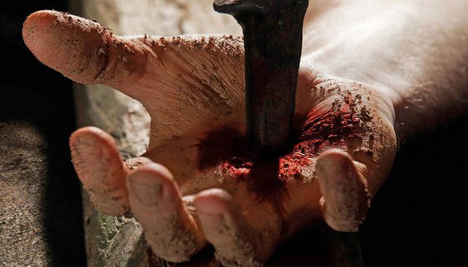
Psalm 22:16
¹⁶他們扎了我的手，我的腳。
¹⁶ they pierce my hands and my feet.
John 19:18
¹⁸ 他們就在那裏釘他在十字架上…
¹⁸ There they crucified him…

Slide 32
Psalm 22:18
¹⁸ 他們分我的外衣， 為我的裏衣拈鬮。
¹⁸ They divide my clothes among them and cast lots for my garment.

Slide 33
John 19:23–24 ²³ 兵丁既然將耶穌釘在十字架上，就拿他的衣服分為四分，每兵一分；又拿他的裏衣，這件裏衣原來沒有縫兒，是上下一片織成的。²⁴ 他們就彼此說：「我們不要撕開，只要拈鬮，看誰得著。」
²³ When the soldiers crucified Jesus, they took his clothes, dividing them into four shares, one for each of them, with the undergarment remaining. This garment was seamless, woven in one piece from top to bottom. ²⁴ “Let’s not tear it,” they said to one another. “Let’s decide by lot who will get it.”

Slide 34
Psalm 16:10
¹⁰ 因為你必不將我的靈魂撇在陰間， 也不叫你的聖者見朽壞。
¹⁰ because you will not abandon me to the realm of the dead, nor will you let your faithful one see decay.

Slide 35
3. 問題：選擇死亡的原因 Question : Reason to Choose Death
Matthew 26:47–50 ⁴⁷ 說話之間，那十二個門徒裏的猶大來了，並有許多人帶著刀棒，從祭司長和民間的長老那裏與他同來。…於是那些人上前，下手拿住耶穌。
⁴⁷ While he was still speaking, Judas, one of the Twelve, arrived. With him was a large crowd armed with swords and clubs, sent from the chief priests and the elders of the people…Then the men stepped forward, seized Jesus and arrested him.

Slide 36
Matthew 26:51–54 ⁵¹ 有跟隨耶穌的一個人伸手拔出刀來，將大祭司的僕人砍了一刀，削掉了他一個耳朵。
⁵¹ With that, one of Jesus’ companions reached for his sword, drew it out and struck the servant of the high priest, cutting off his ear.

Slide 37
⁵² 耶穌對他說：「收刀入鞘吧！…⁵³ 你想，我不能求我父現在為我差遣十二營多天使來嗎？⁵⁴ 若是這樣，經上所說，事情必須如此的話怎麼應驗呢？」
⁵² “Put your sword back in its place,” Jesus said to him, “…⁵³ Do you think I cannot call on my Father, and he will at once put at my disposal more than twelve legions of angels? ⁵⁴ But how then would the Scriptures be fulfilled that say it must happen in this way?”

Slide 38
Isaiah 53:11
¹¹ 他必看見自己勞苦的功效， 便心滿意足。 有許多人因認識我的義僕得稱為義； 並且他要擔當他們的罪孽。
¹¹ After he has suffered, he will see the light of life and be satisfied; by his knowledge my righteous servant will justify many, and he will bear their iniquities.

