Slide 1
Daniel 5:1-9, 17-31
King Belshazzar gave a great banquet for a thousand of his nobles and drank wine with them. ² While Belshazzar was drinking his wine, he gave orders to bring in the gold and silver goblets that Nebuchadnezzar his father had taken from the temple in Jerusalem, so that the king and his nobles, his wives and his concubines might drink from them.
¹ 伯沙撒王为他的一千大臣设摆盛筵，与这一千人对面饮酒。² 伯沙撒欢饮之间，吩咐人将他父尼布甲尼撒从耶路撒冷殿中所掠的金银器皿拿来，王与大臣、皇后、妃嫔好用这器皿饮酒。

Slide 2
Daniel 5:1-9, 17-31
³ 于是他们把耶路撒冷 神殿库房中所掠的金器皿拿来，王和大臣、皇后、妃嫔就用这器皿饮酒。⁴ 他们饮酒，赞美金、银、铜、铁、木、石所造的神。
⁵ 当时，忽有人的指头显出，在王宫与灯台相对的粉墙上写字。王看见写字的指头
³ So they brought in the gold goblets that had been taken from the temple of God in Jerusalem, and the king and his nobles, his wives and his concubines drank from them. ⁴ As they drank the wine, they praised the gods of gold and silver, of bronze, iron, wood and stone.
⁵ Suddenly the fingers of a human hand appeared and wrote on the plaster of the wall, near the lampstand in the royal palace. The king watched the hand as it wrote.

Slide 3
Daniel 5:1-9, 17-31
⁶ His face turned pale and he was so frightened that his legs became weak and his knees were knocking.
⁷ The king summoned the enchanters, astrologers and diviners. Then he said to these wise men of Babylon, “Whoever reads this writing and tells me what it means will be clothed in purple and have a gold chain placed around his neck, and he will be made the third highest ruler in the kingdom.”
⁶ 就变了脸色，心意惊惶，腰骨好像脱节，双膝彼此相碰，⁷ 大声吩咐将用法术的和迦勒底人并观兆的领进来，对巴比伦的哲士说，谁能读这文字，把讲解告诉我，他必身穿紫袍，项带金链，在我国中位列第三。

Slide 4
Daniel 5:1-9, 17-31
⁸ Then all the king’s wise men came in, but they could not read the writing or tell the king what it meant. ⁹ So King Belshazzar became even more terrified and his face grew more pale. His nobles were baffled.
…
⁸ 于是王的一切哲士都进来，却不能读那文字，也不能把讲解告诉王。⁹ 伯沙撒王就甚惊惶，脸色改变，他的大臣也都惊奇。
…

Slide 5
Daniel 5:1-9, 17-31
¹⁷ 但以理在王面前回答说：「你的赠品可以归你自己，你的赏赐可以归给别人；我却要为王读这文字，把讲解告诉王。¹⁸ 王啊，至高的 神曾将国位、大权、荣耀、威严赐与你父尼布甲尼撒；
¹⁷ Then Daniel answered the king, “You may keep your gifts for yourself and give your rewards to someone else. Nevertheless, I will read the writing for the king and tell him what it means.
¹⁸ “Your Majesty, the Most High God gave your father Nebuchadnezzar sovereignty and greatness and glory and splendor.

Slide 6
Daniel 5:1-9, 17-31
¹⁹ 因神所赐他的大权，各方、各国、各族的人都在他面前战兢恐惧。他可以随意生杀，随意升降。²⁰ 但他心高气傲，灵也刚愎，甚至行事狂傲，就被革去王位，夺去荣耀。
¹⁹ Because of the high position he gave him, all the nations and peoples of every language dreaded and feared him. Those the king wanted to put to death, he put to death; those he wanted to spare, he spared; those he wanted to promote, he promoted; and those he wanted to humble, he humbled. ²⁰ But when his heart became arrogant and hardened with pride, he was deposed from his royal throne and stripped of his glory.

Slide 7
Daniel 5:1-9, 17-31
²¹ 他被赶出离开世人，他的心变如兽心，与野驴同居，吃草如牛，身被天露滴湿，等他知道至高的 神在人的国中掌权，凭自己的意旨立人治国。²² 伯沙撒啊，你是他的儿子，你虽知道这一切，你心仍不自卑，
²¹ He was driven away from people and given the mind of an animal; he lived with the wild donkeys and ate grass like the ox; and his body was drenched with the dew of heaven, until he acknowledged that the Most High God is sovereign over all kingdoms on earth and sets over them anyone he wishes.
²² “But you, Belshazzar, his son, have not humbled yourself, though you knew all this.

Slide 8
Daniel 5:1-9, 17-31
²³ 竟向天上的主自高，使人将他殿中的器皿拿到你面前，你和大臣、皇后、妃嫔用这器皿饮酒。你又赞美那不能看、不能听、无知无识、金、银、铜、铁、木、石所造的神，却没有将荣耀归与那手中有你气息，管理你一切行动的神。
²³ Instead, you have set yourself up against the Lord of heaven. You had the goblets from his temple brought to you, and you and your nobles, your wives and your concubines drank wine from them. You praised the gods of silver and gold, of bronze, iron, wood and stone, which cannot see or hear or understand. But you did not honor the God who holds in his hand your life and all your ways.

Slide 9
Daniel 5:1-9, 17-31
²⁴ 因此从 神那里显出指头来写这文字。
²⁵ 「所写的文字是：『弥尼，弥尼，提客勒，乌法珥新。』²⁶ 讲解是这样：弥尼，就是 神已经数算你国的年日到此完毕。²⁷ 提客勒，就是你被称在天平里，显出你的亏欠。²⁸ 毗勒斯，就是你的国分裂，归与米底亚人和波斯人。」
²⁴ Therefore he sent the hand that wrote the inscription.
²⁵ “This is the inscription that was written:
mene, mene, tekel, parsin
²⁶ “Here is what these words mean:
Mene: God has numbered the days of your reign and brought it to an end.
²⁷ Tekel: You have been weighed on the scales and found wanting.
²⁸ Peres: Your kingdom is divided and given to the Medes and Persians.”

Slide 10
Daniel 5:1-9, 17-31
²⁹ 伯沙撒下令，人就把紫袍给但以理穿上，把金链给他戴在颈项上，又传令使他在国中位列第三。³⁰ 当夜，迦勒底王伯沙撒被杀。³¹ 米底亚人大流士年六十二岁，取了迦勒底国。
²⁹ Then at Belshazzar’s command, Daniel was clothed in purple, a gold chain was placed around his neck, and he was proclaimed the third highest ruler in the kingdom.
³⁰ That very night Belshazzar, king of the Babylonians, was slain, ³¹ and Darius the Mede took over the kingdom, at the age of sixty-two.

Slide 11
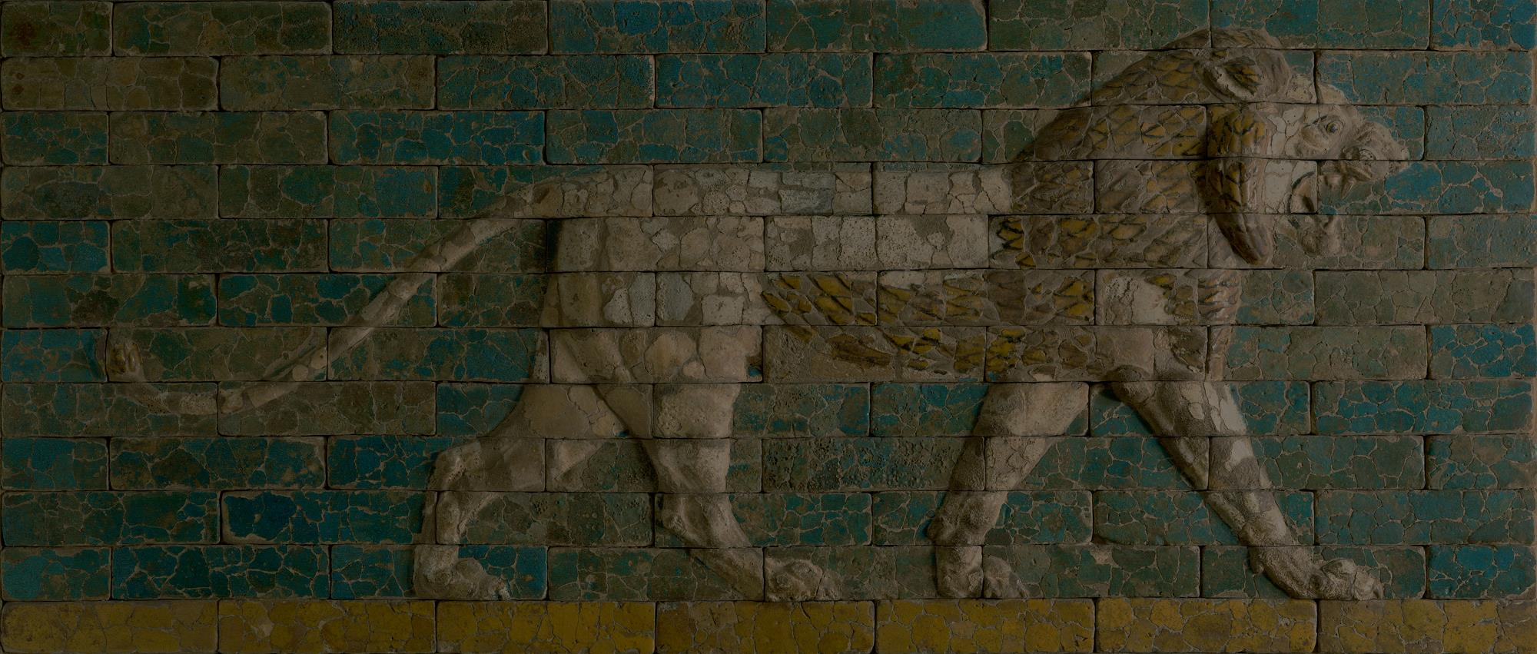
The Writing is on the Wall
Daniel 5

Slide 12
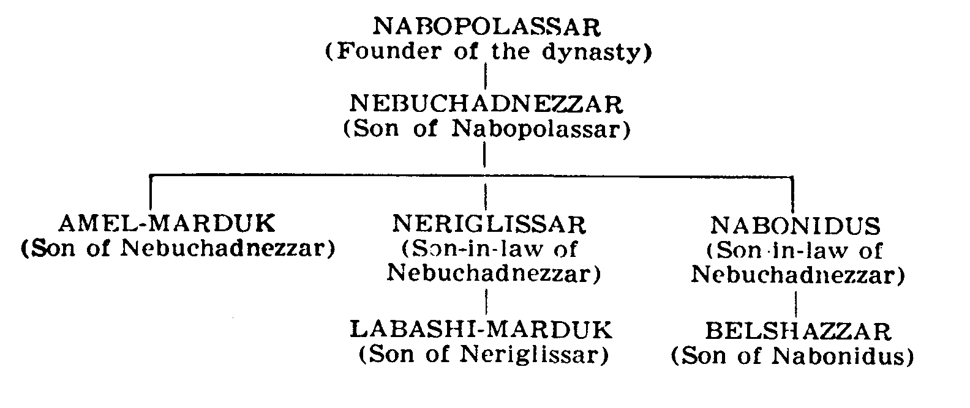

Slide 13
Daniel 5:3–4 (NIV)
³ So they brought in the gold goblets that had been taken from the temple of God in Jerusalem, and the king and his nobles, his wives and his concubines drank from them. ⁴ As they drank the wine, they praised the gods of gold and silver, of bronze, iron, wood and stone.
³ 于是他们把耶路撒冷 神殿库房中所掠的金器皿拿来，王和大臣、皇后、妃嫔就用这器皿饮酒。⁴ 他们饮酒，赞美金、银、铜、铁、木、石所造的神。

Slide 14
Daniel 5:22–24
²² “But you, Belshazzar, his son, have not humbled yourself, though you knew all this. ²³ Instead, you have set yourself up against the Lord of heaven. You had the goblets from his temple brought to you, and you and your nobles, your wives and your concubines drank wine from them. You praised the gods of silver and gold, of bronze, iron, wood and stone, which cannot see or hear or understand. But you did not honor the God who holds in his hand your life and all your ways. ²⁴ Therefore he sent the hand that wrote the inscription.
²² 伯沙撒啊，你是他的儿子，你虽知道这一切，你心仍不自卑，²³ 竟向天上的主自高，使人将他殿中的器皿拿到你面前，你和大臣、皇后、妃嫔用这器皿饮酒。你又赞美那不能看、不能听、无知无识、金、银、铜、铁、木、石所造的神，却没有将荣耀归与那手中有你气息，管理你一切行动的 神。²⁴ 因此从 神那里显出指头来写这文字。

Slide 15
Luke 10:13–14 (NIV)
¹³ “Woe to you, Chorazin! Woe to you, Bethsaida! For if the miracles that were performed in you had been performed in Tyre and Sidon, they would have repented long ago, sitting in sackcloth and ashes. ¹⁴ But it will be more bearable for Tyre and Sidon at the judgment than for you.
¹³ 「哥拉汛哪，你有祸了！伯赛大啊，你有祸了！因为在你们中间所行的异能若行在泰尔、西顿，他们早已披麻蒙灰，坐在地上悔改了。¹⁴ 当审判的日子，泰尔、西顿所受的，比你们还容易受呢！

Slide 16
R.C. Sproul
We hear all the time about God’s infinite grace and mercy. I cringe when I hear it. … I have problems with it because the Bible makes very clear that there is a limit to God’s mercy. There is a limit to his grace, and he is determined not to pour out his mercy on impenitent people forever. There is a time, … that God stops being gracious with people, and he gives them over to their sin.

Slide 17
Isaiah 55:6–7
6 Seek the LORD while he may be found;
call on him while he is near.
7 Let the wicked forsake their ways
and the unrighteous their thoughts.
Let them turn to the LORD, and he will have mercy on them,
and to our God, for he will freely pardon.
⁶ 当趁耶和华可寻找的时候寻找他，
相近的时候求告他。
⁷ 恶人当离弃自己的道路；
不义的人当除掉自己的意念。
归向耶和华，耶和华就必怜恤他；
当归向我们的 神，因为 神必广行赦免。

Slide 18
MN’MN’TKLPRSN
MENE, MENE, TEKEL, PARSIN

