Slide 1
馬太福音 Matthew 21:33-46
³³ 「你們再聽一個比喻：有個家主栽了一個葡萄園，周圍圈上籬笆，裏面挖了一個壓酒池，蓋了一座樓，租給園戶，就往外國去了。³⁴ 收果子的時候近了，就打發僕人到園戶那裏去收果子。
³³ “Listen to another parable: There was a landowner who planted a vineyard. He put a wall around it, dug a winepress in it and built a watchtower. Then he rented the vineyard to some farmers and moved to another place. ³⁴ When the harvest time approached, he sent his servants to the tenants to collect his fruit.

Slide 2
³⁵ 園戶拿住僕人，打了一個，殺了一個，用石頭打死一個。³⁶ 主人又打發別的僕人去，比先前更多；園戶還是照樣待他們。³⁷ 後來打發他的兒子到他們那裏去，意思說：『他們必尊敬我的兒子。』³⁸ 不料，園戶看見他兒子，就彼此說：
³⁵ “The tenants seized his servants; they beat one, killed another, and stoned a third. ³⁶ Then he sent other servants to them, more than the first time, and the tenants treated them the same way. ³⁷ Last of all, he sent his son to them. ‘They will respect my son,’ he said. ³⁸ “But when the tenants saw the son, they said to each other,

Slide 3
『這是承受產業的。來吧，我們殺他，佔他的產業！』³⁹ 他們就拿住他，推出葡萄園外，殺了。⁴⁰ 園主來的時候要怎樣處治這些園戶呢？」⁴¹ 他們說：「要下毒手除滅那些惡人，將葡萄園另租給那按著時候交果子的園戶。」
‘This is the heir. Come, let’s kill him and take his inheritance.’ ³⁹ So they took him and threw him out of the vineyard and killed him. ⁴⁰ “Therefore, when the owner of the vineyard comes, what will he do to those tenants?” ⁴¹ “He will bring those wretches to a wretched end,” they replied, “and he will rent the vineyard to other tenants, who will give him his share of the crop at harvest time.”

Slide 4
⁴² 耶穌說：「經上寫著： 匠人所棄的石頭 已作了房角的頭塊石頭。 這是主所做的， 在我們眼中看為希奇。 這經你們沒有念過嗎？⁴³ 所以我告訴你們，上帝的國必從你們奪去，賜給那能結果子的百姓。⁴⁴ 誰掉在這石頭上，必要跌碎；
⁴² Jesus said to them, “Have you never read in the Scriptures: “ ‘The stone the builders rejected has become the cornerstone; the Lord has done this, and it is marvelous in our eyes’? ⁴³ “Therefore I tell you that the kingdom of God will be taken away from you and given to a people who will produce its fruit. ⁴⁴ Anyone who falls on this stone will be broken to pieces;

Slide 5
這石頭掉在誰的身上，就要把誰砸得稀爛。」⁴⁵ 祭司長和法利賽人聽見他的比喻，就看出他是指著他們說的。⁴⁶ 他們想要捉拿他，只是怕眾人，因為眾人以他為先知。
anyone on whom it falls will be crushed.” ⁴⁵ When the chief priests and the Pharisees heard Jesus’ parables, they knew he was talking about them. ⁴⁶ They looked for a way to arrest him, but they were afraid of the crowd because the people held that he was a prophet.

Slide 6
欠交屋租 Fail to Pay Rent
馬太福音 Matthew 21:33-46

Slide 7
Notes:
https://www.npr.org/sections/thetwo-way/2018/06/01/616092288/30-year-old-leaves-the-nest-after-parents-win-court-ordered-eviction
https://www.npr.org/sections/thetwo-way/2018/05/23/613616315/judge-backs-n-y-parents-saying-their-30-year-old-son-must-move-out

Slide 8
馬太福音 Matthew 21:33
³³ 「你們再聽一個比喻：有個家主栽了一個葡萄園，周圍圈上籬笆，裏面挖了一個壓酒池，蓋了一座樓，租給園戶，就往外國去了。
³³ “Listen to another parable: There was a landowner who planted a vineyard. He put a wall around it, dug a winepress in it and built a watchtower. Then he rented the vineyard to some farmers and moved to another place.

Slide 9
Matthew 21:34–35 ³⁴ 收果子的時候近了，就打發僕人到園戶那裏去收果子。³⁵ 園戶拿住僕人，打了一個，殺了一個，用石頭打死一個。
³⁴ When the harvest time approached, he sent his servants to the tenants to collect his fruit. ³⁵ “The tenants seized his servants; they beat one, killed another, and stoned a third.

Slide 10
1. 租客以為自己是主人 (33-35) Tenant Treats Himself as an Owner

Slide 11
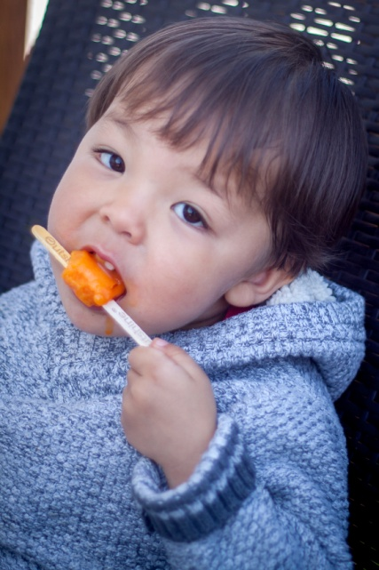
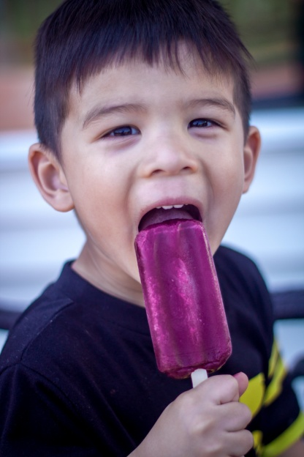
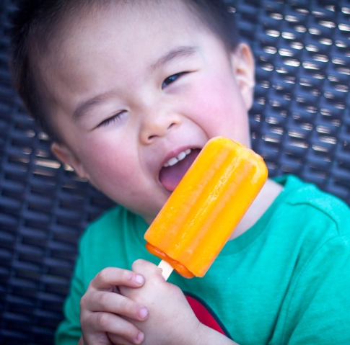

Slide 12
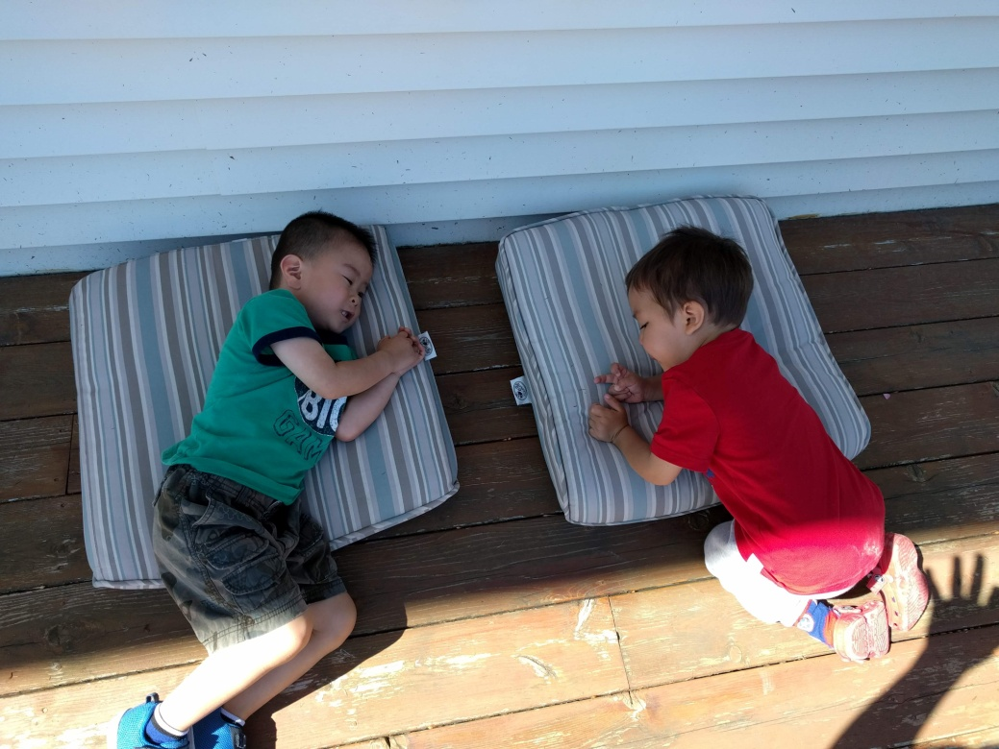

Slide 13
Deuteronomy 6:7 也要殷勤教訓你的兒女。無論你坐在家裏，行在路上，躺下，起來，都要談論。
⁷ Impress them on your children. Talk about them when you sit at home and when you walk along the road, when you lie down and when you get up.
Ephesians 6:4
⁴ 你們作父親的…只要照著主的教訓和警戒養育他們。
⁴ Fathers…bring them up in the training and instruction of the Lord.

Slide 14
Matthew 21:34–36 ³⁴ 收果子的時候近了，就打發僕人到園戶那裏去收果子。³⁵ 園戶拿住僕人，打了一個，殺了一個，用石頭打死一個。³⁶ 主人又打發別的僕人去，比先前更多；園戶還是照樣待他們。
³⁴ When the harvest time approached, he sent his servants to the tenants to collect his fruit. ³⁵ “The tenants seized his servants; they beat one, killed another, and stoned a third. ³⁶ Then he sent other servants to them, more than the first time, and the tenants treated them the same way.

Slide 15
Matthew 21:37–39 ³⁷ 後來打發他的兒子到他們那裏去，意思說：『他們必尊敬我的兒子。』³⁸ 不料，園戶看見他兒子，就彼此說：『這是承受產業的。來吧，我們殺他，佔他的產業！』³⁹ 他們就拿住他，推出葡萄園外，殺了。
³⁷ Last of all, he sent his son to them. ‘They will respect my son,’ he said. ³⁸ “But when the tenants saw the son, they said to each other, ‘This is the heir. Come, let’s kill him and take his inheritance.’ ³⁹ So they took him and threw him out of the vineyard and killed him.

Slide 16
2. 罪人以為可以逍遙法外 (36-38) Sinner Thinks He Can Escape from Judgment

Slide 17
Matthew 21:40–41
⁴⁰ 園主來的時候要怎樣處治這些園戶呢？」⁴¹ 他們說：「要下毒手除滅那些惡人，將葡萄園另租給那按著時候交果子的園戶。」
⁴⁰ “Therefore, when the owner of the vineyard comes, what will he do to those tenants?” ⁴¹ “He will bring those wretches to a wretched end,” they replied, “and he will rent the vineyard to other tenants, who will give him his share of the crop at harvest time.”

Slide 18
Matthew 21:42–43 ⁴² 耶穌說：「經上寫著： 匠人所棄的石頭 已作了房角的頭塊石頭。 這是主所做的， 在我們眼中看為希奇。 這經你們沒有念過嗎？⁴³ 所以我告訴你們，上帝的國必從你們奪去，賜給那能結果子的百姓。
⁴² Jesus said to them, “Have you never read in the Scriptures: “ ‘The stone the builders rejected has become the cornerstone; the Lord has done this, and it is marvelous in our eyes’? ⁴³ “Therefore I tell you that the kingdom of God will be taken away from you and given to a people who will produce its fruit.

Slide 19
Matthew 21:44
⁴⁴ 誰掉在這石頭上，必要跌碎；這石頭掉在誰的身上，就要把誰砸得稀爛。」
⁴⁴ Anyone who falls on this stone will be broken to pieces; anyone on whom it falls will be crushed.”

Slide 20
3. 人當結什麼果子呢？ What Fruit Should I Bear?

Slide 21
星期日 Sun | 凱旋入京/離開耶路撒冷 Triumphal entry/Leave Jerusalem
星期一 Mon | 咒詛無花果樹 Curse the fig tree
 | 潔淨聖殿/離開耶路撒冷 Cleansing the temple/Leave Jerusalem
星期二 Tue | 無花果樹枯乾 The fig tree withered
 | 質問耶穌的權柄 Question Jesus’ authority
 | 耶穌用三個比喻回答 Jesus answers in 3 parable

Slide 22
Matthew 21:45–46
⁴⁵ 祭司長和法利賽人聽見他的比喻，就看出他是指著他們說的。⁴⁶ 他們想要捉拿他，只是怕眾人，因為眾人以他為先知。
⁴⁵ When the chief priests and the Pharisees heard Jesus’ parables, they knew he was talking about them. ⁴⁶ They looked for a way to arrest him, but they were afraid of the crowd because the people held that he was a prophet.

Slide 23
1 Peter 2:6
⁶ 因為經上說： 看哪，我把所揀選、 所寶貴的房角石安放在錫安； 信靠他的人必不至於羞愧。
⁶ For in Scripture it says: “See, I lay a stone in Zion, a chosen and precious cornerstone, and the one who trusts in him will never be put to shame.”

