Slide 1
Daniel 6:13-28
¹³ Then they said to the king, “Daniel, who is one of the exiles from Judah, pays no attention to you, Your Majesty, or to the decree you put in writing. He still prays three times a day.” ¹⁴ When the king heard this, he was greatly distressed; he was determined to rescue Daniel and made every effort until sundown to save him.
¹³ 他们对王说：「王啊，那被掳之犹大人中的但以理不理你，也不遵你盖了玉玺的禁令，他竟一日三次祈祷。」¹⁴ 王听见这话，就甚愁烦，一心要救但以理，筹划解救他，直到日落的时候。

Slide 2
Daniel 6:13-28
¹⁵ Then the men went as a group to King Darius and said to him, “Remember, Your Majesty, that according to the law of the Medes and Persians no decree or edict that the king issues can be changed.”
¹⁶ So the king gave the order, and they brought Daniel and threw him into the lions’ den. The king said to Daniel, “May your God, whom you serve continually, rescue you!”
¹⁵ 那些人就纷纷聚集来见王，说：「王啊，当知道米底亚人和波斯人有例，凡王所立的禁令和律例都不可更改。」
¹⁶ 王下令，人就把但以理带来，扔在狮子坑中。王对但以理说：「你所常事奉的 神，他必救你。」

Slide 3
Daniel 6:13-28
¹⁷ A stone was brought and placed over the mouth of the den, and the king sealed it with his own signet ring and with the rings of his nobles, so that Daniel’s situation might not be changed. ¹⁸ Then the king returned to his palace and spent the night without eating and without any entertainment being brought to him. And he could not sleep.
¹⁹ At the first light of dawn, the king got up and hurried to the lions’ den.
¹⁷ 有人搬石头放在坑口，王用自己的玺和大臣的印，封闭那坑，使惩办但以理的事毫无更改。¹⁸ 王回宫，终夜禁食，无人拿乐器到他面前，并且睡不着觉。
¹⁹ 次日黎明，王就起来，急忙往狮子坑那里去。

Slide 4
Daniel 6:13-28
²⁰ When he came near the den, he called to Daniel in an anguished voice, “Daniel, servant of the living God, has your God, whom you serve continually, been able to rescue you from the lions?”
²¹ Daniel answered, “May the king live forever! ²² My God sent his angel, and he shut the mouths of the lions. They have not hurt me, because I was found innocent in his sight. Nor have I ever done any wrong before you, Your Majesty.”
²⁰ 临近坑边，哀声呼叫但以理，对但以理说：「永生 神的仆人但以理啊，你所常事奉的 神能救你脱离狮子吗？」²¹ 但以理对王说：「愿王万岁！²² 我的 神差遣使者，封住狮子的口，叫狮子不伤我；因我在 神面前无辜，我在王面前也没有行过亏损的事。」

Slide 5
Daniel 6:13-28
²³ The king was overjoyed and gave orders to lift Daniel out of the den. And when Daniel was lifted from the den, no wound was found on him, because he had trusted in his God.
²⁴ At the king’s command, the men who had falsely accused Daniel were brought in and thrown into the lions’ den, along with their wives and children. And before they reached the floor of the den, the lions overpowered them and crushed all their bones.
²³ 王就甚喜乐，吩咐人将但以理从坑里系上来。于是但以理从坑里被系上来，身上毫无伤损，因为信靠他的 神。²⁴ 王下令，人就把那些控告但以理的人，连他们的妻子儿女都带来，扔在狮子坑中。他们还没有到坑底，狮子就抓住他们，咬碎他们的骨头。

Slide 6
Daniel 6:13-28
²⁵ Then King Darius wrote to all the nations and peoples of every language in all the earth:
“May you prosper greatly!
²⁶ “I issue a decree that in every part of my kingdom people must fear and reverence the God of Daniel.
²⁵ 那时，大流士王传旨，晓谕住在全地各方、各国、各族的人说：「愿你们大享平安！²⁶ 现在我降旨晓谕我所统辖的全国人民，要在但以理的 神面前，战兢恐惧。
。

Slide 7
Daniel 6:13-28
“For he is the living God
and he endures forever;
his kingdom will not be destroyed,
his dominion will never end.
²⁷ He rescues and he saves;
he performs signs and wonders
in the heavens and on the earth.
He has rescued Daniel
from the power of the lions.”
²⁸ So Daniel prospered during the reign of Darius and the reign of Cyrus the Persian.
因为他是永远长存的活 神，
他的国永不败坏；
他的权柄永存无极！
²⁷ 他护庇人，搭救人，
在天上地下施行神迹奇事，
救了但以理脱离狮子的口。」
²⁸ 如此，这但以理，当大流士王在位的时候和波斯王塞鲁士在位的时候，大享亨通。

Slide 8
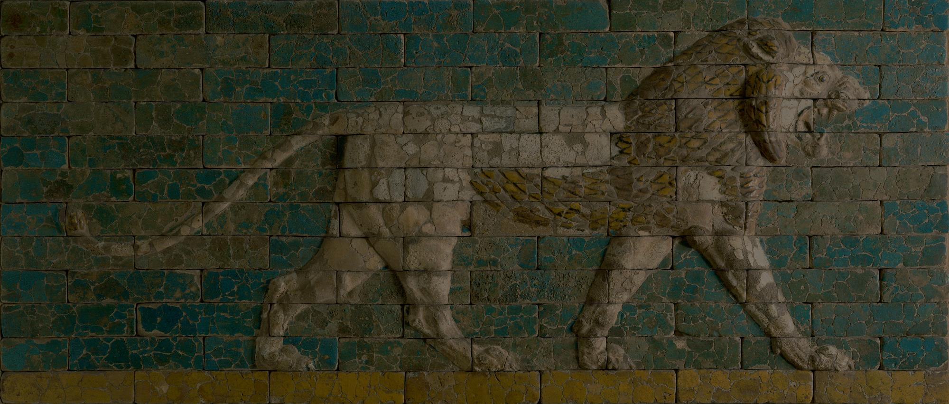
God is Mighty to Save
Daniel 6

Slide 9
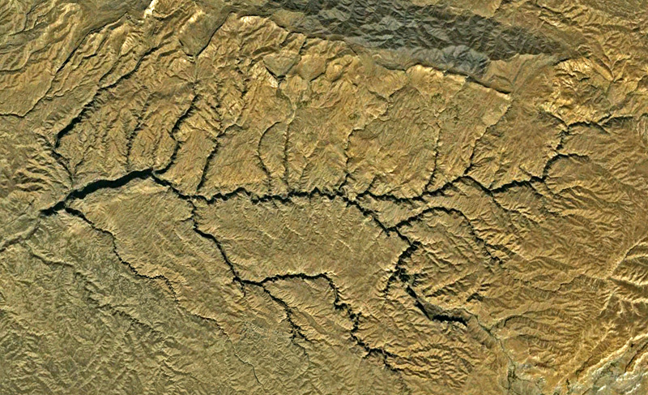

Slide 10
Psalm 78:4–7 (NIV)
⁴ We will not hide them from their descendants;
we will tell the next generation
the praiseworthy deeds of the Lord,
his power, and the wonders he has done.
⁵ He decreed statutes for Jacob
and established the law in Israel,
which he commanded our ancestors
to teach their children,
⁶ so the next generation would know them,
even the children yet to be born,
and they in turn would tell their children.
⁷ Then they would put their trust in God
and would not forget his deeds
but would keep his commands.
⁴ 我们不将这些事向他们的子孙隐瞒，
要将耶和华的美德和他的能力，
并他奇妙的作为，述说给后代听。
⁵ 因为，他在雅各中立法度，
在以色列中设律法；
是他吩咐我们祖宗要传给子孙的，
⁶ 使将要生的后代子孙可以晓得；
他们也要起来告诉他们的子孙，
⁷ 好叫他们仰望 神，
不忘记 神的作为，
惟要守他的命令。

Slide 11
1 Peter 3:13–15a
¹³ Who is going to harm you if you are eager to do good? ¹⁴ But even if you should suffer for what is right, you are blessed. “Do not fear their threats; do not be frightened.” ¹⁵ But in your hearts revere Christ as Lord.
¹³ 你们若是热心行善，有谁害你们呢？¹⁴ 你们就是为义受苦，也是有福的。不要怕人的威吓，也不要惊慌；¹⁵ 只要心里尊主基督为圣。

Slide 12
“As the chapter explores this conflict, it again emphasizes the overarching theme of the whole book: In spite of present appearances God is in control. God will be victorious over the seemingly powerful forces ranged against him and his people. Thus, this story, like those that preceded it, provides comfort for God’s people, who find themselves in situations that seem beyond their control.”
Tremper Longman III

Slide 13
2 Peter 3:8-10
⁸ But do not forget this one thing, dear friends: With the Lord a day is like a thousand years, and a thousand years are like a day. ⁹ The Lord is not slow in keeping his promise, as some understand slowness. Instead he is patient with you, not wanting anyone to perish, but everyone to come to repentance. ¹⁰ But the day of the Lord will come like a thief. The heavens will disappear with a roar; the elements will be destroyed by fire, and the earth and everything done in it will be laid bare.
⁸ 亲爱的弟兄啊，有一件事你们不可忘记，就是主看一日如千年，千年如一日。⁹ 主所应许的尚未成就，有人以为他是耽延，其实不是耽延，乃是宽容你们，不愿有一人沉沦，乃愿人人都悔改。¹⁰ 但主的日子要像贼来到一样。那日，天必大有响声废去，有形质的都要被烈火销化，地和其上的物都要烧尽了。

Slide 14
Matthew 10:39 (NIV)
³⁹ Whoever finds their life will lose it, and whoever loses their life for my sake will find it.
³⁹ 得着生命的，将要失丧生命；为我失丧生命的，将要得着生命。」

