Slide 1
馬太福音 Matthew 23:37-24:3
³⁷ 「耶路撒冷啊，耶路撒冷啊，你常殺害先知，又用石頭打死那奉差遣到你這裏來的人。我多次願意聚集你的兒女，好像母雞把小雞聚集在翅膀底下，只是你們不願意。³⁸ 看哪，你們的家成為荒場留給你們。
³⁷ “Jerusalem, Jerusalem, you who kill the prophets and stone those sent to you, how often I have longed to gather your children together, as a hen gathers her chicks under her wings, and you were not willing. ³⁸ Look, your house is left to you desolate.

Slide 2
³⁹ 我告訴你們，從今以後，你們不得再見我，直等到你們說：『奉主名來的是應當稱頌的。』」 ¹ 耶穌出了聖殿，正走的時候，門徒進前來，把殿宇指給他看。² 耶穌對他們說：「你們不是看見這殿宇嗎？
³⁹ For I tell you, you will not see me again until you say, ‘Blessed is he who comes in the name of the Lord.’” ¹ Jesus left the temple and was walking away when his disciples came up to him to call his attention to its buildings. ² “Do you see all these things?” he asked.

Slide 3
我實在告訴你們，將來在這裏沒有一塊石頭留在石頭上，不被拆毀了。」 ³ 耶穌在橄欖山上坐著，門徒暗暗地來說：「請告訴我們，甚麼時候有這些事？你降臨和世界的末了有甚麼預兆呢？」
“Truly I tell you, not one stone here will be left on another; every one will be thrown down.” ³ As Jesus was sitting on the Mount of Olives, the disciples came to him privately. “Tell us,” they said, “when will this happen, and what will be the sign of your coming and of the end of the age?”

Slide 4
必定要去的地方 A Place You Must Visit
馬太福音 Matthew 23:39-24:3

Slide 6
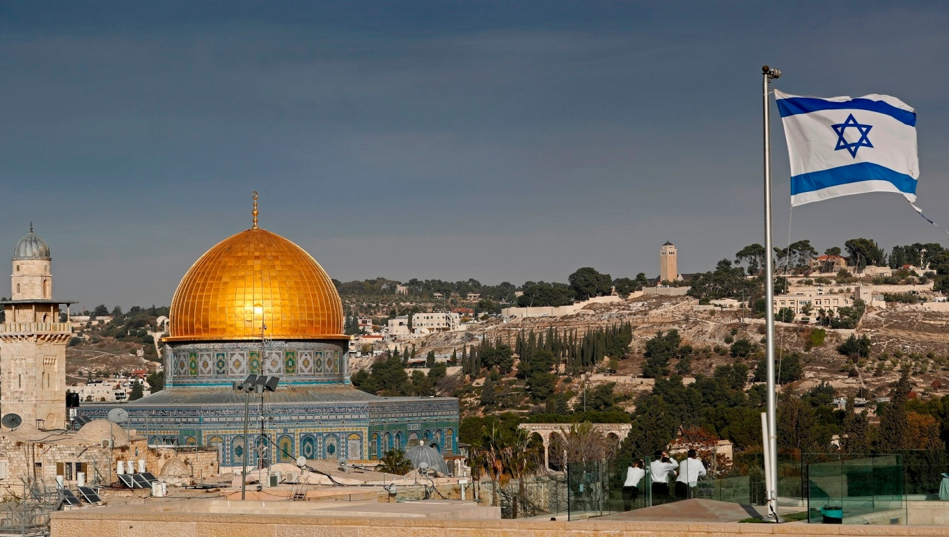
耶路撒冷 Jerusalem

Slide 7
1.耶路撒冷的重要性 (23:37-24:3) The Importance of Jerusalem
Matthew 23:37 ³⁷ 「耶路撒冷啊，耶路撒冷啊，你常殺害先知，又用石頭打死那奉差遣到你這裏來的人。我多次願意聚集你的兒女，好像母雞把小雞聚集在翅膀底下，只是你們不願意。
³⁷ “Jerusalem, Jerusalem, you who kill the prophets and stone those sent to you, how often I have longed to gather your children together, as a hen gathers her chicks under her wings, and you were not willing.

Slide 8
Matthew 23:38
³⁸ 看哪，你們的家成為荒場留給你們。
³⁸ Look, your house is left to you desolate.

Slide 9
Matthew 23:39
³⁹ 我告訴你們，從今以後，你們不得再見我，直等到你們說：『奉主名來的是應當稱頌的。』」
³⁹ For I tell you, you will not see me again until you say, ‘Blessed is he who comes in the name of the Lord.’”

Slide 10
Matthew 24:1-2
¹ 耶穌出了聖殿，正走的時候，門徒進前來，把殿宇指給他看。 ² 耶穌對他們說：「你們不是看見這殿宇嗎？我實在告訴你們，將來在這裏沒有一塊石頭留在石頭上，不被拆毀了。」
¹ Jesus left the temple and was walking away when his disciples came up to him to call his attention to its buildings. ² “Do you see all these things?” he asked. “Truly I tell you, not one stone here will be left on another; every one will be thrown down.”

Slide 11
Matthew 24:3 ³ 耶穌在橄欖山上坐著，門徒暗暗地來說：「請告訴我們，甚麼時候有這些事？你降臨和世界的末了有甚麼預兆呢？」
³ As Jesus was sitting on the Mount of Olives, the disciples came to him privately. “Tell us,” they said, “when will this happen, and what will be the sign of your coming and of the end of the age?”

Slide 12
2. 耶路撒冷的過去、現在與將來 The Past, Present and Future of Jerusalem (Ezek 16)
由棄嬰到皇后 From an abandoned baby to a queen
由皇后到妓女 From a queen to a prostitute
由妓女到寡婦 From a prostitute to a widow
由寡婦到新娘 From a widow to a bride

Slide 13
2a. 由棄嬰到皇后 (Ezek 16:1-14) From an abandoned baby to a queen
Ezekiel 16:3–5 ³ 說主耶和華對耶路撒冷如此說：你根本，你出世，是在迦南地；你父親是亞摩利人，你母親是赫人。
³ and say, ‘This is what the Sovereign Lord says to Jerusalem: Your ancestry and birth were in the land of the Canaanites; your father was an Amorite and your mother a Hittite.

Slide 14
⁴ 論到你出世的景況，… ⁵ 誰的眼也不可憐你，為你做一件這樣的事憐恤你；但你初生的日子扔在田野，是因你被厭惡。
⁴ On the day you were born … ⁵ No one looked on you with pity or had compassion enough to do any of these things for you. Rather, you were thrown out into the open field, for on the day you were born you were despised.

Slide 15
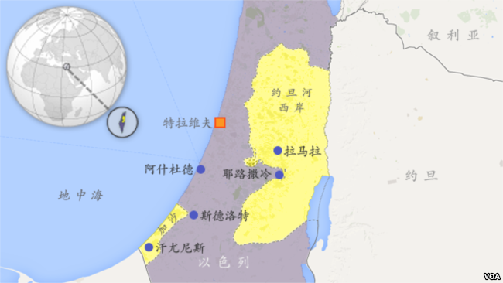
Jerusalem

Slide 16
Ezekiel 16:6
⁶ 「我從你旁邊經過，見你滾在血中，就對你說：你雖在血中，仍可存活；你雖在血中，仍可存活。
⁶ “ ‘Then I passed by and saw you kicking about in your blood, and as you lay there in your blood I said to you, “Live!”

Slide 17
Ezekiel 16:8
⁸ 「我從你旁邊經過，看見你的時候正動愛情，便用衣襟搭在你身上，遮蓋你的赤體；又向你起誓，與你結盟，你就歸於我。這是主耶和華說的。
⁸ “ ‘Later I passed by, and when I looked at you and saw that you were old enough for love, I spread the corner of my garment over you and covered your naked body. I gave you my solemn oath and entered into a covenant with you, declares the Sovereign Lord, and you became mine.

Slide 18
Ezekiel 16:13–14¹³ 這樣，你就有金銀的妝飾，穿的是細麻衣和絲綢，並繡花衣；… 你也極其美貌，發達到王后的尊榮。¹⁴ 你美貌的名聲傳在列邦中，你十分美貌，是因我加在你身上的威榮。這是主耶和華說的。
¹³ So you were adorned with gold and silver; your clothes were of fine linen and costly fabric and embroidered cloth... You became very beautiful and rose to be a queen. ¹⁴ And your fame spread among the nations on account of your beauty, because the splendor I had given you made your beauty perfect, declares the Sovereign Lord.

Slide 19
2 Chronicles 6:5–6 ⁵ 他說：『自從我領我民出埃及地以來，我未曾在以色列眾支派中選擇一城建造殿宇為我名的居所，也未曾揀選一人作我民以色列的君；⁶ 但選擇耶路撒冷為我名的居所，又揀選大衛治理我民以色列。』」
⁵ ‘Since the day I brought my people out of Egypt, I have not chosen a city in any tribe of Israel to have a temple built so that my Name might be there, nor have I chosen anyone to be ruler over my people Israel. ⁶ But now I have chosen Jerusalem for my Name to be there, and I have chosen David to rule my people Israel.’

Slide 20
2b. 由皇后到妓女 (Ezek 16:15-34) From a queen to a prostitute
Ezekiel 16:15
¹⁵ 「只是你仗著自己的美貌，又因你的名聲就行邪淫。你縱情淫亂，使過路的任意而行。
¹⁵ “ ‘But you trusted in your beauty and used your fame to become a prostitute. You lavished your favors on anyone who passed by and your beauty became his.

Slide 21
Ezekiel 16:22
²² 你行這一切可憎和淫亂的事，並未追念你幼年赤身露體滾在血中的日子。」
²² In all your detestable practices and your prostitution you did not remember the days of your youth, when you were naked and bare, kicking about in your blood.

Slide 22
Ezekiel 16:32–33
³² 哎！你這行淫的妻啊，寧肯接外人，不接丈夫。³³ 凡妓女是得人贈送，你反倒贈送你所愛的人，賄賂他們從四圍來與你行淫。
³² “ ‘You adulterous wife! You prefer strangers to your own husband! ³³ All prostitutes receive gifts, but you give gifts to all your lovers, bribing them to come to you from everywhere for your illicit favors.

Slide 23
2c. 由妓女到寡婦 (Ezek 16:35-59) From a prostitute to a widow
Ezekiel 16:37 ³⁷ 我就要將你一切相歡相愛的和你一切所恨的都聚集來，從四圍攻擊你；又將你的下體露出，使他們看盡了。
³⁷ therefore I am going to gather all your lovers, with whom you found pleasure, those you loved as well as those you hated. I will gather them against you from all around and will strip you in front of them, and they will see you stark naked.

Slide 24
Ezekiel 16:39–41 ³⁹ 我又要將你交在他們手中；他們必拆毀你的圓頂花樓，毀壞你的高臺，剝去你的衣服，奪取你的華美寶器，留下你赤身露體。⁴⁰ 他們也必帶多人來攻擊你，用石頭打死你，用刀劍刺透你，⁴¹ 用火焚燒你的房屋…。
³⁹ Then I will deliver you into the hands of your lovers, … They will strip you of your clothes and take your fine jewelry and leave you stark naked. ⁴⁰ They will bring a mob against you, who will stone you and hack you to pieces with their swords. ⁴¹ They will burn down your houses ...

Slide 25
Matthew 24:1-2
¹ 耶穌出了聖殿，正走的時候，門徒進前來，把殿宇指給他看。 ² 耶穌對他們說：「你們不是看見這殿宇嗎？我實在告訴你們，將來在這裏沒有一塊石頭留在石頭上，不被拆毀了。」
¹ Jesus left the temple and was walking away when his disciples came up to him to call his attention to its buildings. ² “Do you see all these things?” he asked. “Truly I tell you, not one stone here will be left on another; every one will be thrown down.”

Slide 26
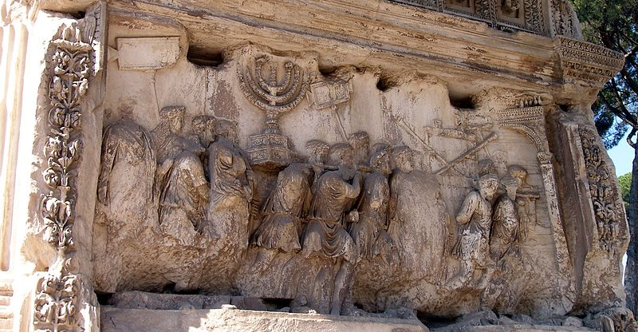
提多凱旋門 Arc of Titus

Slide 27
2d.由寡婦到新娘 (Ezek 16:60-63) From a widow to a bride
Ezekiel 16:60
⁶⁰ 然而我要追念在你幼年時與你所立的約，也要與你立定永約。
⁶⁰ Yet I will remember the covenant I made with you in the days of your youth, and I will establish an everlasting covenant with you.

Slide 28
2d.由寡婦到新娘 (Ezek 16:60-63) From a widow to a bride
Ezekiel 16:62–63 ⁶² 我要堅定與你所立的約（你就知道我是耶和華），⁶³ 好使你在我赦免你一切所行的時候，心裏追念，自覺抱愧，又因你的羞辱就不再開口。這是主耶和華說的。」
⁶² So I will establish my covenant with you, and you will know that I am the Lord. ⁶³ Then, when I make atonement for you for all you have done, you will remember and be ashamed and never again open your mouth because of your humiliation, declares the Sovereign Lord.’ ”

Slide 29
Zechariah 14:1–2 ¹ 耶和華的日子臨近，你的財物必被搶掠，在你中間分散。² 因為我必聚集萬國與耶路撒冷爭戰，城必被攻取，房屋被搶奪，婦女被玷污，城中的民一半被擄去；剩下的民仍在城中，不致剪除。
¹ A day of the Lord is coming, Jerusalem, when your possessions will be plundered and divided up within your very walls. ² I will gather all the nations to Jerusalem to fight against it; the city will be captured, the houses ransacked, and the women raped. Half of the city will go into exile, but the rest of the people will not be taken from the city.

Slide 30
Zechariah 14:3
³ 那時，耶和華必出去與那些國爭戰，好像從前爭戰一樣。
³ Then the Lord will go out and fight against those nations, as he fights on a day of battle.

Slide 31
Zechariah 12:10 ¹⁰ 「我必將那施恩叫人懇求的靈，澆灌大衛家和耶路撒冷的居民。他們必仰望我，就是他們所扎的；必為我悲哀，如喪獨生子，又為我愁苦，如喪長子。
¹⁰ “And I will pour out on the house of David and the inhabitants of Jerusalem a spirit of grace and supplication. They will look on me, the one they have pierced, and they will mourn for him as one mourns for an only child, and grieve bitterly for him as one grieves for a firstborn son.

Slide 32
Matthew 23:39
³⁹ 我告訴你們，從今以後，你們不得再見我，直等到你們說：『奉主名來的是應當稱頌的。』」
³⁹ For I tell you, you will not see me again until you say, ‘Blessed is he who comes in the name of the Lord.’”

Slide 33
Zechariah 14:4
⁴ 那日，他的腳必站在耶路撒冷前面朝東的橄欖山上。這山必從中間分裂，自東至西成為極大的谷。山的一半向北挪移，一半向南挪移。
⁴ On that day his feet will stand on the Mount of Olives, east of Jerusalem, and the Mount of Olives will be split in two from east to west, forming a great valley, with half of the mountain moving north and half moving south.

Slide 34
Zechariah 14:5
⁵ 你們要從我山的谷中逃跑，因為山谷必延到亞薩。你們逃跑，必如猶大王烏西雅年間的人逃避大地震一樣。耶和華－我的上帝必降臨，有一切聖者同來。
⁵ You will flee by my mountain valley, for it will extend to Azel. You will flee as you fled from the earthquake in the days of Uzziah king of Judah. Then the Lord my God will come, and all the holy ones with him.

Slide 35
Revelation 21:2–4 ² 我又看見聖城新耶路撒冷由上帝那裏從天而降，預備好了，就如新婦妝飾整齊，等候丈夫。³ 我聽見有大聲音從寶座出來說：「看哪，上帝的帳幕在人間。他要與人同住，他們要作他的子民。上帝要親自與他們同在，作他們的上帝。
² I saw the Holy City, the new Jerusalem, coming down out of heaven from God, prepared as a bride beautifully dressed for her husband. ³ And I heard a loud voice from the throne saying, “Look! God’s dwelling place is now among the people, and he will dwell with them. They will be his people, and God himself will be with them and be their God.

Slide 36
Revelation 21:9
⁹ 拿著七個金碗、盛滿末後七災的七位天使中，有一位來對我說：「你到這裏來，我要將新婦，就是羔羊的妻，指給你看。」
⁹ One of the seven angels who had the seven bowls full of the seven last plagues came and said to me, “Come, I will show you the bride, the wife of the Lamb.”

Slide 37
⁴ 上帝要擦去他們一切的眼淚；不再有死亡，也不再有悲哀、哭號、疼痛，因為以前的事都過去了。」
⁴ ‘He will wipe every tear from their eyes. There will be no more death’ or mourning or crying or pain, for the old order of things has passed away.”

Slide 38
Revelation 21:6–7 ⁶ … 我要將生命泉的水白白賜給那口渴的人喝。⁷ 得勝的，必承受這些為業：我要作他的上帝，他要作我的兒子。
⁶ …To the thirsty I will give water without cost from the spring of the water of life. ⁷ Those who are victorious will inherit all this, and I will be their God and they will be my children.

Slide 39
Revelation 21:8
⁸ 惟有膽怯的、不信的、可憎的、殺人的、淫亂的、行邪術的、拜偶像的，和一切說謊話的，他們的分就在燒著硫磺的火湖裏；這是第二次的死。」
⁸ But the cowardly, the unbelieving, the vile, the murderers, the sexually immoral, those who practice magic arts, the idolaters and all liars—they will be consigned to the fiery lake of burning sulfur. This is the second death.”

Slide 40
Revelation 21:6–7 ⁶ … 我要將生命泉的水白白賜給那口渴的人喝。⁷ 得勝的，必承受這些為業：我要作他的上帝，他要作我的兒子。
⁶ …To the thirsty I will give water without cost from the spring of the water of life. ⁷ Those who are victorious will inherit all this, and I will be their God and they will be my children.

