Slide 1
Daniel 8:3-14
In the first year of Darius son of Xerxes (a Mede by descent), who was made ruler over the Babylonian kingdom— ² in the first year of his reign, I, Daniel, understood from the Scriptures, according to the word of the Lord given to Jeremiah the prophet, that the desolation of Jerusalem would last seventy years. ³ So I turned to the Lord God and pleaded with him in prayer and petition, in fasting, and in sackcloth and ashes.
玛代族亚哈随鲁的儿子大流士立为迦勒底国的王元年， ² 就是他在位第一年，我但以理从书上得知耶和华的话临到先知耶利米，论耶路撒冷荒凉的年数，七十年为满。
³ 我便禁食，披麻蒙灰，定意向主神祈祷恳求。

Slide 2
Daniel 8:3-14
⁴ I prayed to the Lord my God and confessed:
“Lord, the great and awesome God, who keeps his covenant of love with those who love him and keep his commandments, ⁵ we have sinned and done wrong. We have been wicked and have rebelled; we have turned away from your commands and laws. ⁶ We have not listened to your servants the prophets, who spoke in your name to our kings, our princes and our ancestors, and to all the people of the land.
⁴ 我向耶和华我的神祈祷、认罪，说：“主啊，大而可畏的神，向爱主守主诫命的人守约施慈爱。 ⁵ 我们犯罪作孽，行恶叛逆，偏离你的诫命、典， ⁶ 没有听从你仆人众先知奉你名向我们君王、首领、列祖和国中一切百姓所说的话。

Slide 3
Daniel 8:3-14
⁷ “Lord, you are righteous, but this day we are covered with shame—the people of Judah and the inhabitants of Jerusalem and all Israel, both near and far, in all the countries where you have scattered us because of our unfaithfulness to you. ⁸ We and our kings, our princes and our ancestors are covered with shame, Lord, because we have sinned against you. ⁹ The Lord our God is merciful and forgiving, even though we have rebelled against him;
⁷ 主啊，你是公义的，我们是脸上蒙羞的，因我们犹大人和耶路撒冷的居民，并以色列众人——或在近处或在远处被你赶到各国的人，都得罪了你，正如今日一样。 ⁸ 主啊，我们和我们的君王、首领、列祖因得罪了你，就都脸上蒙羞。 ⁹ 主我们的神是怜悯饶恕人的，我们却违背了他，

Slide 4
Daniel 8:3-14
¹⁰ we have not obeyed the Lord our God or kept the laws he gave us through his servants the prophets. ¹¹ All Israel has transgressed your law and turned away, refusing to obey you. “Therefore the curses and sworn judgments written in the Law of Moses, the servant of God, have been poured out on us, because we have sinned against you. ¹² You have fulfilled the words spoken against us and against our rulers by bringing on us great disaster. Under the whole heaven nothing has ever been done like what has been done to Jerusalem.
¹⁰ 也没有听从耶和华我们神的话，没有遵行他借仆人众先知向我们所陈明的律法。 ¹¹ 以色列众人都犯了你的律法，偏行，不听从你的话，因此在你仆人摩西律法上所写的咒诅和誓言都倾在我们身上，因我们得罪了神。 ¹² 他使大灾祸临到我们，成就了警戒我们和审判我们官长的话。原来在普天之下，未曾行过像在耶路撒冷所行的。

Slide 5
Daniel 8:3-14
¹³ Just as it is written in the Law of Moses, all this disaster has come on us, yet we have not sought the favor of the Lord our God by turning from our sins and giving attention to your truth. ¹⁴ The Lord did not hesitate to bring the disaster on us, for the Lord our God is righteous in everything he does; yet we have not obeyed him.
¹³ 这一切灾祸临到我们身上，是照摩西律法上所写的，我们却没有求耶和华我们神的恩典，使我们回头离开罪孽，明白你的真理。 ¹⁴ 所以耶和华留意使这灾祸临到我们身上，因为耶和华我们的神在他所行的事上都是公义，我们并没有听从他的话。

Slide 6
Daniel 8:3-14
¹⁵ “Now, Lord our God, who brought your people out of Egypt with a mighty hand and who made for yourself a name that endures to this day, we have sinned, we have done wrong. ¹⁶ Lord, in keeping with all your righteous acts, turn away your anger and your wrath from Jerusalem, your city, your holy hill. Our sins and the iniquities of our ancestors have made Jerusalem and your people an object of scorn to all those around us.
¹⁵ 主我们的神啊，你曾用大能的手领你的子民出埃及地，使自己得了名，正如今日一样。我们犯了罪，作了恶。
¹⁶ “主啊，求你按你的大仁大义，使你的怒气和愤怒转离你的城耶路撒冷，就是你的圣山。耶路撒冷和你的子民，因我们的罪恶和我们列祖的罪孽被四围的人羞辱。

Slide 7
Daniel 8:3-14
¹⁷ “Now, our God, hear the prayers and petitions of your servant. For your sake, Lord, look with favor on your desolate sanctuary. ¹⁸ Give ear, our God, and hear; open your eyes and see the desolation of the city that bears your Name. We do not make requests of you because we are righteous, but because of your great mercy. ¹⁹ Lord, listen! Lord, forgive! Lord, hear and act! For your sake, my God, do not delay, because your city and your people bear your Name.”
¹⁷ 我们的神啊，现在求你垂听仆人的祈祷恳求，为自己使脸光照你荒凉的圣所。 ¹⁸ 我的神啊，求你侧耳而听，睁眼而看，眷顾我们荒凉之地和称为你名下的城。我们在你面前恳求，原不是因自己的义，乃因你的大怜悯。 ¹⁹ 求主垂听，求主赦免，求主应允而行，为你自己不要迟延，我的神啊，因这城和这民都是称为你名下的。”

Slide 8
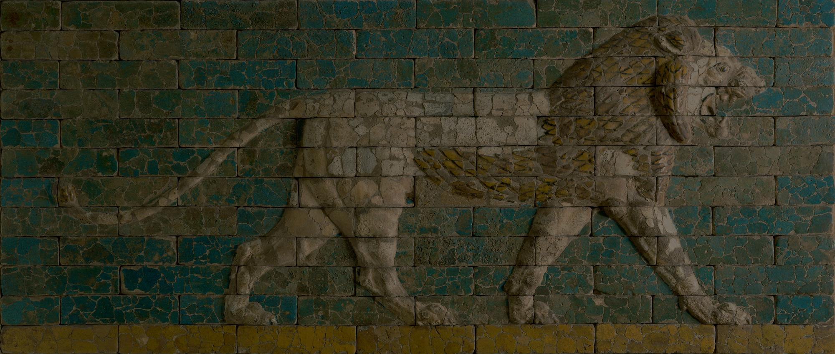
A Prayer of Confession
Daniel 9:1-19

Slide 9
Exodus 19:3–6
³ Then Moses went up to God, and the Lord called to him from the mountain and said, “This is what you are to say to the descendants of Jacob and what you are to tell the people of Israel: ⁴ ‘You yourselves have seen what I did to Egypt, and how I carried you on eagles’ wings and brought you to myself. ⁵ Now if you obey me fully and keep my covenant, then out of all nations you will be my treasured possession. Although the whole earth is mine, ⁶ you will be for me a kingdom of priests and a holy nation.’ These are the words you are to speak to the Israelites.”

Slide 10
Exodus 19:3–6
³ 摩西到神那里，耶和华从山上呼唤他说：“你要这样告诉雅各家，晓谕以色列人说： ⁴ 我向埃及人所行的事，你们都看见了；且看见我如鹰将你们背在翅膀上，带来归我。 ⁵ 如今你们若实在听从我的话，遵守我的约，就要在万民中做属我的子民，因为全地都是我的。 ⁶ 你们要归我做祭司的国度，为圣洁的国民。这些话你要告诉以色列人。

Slide 11
contracts are limited by the terms of the exchange of property (“this is yours, that is mine”), while covenants involve an exchange of life (“I am yours, you are mine”)
Scott Hahn, “Covenant,” ed. John D. Barry et al., The Lexham Bible Dictionary (Bellingham, WA: Lexham Press, 2016).

Slide 12
Deuteronomy 28:1–6
If you fully obey the Lord your God and carefully follow all his commands I give you today, the Lord your God will set you high above all the nations on earth. ² All these blessings will come on you and accompany you if you obey the Lord your God:
³ You will be blessed in the city and blessed in the country.
⁴ The fruit of your womb will be blessed, and the crops of your land and the young of your livestock—the calves of your herds and the lambs of your flocks.
⁵ Your basket and your kneading trough will be blessed.
⁶ You will be blessed when you come in and blessed when you go out.

Slide 13
Deuteronomy 28:1–6
“你若留意听从耶和华你神的话，谨守遵行他的一切诫命，就是我今日所吩咐你的，他必使你超乎天下万民之上。 ² 你若听从耶和华你神的话，这以下的福必追随你，临到你身上。 ³ 你在城里必蒙福，在田间也必蒙福。 ⁴ 你身所生的，地所产的，牲畜所下的，以及牛犊、羊羔，都必蒙福。 ⁵ 你的筐子和你的抟面盆都必蒙福。 ⁶ 你出也蒙福，入也蒙福。

Slide 14
Deut 28:15-19
¹⁵ However, if you do not obey the Lord your God and do not carefully follow all his commands and decrees I am giving you today, all these curses will come on you and overtake you:
¹⁶ You will be cursed in the city and cursed in the country.
¹⁷ Your basket and your kneading trough will be cursed.
¹⁸ The fruit of your womb will be cursed, and the crops of your land, and the calves of your herds and the lambs of your flocks.
¹⁹ You will be cursed when you come in and cursed when you go out.

Slide 15
Deut 28:15-19
¹⁵ “你若不听从耶和华你神的话，不谨守遵行他的一切诫命、律例，就是我今日所吩咐你的，这以下的咒诅都必追随你，临到你身上。 ¹⁶ 你在城里必受咒诅，在田间也必受咒诅。 ¹⁷ 你的筐子和你的抟面盆都必受咒诅。 ¹⁸ 你身所生的，地所产的，以及牛犊、羊羔，都必受咒诅。¹⁹ 你出也受咒诅，入也受咒诅。

Slide 16
Jeremiah 29:10-14
¹⁰ This is what the Lord says: “When seventy years are completed for Babylon, I will come to you and fulfill my good promise to bring you back to this place. ¹¹ For I know the plans I have for you,” declares the Lord, “plans to prosper you and not to harm you, plans to give you hope and a future. ¹² Then you will call on me and come and pray to me, and I will listen to you. ¹³ You will seek me and find me when you seek me with all your heart. ¹⁴ I will be found by you,” declares the Lord, “and will bring you back from captivity. I will gather you from all the nations and places where I have banished you,” declares the Lord, “and will bring you back to the place from which I carried you into exile.”

Slide 17
Jeremiah 29:10-14
¹⁰ “耶和华如此说：为巴比伦所定的七十年满了以后，我要眷顾你们，向你们成就我的恩言，使你们仍回此地。 ¹¹ 耶和华说：我知道我向你们所怀的意念是赐平安的意念，不是降灾祸的意念，要叫你们末后有指望。 ¹² 你们要呼求我，祷告我，我就应允你们。 ¹³ 你们寻求我，若专心寻求我，就必寻见。 ¹⁴ 耶和华说：我必被你们寻见，我也必使你们被掳的人归回，将你们从各国中和我所赶你们到的各处招聚了来，又将你们带回我使你们被掳掠离开的地方。这是耶和华说的。

Slide 18
1 John 1:9–10
⁹ If we confess our sins, he is faithful and just and will forgive us our sins and purify us from all unrighteousness. ¹⁰ If we claim we have not sinned, we make him out to be a liar and his word is not in us.
⁹ 我们若认自己的罪，神是信实的，是公义的，必要赦免我们的罪，洗净我们一切的不义。 ¹⁰ 我们若说自己没有犯过罪，便是以神为说谎的，他的道也不在我们心里了。

Slide 19
Daniel 9:19
¹⁹ Lord, listen! Lord, forgive! Lord, hear and act! For your sake, my God, do not delay, because your city and your people bear your Name.”
¹⁹ 求主垂听，求主赦免，求主应允而行，为你自己不要迟延，我的神啊，因这城和这民都是称为你名下的。”

