Slide 1
馬太福音 Matthew 26:17-30
¹⁷ 除酵節的第一天，門徒來問耶穌說：「你吃逾越節的筵席，要我們在哪裏給你預備？」¹⁸ 耶穌說：「你們進城去，到某人那裏，對他說：『夫子說：我的時候快到了，我與門徒要
¹⁷ On the first day of the Festival of Unleavened Bread, the disciples came to Jesus and asked, “Where do you want us to make preparations for you to eat the Passover?” ¹⁸ He replied, “Go into the city to a certain man and tell him, ‘The Teacher says: My appointed time is near. I am going to celebrate the Passover with my

Slide 2
在你家裏守逾越節。』」¹⁹ 門徒遵著耶穌所吩咐的就去預備了逾越節的筵席。²⁰ 到了晚上，耶穌和十二個門徒坐席。²¹ 正吃的時候，耶穌說：「我實在告訴你們，你們中間有一個人要賣我了。」²² 他們就甚憂愁，
disciples at your house.’ ” ¹⁹ So the disciples did as Jesus had directed them and prepared the Passover. ²⁰ When evening came, Jesus was reclining at the table with the Twelve. ²¹ And while they were eating, he said, “Truly I tell you, one of you will betray me.” ²² They were very sad

Slide 3
一個一個地問他說：「主，是我嗎？」²³ 耶穌回答說：「同我蘸手在盤子裏的，就是他要賣我。²⁴ 人子必要去世，正如經上指著他所寫的；但賣人子的人有禍了！那人不生在世上倒好。」²⁵ 賣耶穌的猶大問他說：
and began to say to him one after the other, “Surely you don’t mean me, Lord?” ²³ Jesus replied, “The one who has dipped his hand into the bowl with me will betray me. ²⁴ The Son of Man will go just as it is written about him. But woe to that man who betrays the Son of Man! It would be better for him if he had not been born.” ²⁵ Then Judas, the one who would betray him, said,

Slide 4
「拉比，是我嗎？」耶穌說：「你說的是。」 ²⁶ 他們吃的時候，耶穌拿起餅來，祝福，就擘開，遞給門徒，說：「你們拿著吃，這是我的身體」；²⁷ 又拿起杯來，祝謝了，遞給他們，說：「你們都喝這個；
“Surely you don’t mean me, Rabbi?” Jesus answered, “You have said so.” ²⁶ While they were eating, Jesus took bread, and when he had given thanks, he broke it and gave it to his disciples, saying, “Take and eat; this is my body.” ²⁷ Then he took a cup, and when he had given thanks, he gave it to them, saying, “Drink from it, all of you.

Slide 5
²⁸ 因為這是我立約的血，為多人流出來，使罪得赦。²⁹ 但我告訴你們，從今以後，我不再喝這葡萄汁，直到我在我父的國裏同你們喝新的那日子。」³⁰ 他們唱了詩，就出來往橄欖山去。
²⁸ This is my blood of the covenant, which is poured out for many for the forgiveness of sins. ²⁹ I tell you, I will not drink from this fruit of the vine from now on until that day when I drink it new with you in my Father’s kingdom.” ³⁰ When they had sung a hymn, they went out to the Mount of Olives.

Slide 6
真神之死： 死因（一） The Death of God : Cause of Death (1)
馬太福音 Matthew 26:17-30

Slide 7
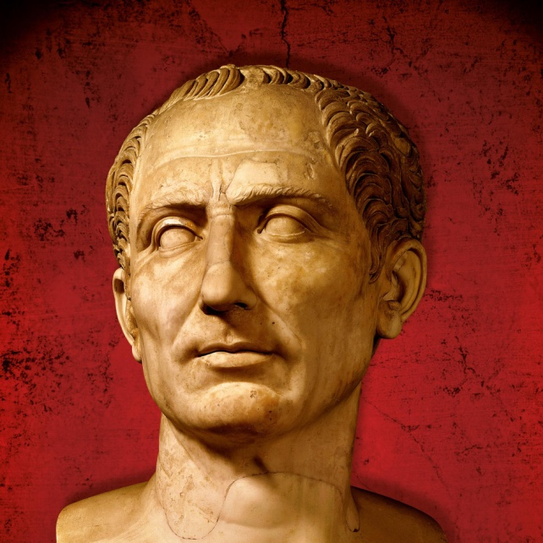
凱撒大帝 Julius Caesar 100 BC - 44 BC

Slide 8
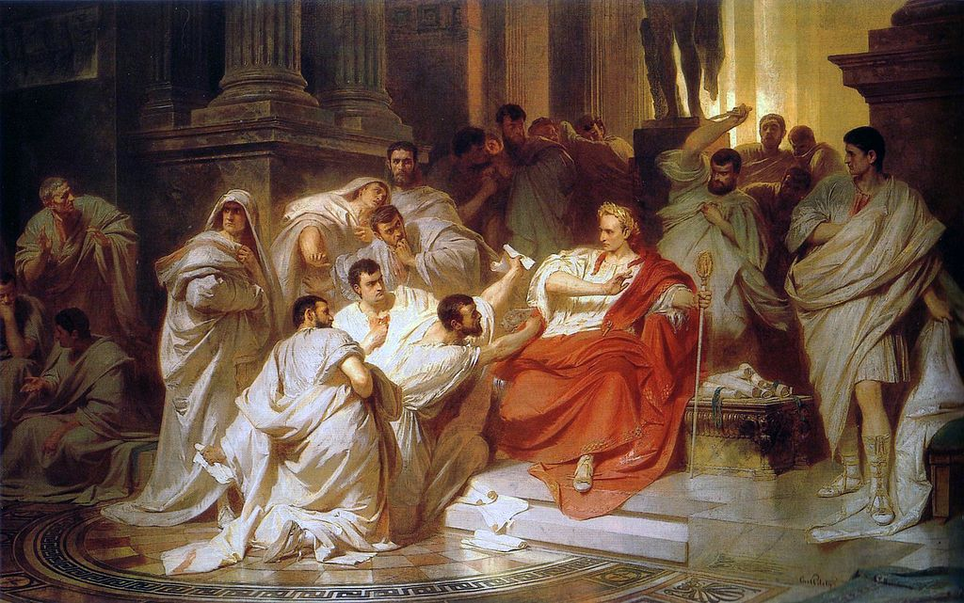
「你也有份嗎？布魯圖！」
"And you, Brutus?"
Notes:
https://en.wikipedia.org/wiki/Julius_Caesar
https://kknews.cc/history/lllv22.html

Slide 9
1. 耶穌並非給人陰謀害死 Jesus Is Not Killed by Conspiracy
馬太福音 Matthew 26:17
¹⁸ 耶穌說：「你們進城去，到某人那裏，對他說：『夫子說：我的時候快到了，我與門徒要在你家裏守逾越節。』」
¹⁸ He replied, “Go into the city to a certain man and tell him, ‘The Teacher says: My appointed time is near. I am going to celebrate the Passover with my disciples at your house.’ ”

Slide 10
約翰福音 John 13:1
¹ 逾越節以前，耶穌知道自己離世歸父的時候到了。
¹ It was just before the Passover Festival. Jesus knew that the hour had come for him to leave this world and go to the Father.

Slide 11
馬太福音 Matthew 26:2
² 「你們知道，過兩天是逾越節，人子將要被交給人，釘在十字架上。」
² “As you know, the Passover is two days away—and the Son of Man will be handed over to be crucified.”

Slide 12
馬太福音 Matthew 26:21–25 ²¹ 正吃的時候，耶穌說：「我實在告訴你們，你們中間有一個人要賣我了。」²² 他們就甚憂愁，一個一個地問他說：「主，是我嗎？」^{… 25} 賣耶穌的猶大問他說：「拉比，是我嗎？」耶穌說：「你說的是。」
²¹ And while they were eating, he said, “Truly I tell you, one of you will betray me.” ²² They were very sad and began to say to him one after the other, “Surely you don’t mean me, Lord?” ^{… 25} Then Judas, the one who would betray him, said, “Surely you don’t mean me, Rabbi?” Jesus answered, “You have said so.”

Slide 13
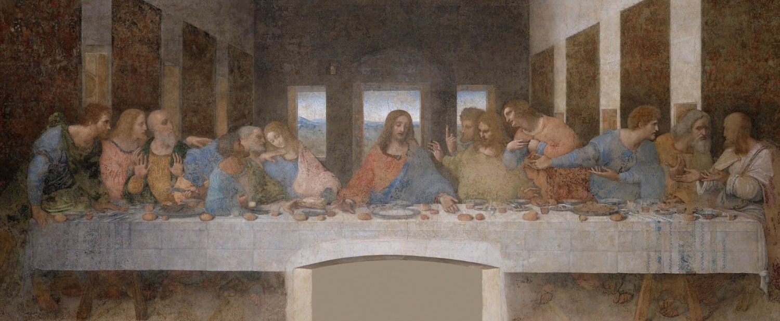
最後的晚餐 (達芬奇) The Last Supper (Leonardo)
Notes:
https://www.cgtrader.com/3d-models/various/various-models/the-last-supper-leonardo-da-vinci

Slide 14
出埃及記 Exodus 12:11–13 ¹¹ 你們吃羊羔…這是耶和華的逾越節。¹² 因為那夜我要巡行埃及地，把埃及地一切頭生的，無論是人是牲畜，都擊殺了…¹³ 這血要在你們所住的房屋上作記號；我一見這血，就越過你們去。
¹¹ … Eat it in haste; it is the Lord’s Passover. ¹² “On that same night I will pass through Egypt and strike down every firstborn of both people and animals…¹³ The blood will be a sign for you on the houses where you are, and when I see the blood, I will pass over you.

Slide 15
馬太福音 Matthew 26:26–28 ²⁶ 他們吃的時候，耶穌拿起餅來，祝福，就擘開，遞給門徒，說：「你們拿著吃，這是我的身體」；²⁷ 又拿起杯來，祝謝了，遞給他們，說：「你們都喝這個；²⁸ 因為這是我立約的血，為多人流出來，使罪得赦。
²⁶ While they were eating, Jesus took bread, and when he had given thanks, he broke it and gave it to his disciples, saying, “Take and eat; this is my body.” ²⁷ Then he took a cup, and when he had given thanks, he gave it to them, saying, “Drink from it, all of you. ²⁸ This is my blood of the covenant, which is poured out for many for the forgiveness of sins.

Slide 16
2. 耶穌死於父神的計劃 Jesus Is Killed According to God’s Plan
徒 Acts 2:22–23 ²² 「神藉著拿撒勒人耶穌在你們中間施行異能、奇事、神蹟，將他證明出來，這是你們自己知道的。²³ 他既按著神的定旨先見被交與人，你們就藉著無法之人的手，把他釘在十字架上，殺了。
²² “Jesus of Nazareth was a man accredited by God to you by miracles, wonders and signs, which God did among you through him, as you yourselves know. ²³ This man was handed over to you by God’s deliberate plan and foreknowledge; and you, with the help of wicked men, put him to death by nailing him to the cross.

Slide 17
以賽亞書 Isaiah 53:10
¹⁰ 耶和華卻定意將他壓傷， 使他受痛苦。 耶和華以他為贖罪祭。 他必看見後裔，並且延長年日。 耶和華所喜悅的事必在他手中亨通。
¹⁰ Yet it was the Lord’s will to crush him and cause him to suffer, and though the Lord makes his life an offering for sin, he will see his offspring and prolong his days, and the will of the Lord will prosper in his hand.

Slide 18
馬太福音 Matthew 26:59–60
⁵⁹ 祭司長和全公會尋找假見證控告耶穌，要治死他。⁶⁰ 雖有好些人來作假見證，總得不著實據。
⁵⁹ The chief priests and the whole Sanhedrin were looking for false evidence against Jesus so that they could put him to death. ⁶⁰ But they did not find any, though many false witnesses came forward.

Slide 19
馬太福音 Matthew 27:4
⁴ 「我賣了無辜之人的血是有罪了。」
⁴ “I have sinned,” he said, “for I have betrayed innocent blood.”

Slide 20
路加福音 Luke 23:4
⁴ 彼拉多對祭司長和眾人說：「我查不出這人有甚麼罪來。」
⁴ Then Pilate announced to the chief priests and the crowd, “I find no basis for a charge against this man.”

Slide 21
路加福音 Luke 23:47
⁴⁷ 百夫長看見所成的事，就歸榮耀與上帝，說：「這真是個義人！」
⁴⁷ The centurion, seeing what had happened, praised God and said, “Surely this was a righteous man.”

Slide 22
路加福音 Luke 22:20
²⁰ 飯後也照樣拿起杯來，說：「這杯是用我血所立的新約，是為你們流出來的。
²⁰ In the same way, after the supper he took the cup, saying, “This cup is the new covenant in my blood, which is poured out for you.

Slide 23
羅馬書 Romans 10:5 (CUVNP)
⁵ 摩西寫著說：「人若行那出於律法的義，就必因此活著。」
⁵ Moses writes this about the righteousness that is by the law: “The person who does these things will live by them.”

Slide 24
耶利米書 Jeremiah 31:31–34 ³¹ 耶和華說：「日子將到，我要與以色列家和猶大家另立新約，…我要將我的律法放在他們裏面，寫在他們心上。…我要赦免他們的罪孽，不再記念他們的罪惡。這是耶和華說的。」
³¹ “The days are coming,” declares the Lord, “when I will make a new covenant with the people of Israel and with the people of Judah… I will put my law in their minds and write it on their hearts…“For I will forgive their wickedness and will remember their sins no more.”

Slide 25
3. 耶穌的死因對我的影響 How Does the Cause of Jesus’ Death Affect Me
它堅定了信徒和神的關係 It strengthens the relationship between believers and God

Slide 26
羅馬書 Romans 7:18–19 (CUVNP)
¹⁸ 我也知道，在我裏頭，就是我肉體之中，沒有良善。因為，立志為善由得我，只是行出來由不得我。¹⁹ 故此，我所願意的善，我反不做；我所不願意的惡，我倒去做。
¹⁸ For I know that good itself does not dwell in me, that is, in my sinful nature. For I have the desire to do what is good, but I cannot carry it out. ¹⁹ For I do not do the good I want to do, but the evil I do not want to do—this I keep on doing.

Slide 27
羅馬書 Romans 7:24–25
²⁴ 我真是苦啊！誰能救我脫離這取死的身體呢？²⁵ 感謝上帝，靠著我們的主耶穌基督就能脫離了。
²⁴ What a wretched man I am! Who will rescue me from this body that is subject to death? ²⁵ Thanks be to God, who delivers me through Jesus Christ our Lord!

Slide 28
羅馬書 Romans 8:1
¹ 如今，那些在基督耶穌裏的就不定罪了。
¹ Therefore, there is now no condemnation for those who are in Christ Jesus,

Slide 29
羅馬書 Romans 8:32
³² 上帝既不愛惜自己的兒子，為我們眾人捨了，豈不也把萬物和他一同白白地賜給我們嗎？
³² He who did not spare his own Son, but gave him up for us all—how will he not also, along with him, graciously give us all things?

Slide 30
3. 耶穌的死因對我的影響 How Does the Cause of Jesus’ Death Affect Me
馬太福音 Matthew 26:27–28
²⁷ 又拿起杯來，祝謝了，遞給他們，說：「你們都喝這個；²⁸ 因為這是我立約的血，為多人流出來，使罪得赦。
²⁷ Then he took a cup, and when he had given thanks, he gave it to them, saying, “Drink from it, all of you. ²⁸ This is my blood of the covenant, which is poured out for many for the forgiveness of sins.

Slide 31
3. 耶穌的死因對我的影響 How Does the Cause of Jesus’ Death Affect Me
它堅定了信徒和神的關係 It strengthens the relationship between believers and God
它肯定了不信耶穌的人必定滅亡 It affirms that those who do not believe in Jesus must perish

Slide 32
使徒行傳 Acts 4:12
¹² 除他以外，別無拯救；因為在天下人間，沒有賜下別的名，我們可以靠著得救。」
¹² Salvation is found in no one else, for there is no other name under heaven given to mankind by which we must be saved.”

Slide 33
希伯來書 Hebrews 2:3
³ 我們若忽略這麼大的救恩，怎能逃罪呢？
³ how shall we escape if we ignore so great a salvation?

