Slide 1
Daniel 10:1-12:4 (selected Passages)
Daniel 10:1,10-14
10 In the third year of Cyrus king of Persia, a revelation was given to Daniel (who was called Belteshazzar). Its message was true and it concerned a great war. The understanding of the message came to him in a vision.
…
波斯王居鲁士第三年，有事显给称为伯提沙撒的但以理。这事是真的，是指着大争战。但以理通达这事，明白这异象。
…

Slide 2
Daniel 10:1-12:4 (selected Passages)
…
¹⁰ A hand touched me and set me trembling on my hands and knees. ¹¹ He said, “Daniel, you who are highly esteemed, consider carefully the words I am about to speak to you, and stand up, for I have now been sent to you.” And when he said this to me, I stood up trembling.
…
¹⁰ 忽然有一手按在我身上，使我用膝和手掌支持微起。 ¹¹ 他对我说：“大蒙眷爱的但以理啊，要明白我与你所说的话，只管站起来，因为我现在奉差遣来到你这里。”他对我说这话，我便战战兢兢地立起来。

Slide 3
Daniel 10:1-12:4 (selected Passages)
¹² Then he continued, “Do not be afraid, Daniel. Since the first day that you set your mind to gain understanding and to humble yourself before your God, your words were heard, and I have come in response to them. ¹³ But the prince of the Persian kingdom resisted me twenty-one days. Then Michael, one of the chief princes, came to help me, because I was detained there with the king of Persia. ¹⁴ Now I have come to explain to you what will happen to your people in the future, for the vision concerns a time yet to come.”
¹² 他就说：“但以理啊，不要惧怕。因为从你第一日专心求明白将来的事，又在你神面前刻苦己心，你的言语已蒙应允，我是因你的言语而来。 ¹³ 但波斯国的魔君拦阻我二十一日，忽然有大君中的一位米迦勒来帮助我，我就停留在波斯诸王那里。 ¹⁴ 现在我来，要使你明白本国之民日后必遭遇的事，因为这异象关乎后来许多的日子。”

Slide 4
Daniel 10:1-12:4 (selected Passages)
Daniel 11:2–6 (NIV)
² “Now then, I tell you the truth: Three more kings will arise in Persia, and then a fourth, who will be far richer than all the others. When he has gained power by his wealth, he will stir up everyone against the kingdom of Greece. ³ Then a mighty king will arise, who will rule with great power and do as he pleases. ⁴ After he has arisen, his empire will be broken up and parceled out toward the four winds of heaven. It will not go to his descendants, nor will it have the power he exercised, because his empire will be uprooted and given to others.
² “现在我将真事指示你，波斯还有三王兴起，第四王必富足远胜诸王。他因富足成为强盛，就必激动大众攻击希腊国。 ³ 必有一个勇敢的王兴起，执掌大权，随意而行。 ⁴ 他兴起的时候，他的国必破裂，向天的四方^{[a]}分开，却不归他的后裔，治国的权势也都不及他，因为他的国必被拔出，归于他后裔之外的人。

Slide 5
Daniel 10:1-12:4 (selected Passages)
Daniel 11:2–6 (NIV)
⁵ “The king of the South will become strong, but one of his commanders will become even stronger than he and will rule his own kingdom with great power. ⁶ After some years, they will become allies. The daughter of the king of the South will go to the king of the North to make an alliance, but she will not retain her power, and he and his power will not last. In those days she will be betrayed, together with her royal escort and her father and the one who supported her.
⁵ “南方的王必强盛，他将帅中必有一个比他更强盛，执掌权柄，他的权柄甚大。 ⁶ 过些年后，他们必互相联合，南方王的女儿必就了北方王来立约。但这女子帮助之力存立不住，王和他所倚靠之力也不能存立。这女子和引导她来的，并生她的，以及当时扶助她的，都必交于死地。

Slide 6
Daniel 10:1-12:4 (selected Passages)
Daniel 12:1-4
12 “At that time Michael, the great prince who protects your people, will arise. There will be a time of distress such as has not happened from the beginning of nations until then. But at that time your people—everyone whose name is found written in the book—will be delivered. ² Multitudes who sleep in the dust of the earth will awake: some to everlasting life, others to shame and everlasting contempt.
“那时，保佑你本国之民的天使长米迦勒必站起来，并且有大艰难，从有国以来直到此时没有这样的。你本国的民中，凡名录在册上的，必得拯救。 ² 睡在尘埃中的必有多人复醒，其中有得永生的，有受羞辱永远被憎恶的。

Slide 7
Daniel 10:1-12:4 (selected Passages)
³ Those who are wise will shine like the brightness of the heavens, and those who lead many to righteousness, like the stars for ever and ever. ⁴ But you, Daniel, roll up and seal the words of the scroll until the time of the end. Many will go here and there to increase knowledge.”
³ 智慧人必发光，如同天上的光；那使多人归义的，必发光如星，直到永永远远。 ⁴ 但以理啊，你要隐藏这话，封闭这书，直到末时。必有多人来往奔跑^{[b]}，知识就必增长。”

Slide 8
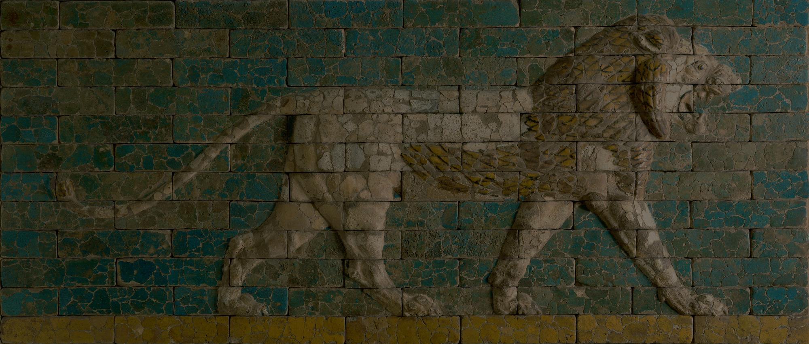
Wars
Daniel 10:1-12:4

Slide 9
Colossians 1:16
¹⁶ For in him all things were created: things in heaven and on earth, visible and invisible, whether thrones or powers or rulers or authorities; all things have been created through him and for him.
¹⁶ 因为万有都是靠他造的，无论是天上的、地上的，能看见的、不能看见的，或是有位的、主治的、执政的、掌权的，一概都是借着他造的，又是为他造的。

Slide 10
Daniel 10:14
¹⁴ Now I have come to explain to you what will happen to your people in the future, for the vision concerns a time yet to come.”
¹⁴ 现在我来，要使你明白本国之民日后必遭遇的事，因为这异象关乎后来许多的日子。”

Slide 11
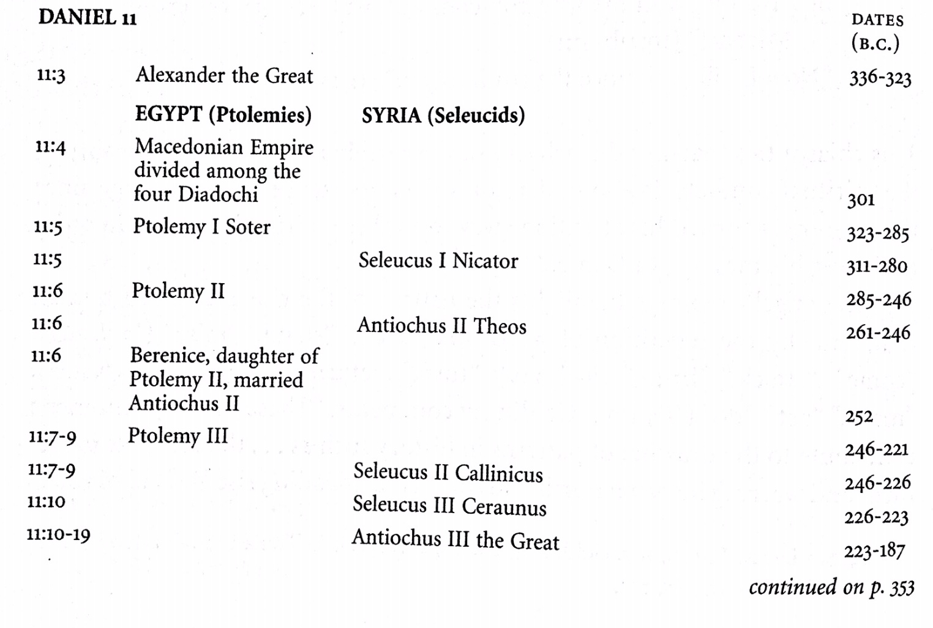
From Preaching Christ in Daniel, Signey Greidanus

Slide 12
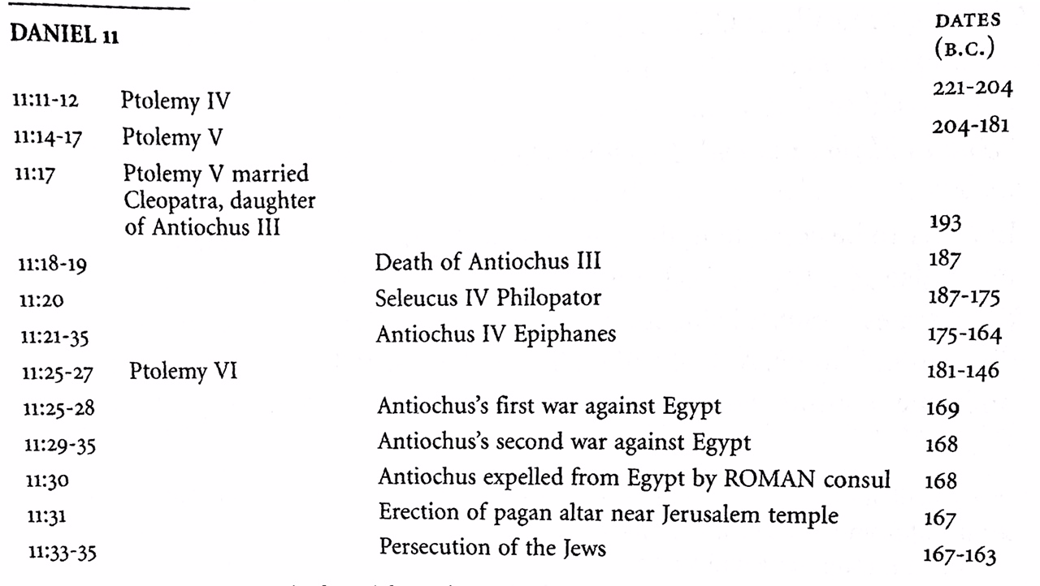
From Preaching Christ in Daniel, Signey Greidanus

Slide 13
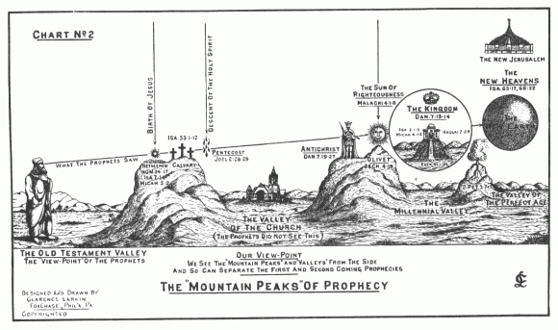

Slide 14
Daniel 12:1-3
“At that time Michael, the great prince who protects your people, will arise. There will be a time of distress such as has not happened from the beginning of nations until then. But at that time your people—everyone whose name is found written in the book—will be delivered. ² Multitudes who sleep in the dust of the earth will awake: some to everlasting life, others to shame and everlasting contempt. ³ Those who are wise will shine like the brightness of the heavens, and those who lead many to righteousness, like the stars for ever and ever.

Slide 15
Daniel 12:1-3
“那时，保佑你本国之民的天使长米迦勒必站起来，并且有大艰难，从有国以来直到此时没有这样的。你本国的民中，凡名录在册上的，必得拯救。 ² 睡在尘埃中的必有多人复醒，其中有得永生的，有受羞辱永远被憎恶的。 ³ 智慧人必发光，如同天上的光；那使多人归义的，必发光如星，直到永永远远。

Slide 16
Ephesians 6:11-12
¹¹ Put on the full armor of God, so that you can take your stand against the devil’s schemes. ¹² For our struggle is not against flesh and blood, but against the rulers, against the authorities, against the powers of this dark world and against the spiritual forces of evil in the heavenly realms.
¹¹ 要穿戴神所赐的全副军装，就能抵挡魔鬼的诡计。 ¹² 因我们并不是与属血气的争战，乃是与那些执政的、掌权的、管辖这幽暗世界的，以及天空属灵气的恶魔争战。

Slide 17
Ephesians 6:13-17
¹³ Therefore put on the full armor of God, so that when the day of evil comes, you may be able to stand your ground, and after you have done everything, to stand. ¹⁴ Stand firm then, with the belt of truth buckled around your waist, with the breastplate of righteousness in place, ¹⁵ and with your feet fitted with the readiness that comes from the gospel of peace. ¹⁶ In addition to all this, take up the shield of faith,with which you can extinguish all the flaming arrows of the evil one. ¹⁷ Take the helmet of salvation and the sword of the Spirit, which is the word of God.
¹³ 所以，要拿起神所赐的全副军装，好在磨难的日子抵挡仇敌；并且成就了一切，还能站立得住。 ¹⁴ 所以要站稳了，用真理当做带子束腰，用公义当做护心镜遮胸， ¹⁵ 又用平安的福音当做预备走路的鞋穿在脚上。 ¹⁶ 此外，又拿着信德当做藤牌，可以灭尽那恶者一切的火箭； ¹⁷ 并戴上救恩的头盔，拿着圣灵的宝剑，就是神的道。

Slide 18
Romans 8:38-39
³⁸ For I am convinced that neither death nor life, neither angels nor demons, neither the present nor the future, nor any powers, ³⁹ neither height nor depth, nor anything else in all creation, will be able to separate us from the love of God that is in Christ Jesus our Lord.
³⁸ 因为我深信：无论是死，是生，是天使，是掌权的，是有能的，是现在的事，是将来的事， ³⁹ 是高处的，是低处的，是别的受造之物，都不能叫我们与神的爱隔绝；这爱是在我们的主基督耶稣里的。

