Slide 1
馬可福音 Mark 12:41-44
⁴¹ 耶穌對銀庫坐著，看眾人怎樣投錢入庫。有好些財主往裏投了若干的錢。⁴² 有一個窮寡婦來，往裏投了兩個小錢，就是一個大錢。
⁴¹ Jesus sat down opposite the place where the offerings were put and watched the crowd putting their money into the temple treasury. Many rich people threw in large amounts. ⁴² But a poor widow came and put in two very small copper coins, worth only a few cents.

Slide 2
⁴³ 耶穌叫門徒來，說：「我實在告訴你們，這窮寡婦投入庫裏的，比眾人所投的更多。⁴⁴ 因為，他們都是自己有餘，拿出來投在裏頭；但這寡婦是自己不足，把她一切養生的都投上了。」
⁴³ Calling his disciples to him, Jesus said, “Truly I tell you, this poor widow has put more into the treasury than all the others. ⁴⁴ They all gave out of their wealth; but she, out of her poverty, put in everything—all she had to live on.”

Slide 3
⁴¹ 耶穌對銀庫坐著，看眾人怎樣投錢入庫。有好些財主往裏投了若干的錢。⁴² 有一個窮寡婦來，往裏投了兩個小錢，就是一個大錢。⁴³ 耶穌叫門徒來，說：
⁴¹ Jesus sat down opposite the place where the offerings were put and watched the crowd putting their money into the temple treasury. Many rich people threw in large amounts. ⁴² But a poor widow came and put in two very small copper coins, worth only a few cents. ⁴³ Calling his disciples to him, Jesus said,

Slide 4
「我實在告訴你們，這窮寡婦投入庫裏的，比眾人所投的更多。⁴⁴ 因為，他們都是自己有餘，拿出來投在裏頭；但這寡婦是自己不足，把她一切養生的都投上了。」
“Truly I tell you, this poor widow has put more into the treasury than all the others. ⁴⁴ They all gave out of their wealth; but she, out of her poverty, put in everything—all she had to live on.”

Slide 5
讓神動容的奉獻 An Offering that impresses God
馬可福音 Mark 12:41-44

Slide 6
From a billionaire to an average Joe; How does he spend his money?

Slide 7
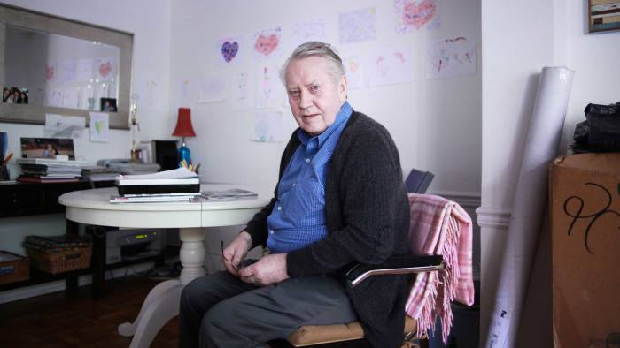
查克·費尼 Chuck Feeney
Notes:
https://en.wikipedia.org/wiki/Chuck_Feeney

Slide 8
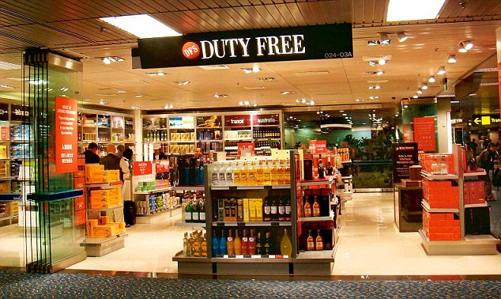

Slide 9
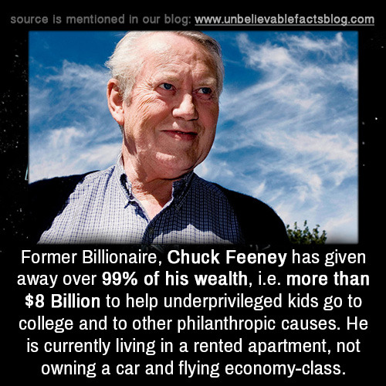

Slide 10
馬可福音 Mark 12:41
⁴¹ 耶穌對銀庫坐著，看眾人怎樣投錢入庫。
⁴¹ Jesus sat down opposite the place where the offerings were put and watched the crowd putting their money into the temple treasury.
Notes:
https://www.ritmeyer.com/2015/05/15/the-treasury-of-the-temple-in-jerusalem/

Slide 11
1. 神留意人的奉獻 (41) God Pays Attention to Our Offering

Slide 12
創世記 Genesis 4:4–5
⁴ … 耶和華看中了亞伯和他的供物，⁵ 只是看不中該隱和他的供物。
⁴ … The Lord looked with favor on Abel and his offering, ⁵ but on Cain and his offering he did not look with favor.

Slide 13
2. 神留意人的奉獻不是因為神需要奉獻 God Pays Attention to Our Offering Not Because He Needs Our Offering

Slide 14
馬可福音 Mark 12:41–43 ⁴¹ 耶穌對銀庫坐著，看眾人怎樣投錢入庫。有好些財主往裏投了若干的錢。⁴² 有一個窮寡婦來，往裏投了兩個小錢，就是一個大錢。⁴³ 耶穌叫門徒來，說：「我實在告訴你們，這窮寡婦投入庫裏的，比眾人所投的更多。
⁴¹ Jesus sat down opposite the place where the offerings were put and watched the crowd putting their money into the temple treasury. Many rich people threw in large amounts. ⁴² But a poor widow came and put in two very small copper coins, worth only a few cents. ⁴³ Calling his disciples to him, Jesus said, “Truly I tell you, this poor widow has put more into the treasury than all the others.

Slide 15
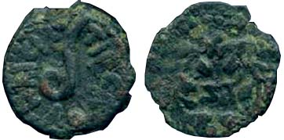
兩個小錢 Two lepta

Slide 16
詩篇 Psalm 50:9–12 ⁹ 我不從你家中取公牛， 也不從你圈內取山羊； ¹⁰ 因為，樹林中的百獸是我的， 千山上的牲畜也是我的。 ¹¹ 山中的飛鳥，我都知道； 野地的走獸也都屬我。 ¹² 我若是飢餓，我不用告訴你， 因為世界和其中所充滿的都是我的。
⁹ I have no need of a bull from your stall or of goats from your pens, ¹⁰ for every animal of the forest is mine, and the cattle on a thousand hills. ¹¹ I know every bird in the mountains, and the insects in the fields are mine. ¹² If I were hungry I would not tell you, for the world is mine, and all that is in it.

Slide 17
3. 神留意人的奉獻因為奉獻反映人的心 God Pays Attention to Our Offering Because Our Offering Reflects Our Heart
馬可福音 Mark 12:43
⁴³ 耶穌叫門徒來，說：「我實在告訴你們，這窮寡婦投入庫裏的，比眾人所投的更多。
⁴³ Calling his disciples to him, Jesus said, “Truly I tell you, this poor widow has put more into the treasury than all the others.

Slide 18
馬可福音 Mark 12:44
⁴⁴ 因為，他們都是自己有餘，拿出來投在裏頭；但這寡婦是自己不足，把她一切養生的都投上了。」
⁴⁴ For they all contributed out of their abundance, but she out of her poverty has put in everything she had, all she had to live on.” (ESV)

Slide 19
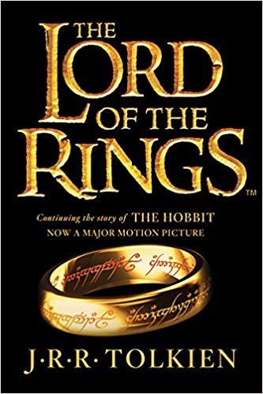
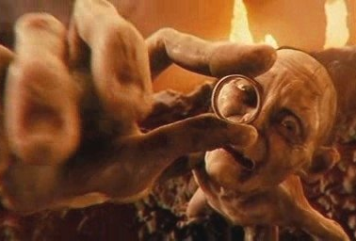
魔戒

Slide 20
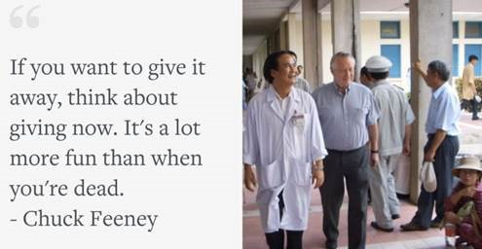
Notes:
https://www.cnbc.com/id/48139956

