Slide 1
Two Sacrifices
Hebrews 13:15-16

Slide 3
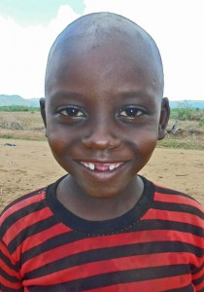
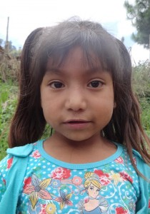
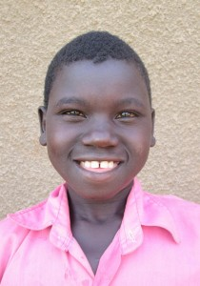
Diid Bridiga Scovia

Slide 4
Our Goals
We are 68% of the way to supporting 3 children for 1 year.

