Slide 1
以斯拉記 Ezra 9-10
¹ 這事做完了，眾首領來見我，說：「以色列民和祭司並利未人，沒有離絕迦南人…仍效法這些國的民，行可憎的事。
¹ After these things had been done, the leaders came to me and said, “The people of Israel, including the priests and the Levites, have not kept themselves separate from the neighboring peoples with their detestable practices, like those of the Canaanites...

Slide 2
² 因他們為自己和兒子娶了這些外邦女子為妻，以致聖潔的種類和這些國的民混雜；而且首領和官長在這事上為罪魁。」³ 我一聽見這事，就撕裂衣服和外袍，拔了頭髮和鬍鬚，驚懼憂悶而坐。
² They have taken some of their daughters as wives for themselves and their sons, and have mingled the holy race with the peoples around them. And the leaders and officials have led the way in this unfaithfulness.” ³ When I heard this, I tore my tunic and cloak, pulled hair from my head and beard and sat down appalled.

Slide 3
⁴ 凡為以色列上帝言語戰兢的，都因這被擄歸回之人所犯的罪聚集到我這裏來。我就驚懼憂悶而坐，直到獻晚祭的時候。 ⁵ 獻晚祭的時候我起來，心中愁苦，穿著撕裂的衣袍，雙膝跪下向耶和華－我的上帝舉手，
⁴ Then everyone who trembled at the words of the God of Israel gathered around me because of this unfaithfulness of the exiles. And I sat there appalled until the evening sacrifice. ⁵ Then, at the evening sacrifice, I rose from my self-abasement, with my tunic and cloak torn, and fell on my knees with my hands spread out to the Lord my God

Slide 4
⁶ 說：「我的上帝啊，我抱愧蒙羞，不敢向我上帝仰面；因為我們的罪孽滅頂，我們的罪惡滔天。⁷ 從我們列祖直到今日，我們的罪惡甚重；因我們的罪孽，我們和君王、祭司都交在外邦列王的手中，殺害、擄掠、搶奪、
⁶ and prayed: “I am too ashamed and disgraced, my God, to lift up my face to you, because our sins are higher than our heads and our guilt has reached to the heavens. ⁷ From the days of our ancestors until now, our guilt has been great. Because of our sins, we and our kings and our priests have been subjected to the sword and captivity, to pillage and

Slide 5
臉上蒙羞正如今日的光景。⁸ 現在耶和華－我們的上帝暫且施恩與我們，給我們留些逃脫的人，使我們安穩如釘子釘在他的聖所，我們的上帝好光照我們的眼目，使我們在受轄制之中稍微復興。⁹ 我們是奴僕，
humiliation at the hand of foreign kings, as it is today. ⁸ “But now, for a brief moment, the Lord our God has been gracious in leaving us a remnant and giving us a firm place in his sanctuary, and so our God gives light to our eyes and a little relief in our bondage. ⁹ Though we are slaves,

Slide 6
然而在受轄制之中，我們的上帝仍沒有丟棄我們，在波斯王眼前向我們施恩，叫我們復興，能重建我們上帝的殿，修其毀壞之處，使我們在猶大和耶路撒冷有牆垣。 ¹⁰ 「我們的上帝啊，既是如此，我們還有甚麼話可說呢？因為我們已經離棄你的命令，
our God has not forsaken us in our bondage. He has shown us kindness in the sight of the kings of Persia: He has granted us new life to rebuild the house of our God and repair its ruins, and he has given us a wall of protection in Judah and Jerusalem. ¹⁰ “But now, our God, what can we say after this? For we have forsaken the commands

Slide 7
¹¹ you gave through your servants the prophets when you said: ‘The land you are entering to possess is a land polluted by the corruption of its peoples. By their detestable practices they have filled it with their impurity from one end to the other. ¹² Therefore, do not give your daughters in marriage to their sons or take their daughters for your sons.
¹¹ 就是你藉你僕人眾先知所吩咐的說：『你們要去得為業之地是污穢之地；因列國之民的污穢和可憎的事，叫全地從這邊直到那邊滿了污穢。¹² 所以不可將你們的女兒嫁他們的兒子，也不可為你們的兒子娶他們的女兒，

Slide 8
永不可求他們的平安和他們的利益，這樣你們就可以強盛，吃這地的美物，並遺留這地給你們的子孫永遠為業。』¹³ 上帝啊，我們因自己的惡行和大罪，遭遇了這一切的事，並且你刑罰我們輕於我們罪所當得的，又給我們留下這些人。
Do not seek a treaty of friendship with them at any time, that you may be strong and eat the good things of the land and leave it to your children as an everlasting inheritance.’ ¹³ “What has happened to us is a result of our evil deeds and our great guilt, and yet, our God, you have punished us less than our sins deserved and have given us a remnant like this.

Slide 9
¹⁴ 我們豈可再違背你的命令，與這行可憎之事的民結親呢？若這樣行，你豈不向我們發怒，將我們滅絕，以致沒有一個剩下逃脫的人嗎？¹⁵ 耶和華－以色列的上帝啊，因你是公義的，我們這剩下的人才得逃脫，正如今日的光景。
¹⁴ Shall we then break your commands again and intermarry with the peoples who commit such detestable practices? Would you not be angry enough with us to destroy us, leaving us no remnant or survivor? ¹⁵ Lord, the God of Israel, you are righteous! We are left this day as a remnant.

Slide 10
看哪，我們在你面前有罪惡，因此無人在你面前站立得住。」
¹ 以斯拉禱告，認罪，哭泣，俯伏在上帝殿前的時候，有以色列中的男女孩童聚集到以斯拉那裏，成了大會，眾民無不痛哭。
Here we are before you in our guilt, though because of it not one of us can stand in your presence.”
¹ While Ezra was praying and confessing, weeping and throwing himself down before the house of God, a large crowd of Israelites—men, women and children—gathered around him. They too wept bitterly.

Slide 11
² 屬以攔的子孫、耶歇的兒子示迦尼對以斯拉說：「我們在此地娶了外邦女子為妻，干犯了我們的上帝，然而以色列人還有指望。³ 現在當與我們的上帝立約，休這一切的妻，離絕她們所生的，
² Then Shekaniah son of Jehiel, one of the descendants of Elam, said to Ezra, “We have been unfaithful to our God by marrying foreign women from the peoples around us. But in spite of this, there is still hope for Israel. ³ Now let us make a covenant before our God to send away all these women and their children,

Slide 12
照著我主和那因上帝命令戰兢之人所議定的，按律法而行。⁴ 你起來，這是你當辦的事，我們必幫助你，你當奮勉而行。」⁵ 以斯拉便起來，使祭司長和利未人，並以色列眾人起誓說，必照這話去行；他們就起了誓。 …
in accordance with the counsel of my lord and of those who fear the commands of our God. Let it be done according to the Law. ⁴ Rise up; this matter is in your hands. We will support you, so take courage and do it.” ⁵ So Ezra rose up and put the leading priests and Levites and all Israel under oath to do what had been suggested. And they took the oath…

Slide 13
¹⁶ 被擄歸回的人如此而行。祭司以斯拉和些族長按著宗族都指名見派；在十月初一日，一同在座查辦這事，¹⁷ 到正月初一日，才查清娶外邦女子的人數。
¹⁶ So the exiles did as was proposed. Ezra the priest selected men who were family heads, one from each family division, and all of them designated by name. On the first day of the tenth month they sat down to investigate the cases, ¹⁷ and by the first day of the first month they finished dealing with all the men who had married foreign women.

Slide 14
復興之路 A Road to Revival
以斯拉記 Ezra 9-10

Slide 15
世界最暢銷的書籍是什麼？ The best-selling book of all time

Slide 16
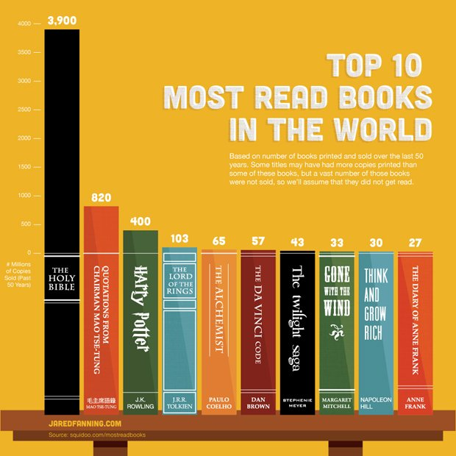
Notes:
https://www.businessinsider.com/the-top-10-most-read-books-in-the-world-infographic-2012-12

Slide 17
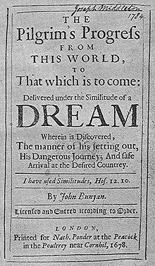
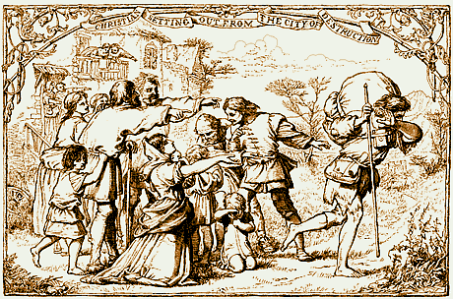
天路歷程 The Pilgrim's Progress

Slide 18
Cyrus
Darius
Xerxes
Artaxerxes
1st Return
2nd
Return

Slide 19
復興之路 A Road to Revival
覺醒 Awaken
認罪 Confession
悔改 Repentance

Slide 20
1. 覺醒 Awaken (9:1-2)

Slide 21
以斯拉記 Ezra 9:1 ¹ 這事做完了，眾首領來見我，說：「以色列民和祭司並利未人，沒有離絕迦南人、赫人、比利洗人、耶布斯人、亞捫人、摩押人、埃及人、亞摩利人，仍效法這些國的民，行可憎的事。
¹ After these things had been done, the leaders came to me and said, “The people of Israel, including the priests and the Levites, have not kept themselves separate from the neighboring peoples with their detestable practices, like those of the Canaanites, Hittites, Perizzites, Jebusites, Ammonites, Moabites, Egyptians and Amorites.

Slide 22
以斯拉記 Ezra 7:10
¹⁰ 以斯拉定志考究遵行耶和華的律法，又將律例典章教訓以色列人。
¹⁰ For Ezra had devoted himself to the study and observance of the Law of the Lord, and to teaching its decrees and laws in Israel.

Slide 23
以斯拉記 Ezra 9:1 ¹ 這事做完了，眾首領來見我，說：「以色列民和祭司並利未人，沒有離絕迦南人、赫人、比利洗人、耶布斯人、亞捫人、摩押人、埃及人、亞摩利人，仍效法這些國的民，行可憎的事。
¹ After these things had been done, the leaders came to me and said, “The people of Israel, including the priests and the Levites, have not kept themselves separate from the neighboring peoples with their detestable practices, like those of the Canaanites, Hittites, Perizzites, Jebusites, Ammonites, Moabites, Egyptians and Amorites.

Slide 24
以斯拉記 Ezra 9:2
² 因他們為自己和兒子娶了這些外邦女子為妻，以致聖潔的種類和這些國的民混雜；而且首領和官長在這事上為罪魁。」
² They have taken some of their daughters as wives for themselves and their sons, and have mingled the holy race with the peoples around them. And the leaders and officials have led the way in this unfaithfulness.”

Slide 25
2. 認罪 Confession (9:3-15)
以斯拉記 Ezra 9:3
³ 我一聽見這事，就撕裂衣服和外袍，拔了頭髮和鬍鬚，驚懼憂悶而坐。
³ When I heard this, I tore my tunic and cloak, pulled hair from my head and beard and sat down appalled.

Slide 26
以斯拉記 Ezra 9:4
⁴ 凡為以色列上帝言語戰兢的，都因這被擄歸回之人所犯的罪聚集到我這裏來。我就驚懼憂悶而坐，直到獻晚祭的時候。
⁴ Then everyone who trembled at the words of the God of Israel gathered around me because of this unfaithfulness of the exiles. And I sat there appalled until the evening sacrifice.

Slide 27
以斯拉記 Ezra 9:6
⁶ 說：「我的上帝啊，我抱愧蒙羞，不敢向我上帝仰面；因為我們的罪孽滅頂，我們的罪惡滔天。
⁶ and prayed: “I am too ashamed and disgraced, my God, to lift up my face to you, because our sins are higher than our heads and our guilt has reached to the heavens.

Slide 28
以斯拉記 Ezra 9:15
¹⁵ 耶和華－以色列的上帝啊，因你是公義的，我們這剩下的人才得逃脫，正如今日的光景。看哪，我們在你面前有罪惡，因此無人在你面前站立得住。」
¹⁵ Lord, the God of Israel, you are righteous! We are left this day as a remnant. Here we are before you in our guilt, though because of it not one of us can stand in your presence.”

Slide 29
約翰一書 1 John 1:9
⁹ 我們若認自己的罪，上帝是信實的，是公義的，必要赦免我們的罪，洗淨我們一切的不義。
⁹ If we confess our sins, he is faithful and just and will forgive us our sins and purify us from all unrighteousness.

Slide 30
3. 悔改 Repentance (10:1-44)
以斯拉記 Ezra 10:2 ² 屬以攔的子孫、耶歇的兒子示迦尼對以斯拉說：「我們在此地娶了外邦女子為妻，干犯了我們的上帝，然而以色列人還有指望。
² Then Shekaniah son of Jehiel, one of the descendants of Elam, said to Ezra, “We have been unfaithful to our God by marrying foreign women from the peoples around us. But in spite of this, there is still hope for Israel.

Slide 31
以斯拉記 Ezra 10:3
³ 現在當與我們的上帝立約，休這一切的妻，離絕她們所生的，照著我主和那因上帝命令戰兢之人所議定的，按律法而行。
³ Now let us make a covenant before our God to send away all these women and their children, in accordance with the counsel of my lord and of those who fear the commands of our God. Let it be done according to the Law.

Slide 32
以斯拉記 Ezra 10:6–7
⁶ 以斯拉從上帝殿前起來，進入以利亞實的兒子約哈難的屋裏，到了那裏不吃飯，也不喝水；因為被擄歸回之人所犯的罪，心裏悲傷。⁷ 他們通告猶大和耶路撒冷被擄歸回的人，叫他們在耶路撒冷聚集。
⁶ Then Ezra withdrew from before the house of God and went to the room of Jehohanan son of Eliashib. While he was there, he ate no food and drank no water, because he continued to mourn over the unfaithfulness of the exiles. ⁷ A proclamation was then issued throughout Judah and Jerusalem for all the exiles to assemble in Jerusalem.

Slide 33
以斯拉記 Ezra 10:16–17
¹⁶ 被擄歸回的人如此而行。祭司以斯拉和些族長按著宗族都指名見派；在十月初一日，一同在座查辦這事，¹⁷ 到正月初一日，才查清娶外邦女子的人數。
¹⁶ So the exiles did as was proposed. Ezra the priest selected men who were family heads, one from each family division, and all of them designated by name. On the first day of the tenth month they sat down to investigate the cases, ¹⁷ and by the first day of the first month they finished dealing with all the men who had married foreign women.

