Slide 1
尼希米記 Nehemiah 2
¹ 亞達薛西王二十年尼散月，在王面前擺酒，我拿起酒來奉給王。我素來在王面前沒有愁容。² 王對我說：「你既沒有病，為甚麼面帶愁容呢？
¹ In the month of Nisan in the twentieth year of King Artaxerxes, when wine was brought for him, I took the wine and gave it to the king. I had not been sad in his presence before, ² so the king asked me, “Why does your face look so sad when you are not ill?

Slide 2
這不是別的，必是你心中愁煩。」於是我甚懼怕。³ 我對王說：「願王萬歲！我列祖墳墓所在的那城荒涼，城門被火焚燒，我豈能面無愁容嗎？」⁴ 王問我說：「你要求甚麼？」於是我默禱天上的上帝。⁵ 我對王說：
This can be nothing but sadness of heart.” I was very much afraid, ³ but I said to the king, “May the king live forever! Why should my face not look sad when the city where my ancestors are buried lies in ruins, and its gates have been destroyed by fire?” ⁴ The king said to me, “What is it you want?” Then I prayed to the God of heaven, ⁵ and I answered the king,

Slide 3
「僕人若在王眼前蒙恩，王若喜歡，求王差遣我往猶大，到我列祖墳墓所在的那城去，我好重新建造。」⁶ 那時王后坐在王的旁邊。王問我說：「你去要多少日子？幾時回來？」我就定了日期。於是王喜歡差遣我去。⁷ 我又對王說：
“If it pleases the king and if your servant has found favor in his sight, let him send me to the city in Judah where my ancestors are buried so that I can rebuild it.” ⁶ Then the king, with the queen sitting beside him, asked me, “How long will your journey take, and when will you get back?” It pleased the king to send me; so I set a time. ⁷ I also said to him,

Slide 4
「王若喜歡，求王賜我詔書，通知大河西的省長准我經過，直到猶大；⁸ 又賜詔書，通知管理王園林的亞薩，使他給我木料，做屬殿營樓之門的橫樑和城牆，與我自己房屋使用的。」
“If it pleases the king, may I have letters to the governors of Trans-Euphrates, so that they will provide me safe-conduct until I arrive in Judah? ⁸ And may I have a letter to Asaph, keeper of the royal park, so he will give me timber to make beams for the gates of the citadel by the temple and for the city wall and for the residence I will occupy?”

Slide 5
王就允准我，因我上帝施恩的手幫助我。 ⁹ 王派了軍長和馬兵護送我。我到了河西的省長那裏，將王的詔書交給他們。¹⁰ 和倫人參巴拉，並為奴的亞捫人多比雅，
And because the gracious hand of my God was on me, the king granted my requests. ⁹ So I went to the governors of Trans-Euphrates and gave them the king’s letters. The king had also sent army officers and cavalry with me. ¹⁰ When Sanballat the Horonite and Tobiah the Ammonite official heard about this,

Slide 6
聽見有人來為以色列人求好處，就甚惱怒。 ¹¹ 我到了耶路撒冷，在那裏住了三日。¹² 我夜間起來，有幾個人也一同起來；但上帝使我心裏要為耶路撒冷做甚麼事，我並沒有告訴人。除了我騎的牲口以外，也沒有別的牲口在我那裏。
they were very much disturbed that someone had come to promote the welfare of the Israelites. ¹¹ I went to Jerusalem, and after staying there three days ¹² I set out during the night with a few others. I had not told anyone what my God had put in my heart to do for Jerusalem. There were no mounts with me except the one I was riding on.

Slide 7
¹³ 當夜我出了谷門，往野狗井去，到了糞廠門，察看耶路撒冷的城牆，見城牆拆毀，城門被火焚燒。¹⁴ 我又往前，到了泉門和王池，但所騎的牲口沒有地方過去。
¹³ By night I went out through the Valley Gate toward the Jackal Well and the Dung Gate, examining the walls of Jerusalem, which had been broken down, and its gates, which had been destroyed by fire. ¹⁴ Then I moved on toward the Fountain Gate and the King’s Pool, but there was not enough room for my mount to get through;

Slide 8
¹⁵ 於是夜間沿溪而上，察看城牆，又轉身進入谷門，就回來了。¹⁶ 我往哪裏去，我做甚麼事，官長都不知道。我還沒有告訴猶大平民、祭司、貴冑、官長，和其餘做工的人。 ¹⁷ 以後，我對他們說：
¹⁵ so I went up the valley by night, examining the wall. Finally, I turned back and reentered through the Valley Gate. ¹⁶ The officials did not know where I had gone or what I was doing, because as yet I had said nothing to the Jews or the priests or nobles or officials or any others who would be doing the work. ¹⁷ Then I said to them,

Slide 9
「我們所遭的難，耶路撒冷怎樣荒涼，城門被火焚燒，你們都看見了。來吧，我們重建耶路撒冷的城牆，免得再受凌辱！」¹⁸ 我告訴他們我上帝施恩的手怎樣幫助我，並王對我所說的話。他們就說：「我們起來建造吧！」於是他們奮勇做這善工。
“You see the trouble we are in: Jerusalem lies in ruins, and its gates have been burned with fire. Come, let us rebuild the wall of Jerusalem, and we will no longer be in disgrace.” ¹⁸ I also told them about the gracious hand of my God on me and what the king had said to me. They replied, “Let us start rebuilding.” So they began this good work.

Slide 10
¹⁹ 但和倫人參巴拉，並為奴的亞捫人多比雅和阿拉伯人基善聽見就嗤笑我們，藐視我們，說：「你們做甚麼呢？要背叛王嗎？」²⁰ 我回答他們說：「天上的上帝必使我們亨通。我們作他僕人的，要起來建造；
¹⁹ But when Sanballat the Horonite, Tobiah the Ammonite official and Geshem the Arab heard about it, they mocked and ridiculed us. “What is this you are doing?” they asked. “Are you rebelling against the king?” ²⁰ I answered them by saying, “The God of heaven will give us success. We his servants will start rebuilding,

Slide 11
你們卻在耶路撒冷無分、無權、無紀念。」
but as for you, you have no share in Jerusalem or any claim or historic right to it.”

Slide 12
一個勇敢的人 A Person of Courage
尼希米記 Nehemiah 2

Slide 13
尼希米記 The Book of Nehemiah
一個禱告的人 A Person of Prayer (1:1-11)
一個勇敢的人 A Person of Courage (2:1-20)

Slide 14
勇敢地等 Courage to Wait (2:1)
尼希米記 Nehemiah 2:1
¹ 亞達薛西王二十年尼散月，在王面前擺酒，我拿起酒來奉給王。
¹ In the month of Nisan in the twentieth year of King Artaxerxes, when wine was brought for him, I took the wine and gave it to the king.

Slide 15
撒母耳記上 1 Samuel 13:8–10
⁸ 掃羅照著撒母耳所定的日期等了七日。撒母耳還沒有來到吉甲，百姓也離開掃羅散去了。⁹ 掃羅說：「把燔祭和平安祭帶到我這裏來。」掃羅就獻上燔祭。¹⁰ 剛獻完燔祭，撒母耳就到了。
⁸ He waited seven days, the time set by Samuel; but Samuel did not come to Gilgal, and Saul’s men began to scatter. ⁹ So he said, “Bring me the burnt offering and the fellowship offerings.” And Saul offered up the burnt offering. ¹⁰ Just as he finished making the offering, Samuel arrived

Slide 16
詩篇 Psalm 25:3
³ 凡等候你的必不羞愧；
³ Indeed, none of those who wait for You will be ashamed; (NASB95)

Slide 17
雅各書 James 1:17
¹⁷ 各樣美善的恩賜和各樣全備的賞賜都是從上頭來的，從眾光之父那裏降下來的；在他並沒有改變，也沒有轉動的影兒。
¹⁷ Every good and perfect gift is from above, coming down from the Father of the heavenly lights, who does not change like shifting shadows.

Slide 18
以賽亞書 Isaiah 40:31
³¹ 但那等候耶和華的必重新得力。 他們必如鷹展翅上騰； 他們奔跑卻不困倦， 行走卻不疲乏。
³¹ but they who wait for the Lord shall renew their strength; they shall mount up with wings like eagles; they shall run and not be weary; they shall walk and not faint. (ESV)

Slide 19
那鴻書 Nahum 1:7
⁷ 耶和華本為善， 在患難的日子為人的保障， 並且認得那些投靠他的人。
⁷ The Lord is good, a refuge in times of trouble. He cares for those who trust in him,

Slide 20
尼希米記 Nehemiah 2:1–2
¹ 亞達薛西王二十年尼散月，在王面前擺酒，我拿起酒來奉給王。我素來在王面前沒有愁容。² 王對我說：「你既沒有病，為甚麼面帶愁容呢？這不是別的，必是你心中愁煩。」。
¹ In the month of Nisan in the twentieth year of King Artaxerxes, when wine was brought for him, I took the wine and gave it to the king. I had not been sad in his presence before, ² so the king asked me, “Why does your face look so sad when you are not ill? This can be nothing but sadness of heart.”

Slide 21
2. 勇敢地求 Courage to Ask (2:2-8)
尼希米記 Nehemiah 2:2
² 王對我說：「你既沒有病，為甚麼面帶愁容呢？這不是別的，必是你心中愁煩。」於是我甚懼怕。
² so the king asked me, “Why does your face look so sad when you are not ill? This can be nothing but sadness of heart.” I was very much afraid,

Slide 22
亞達薛西王 Artaxerxes I (465-424 BC)
亞哈隨魯王第三兒子 3rd son of Xeres
登基時殺長兄 Kill his older brother
登基後殺阿爾達班 Kill Artabanus
經歷埃及和敘利亞作亂 Went through revolt of Egypt (460 BC) and of Syria (448 BC)
禁止起聖殿 Stop temple building (Ezra 4:7-23)
容許起聖殿 Restart temple building (Ezra 7:8)

Slide 23
尼希米記 Nehemiah 2:3
³ 我對王說：「願王萬歲！我列祖墳墓所在的那城荒涼，城門被火焚燒，我豈能面無愁容嗎？」
³ but I said to the king, “May the king live forever! Why should my face not look sad when the city where my ancestors are buried lies in ruins, and its gates have been destroyed by fire?”

Slide 24
尼希米記 Nehemiah 2:4
⁴ 王問我說：「你要求甚麼？」於是我默禱天上的上帝。
⁴ The king said to me, “What is it you want?” Then I prayed to the God of heaven,

Slide 25
尼希米記 Nehemiah 2:5
⁵ 我對王說：「僕人若在王眼前蒙恩，王若喜歡，求王差遣我往猶大，到我列祖墳墓所在的那城去，我好重新建造。」
⁵ and I answered the king, “If it pleases the king and if your servant has found favor in his sight, let him send me to the city in Judah where my ancestors are buried so that I can rebuild it.”

Slide 26
尼希米記 Nehemiah 2:7
⁷ 我又對王說：「王若喜歡，求王賜我詔書，通知大河西的省長准我經過，直到猶大；
⁷ I also said to him, “If it pleases the king, may I have letters to the governors of Trans-Euphrates, so that they will provide me safe-conduct until I arrive in Judah?

Slide 27
尼希米記 Nehemiah 2:8
⁸ 又賜詔書，通知管理王園林的亞薩，使他給我木料，做屬殿營樓之門的橫樑和城牆，與我自己房屋使用的。」王就允准我，因我上帝施恩的手幫助我。
⁸ And may I have a letter to Asaph, keeper of the royal park, so he will give me timber to make beams for the gates of the citadel by the temple and for the city wall and for the residence I will occupy?” And because the gracious hand of my God was on me, the king granted my requests.

Slide 28
3. 勇敢地行 Courage to Act (2:9-20)
尼希米記 Nehemiah 2:9–10 ⁹ 王派了軍長和馬兵護送我。我到了河西的省長那裏，將王的詔書交給他們。¹⁰ 和倫人參巴拉，並為奴的亞捫人多比雅，聽見有人來為以色列人求好處，就甚惱怒。
⁹ So I went to the governors of Trans-Euphrates and gave them the king’s letters. The king had also sent army officers and cavalry with me. ¹⁰ When Sanballat the Horonite and Tobiah the Ammonite official heard about this, they were very much disturbed that someone had come to promote the welfare of the Israelites.

Slide 29
尼希米記 Nehemiah 6:18
¹⁸ 在猶大有許多人與多比雅結盟；因他是亞拉的兒子，示迦尼的女婿，並且他的兒子約哈難娶了比利迦兒子米書蘭的女兒為妻。
¹⁸ For many in Judah were under oath to him, since he was son-in-law to Shekaniah son of Arah, and his son Jehohanan had married the daughter of Meshullam son of Berekiah.

Slide 30
尼希米記 Nehemiah 2:13
¹³ 當夜我出了谷門，往野狗井去，到了糞廠門，察看耶路撒冷的城牆，見城牆拆毀，城門被火焚燒。
¹³ By night I went out through the Valley Gate toward the Jackal Well and the Dung Gate, examining the walls of Jerusalem, which had been broken down, and its gates, which had been destroyed by fire.

Slide 31
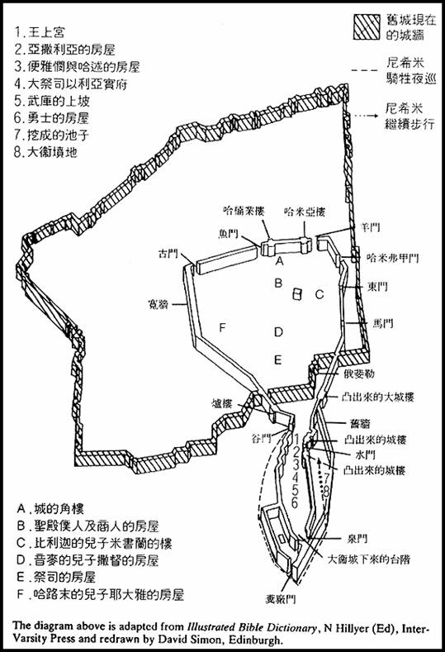
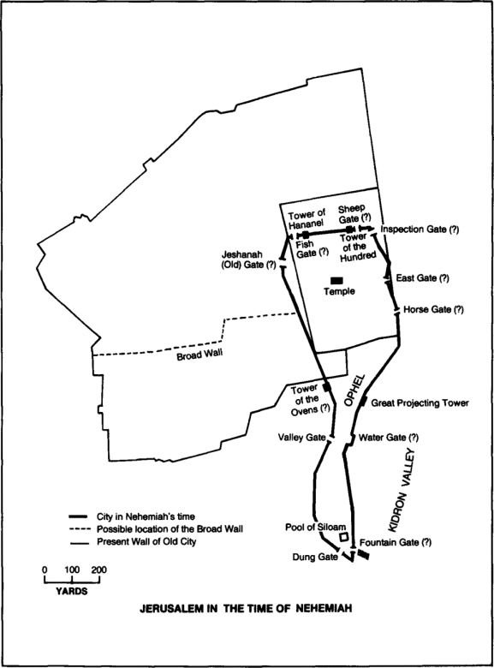

Slide 32
尼希米記 Nehemiah 2:17
¹⁷ 以後，我對他們說：「我們所遭的難，耶路撒冷怎樣荒涼，城門被火焚燒，你們都看見了。來吧，我們重建耶路撒冷的城牆，免得再受凌辱！」
¹⁷ Then I said to them, “You see the trouble we are in: Jerusalem lies in ruins, and its gates have been burned with fire. Come, let us rebuild the wall of Jerusalem, and we will no longer be in disgrace.”

Slide 33
尼希米記 Nehemiah 2:18
¹⁸ 我告訴他們我上帝施恩的手怎樣幫助我，並王對我所說的話。他們就說：「我們起來建造吧！」於是他們奮勇做這善工。
¹⁸ I also told them about the gracious hand of my God on me and what the king had said to me. They replied, “Let us start rebuilding.” So they began this good work.

Slide 34
尼希米記 Nehemiah 2:19
¹⁹ 但和倫人參巴拉，並為奴的亞捫人多比雅和阿拉伯人基善聽見就嗤笑我們，藐視我們，說：「你們做甚麼呢？要背叛王嗎？」
¹⁹ But when Sanballat the Horonite, Tobiah the Ammonite official and Geshem the Arab heard about it, they mocked and ridiculed us. “What is this you are doing?” they asked. “Are you rebelling against the king?”

Slide 35
尼希米記 Nehemiah 2:20
²⁰ 我回答他們說：「天上的上帝必使我們亨通。我們作他僕人的，要起來建造；你們卻在耶路撒冷無分、無權、無紀念。」
²⁰ I answered them by saying, “The God of heaven will give us success. We his servants will start rebuilding, but as for you, you have no share in Jerusalem or any claim or historic right to it.”

Slide 36
尼希米記 Nehemiah 2:20
²⁰ 我回答他們說：「天上的上帝必使我們亨通。我們作他僕人的，要起來建造；你們卻在耶路撒冷無分、無權、無紀念。」
²⁰ I answered them by saying, “The God of heaven will give us success. We his servants will start rebuilding, but as for you, you have no share in Jerusalem or any claim or historic right to it.”

