Slide 1
尼希米記 Nehemiah 3
¹ 那時，大祭司以利亞實和他的弟兄眾祭司起來建立羊門，分別為聖，安立門扇，又築城牆到哈米亞樓，直到哈楠業樓，分別為聖。
¹ Eliashib the high priest and his fellow priests went to work and rebuilt the Sheep Gate. They dedicated it and set its doors in place, building as far as the Tower of the Hundred, which they dedicated, and as far as the Tower of Hananel.

Slide 2
² 其次是耶利哥人建造。其次是音利的兒子撒刻建造。 ³ 哈西拿的子孫建立魚門，架橫樑、安門扇，和閂鎖。⁴ 其次是哈哥斯的孫子、烏利亞的兒子米利末修造。其次是米示薩別的孫子、比利迦的兒子米書蘭修造。
² The men of Jericho built the adjoining section, and Zakkur son of Imri built next to them. ³ The Fish Gate was rebuilt by the sons of Hassenaah. They laid its beams and put its doors and bolts and bars in place. ⁴ Meremoth son of Uriah, the son of Hakkoz, repaired the next section. Next to him Meshullam son of Berekiah, the son of Meshezabel, made repairs,

Slide 3
其次是巴拿的兒子撒督修造。⁵ 其次是提哥亞人修造；但是他們的貴冑不用肩擔他們主的工作。 ⁶ 巴西亞的兒子耶何耶大與比所玳的兒子米書蘭修造古門，架橫樑，安門扇和閂鎖。…
and next to him Zadok son of Baana also made repairs. ⁵ The next section was repaired by the men of Tekoa, but their nobles would not put their shoulders to the work under their supervisors. ⁶ The Jeshanah Gate was repaired by Joiada son of Paseah and Meshullam son of Besodeiah. They laid its beams and put its doors with their bolts and bars in place…

Slide 4
⁸ 其次是銀匠哈海雅的兒子烏薛修造。其次是做香的哈拿尼雅修造。這些人修堅耶路撒冷，直到寬牆。⁹ 其次是管理耶路撒冷一半、戶珥的兒子利法雅修造。¹⁰ 其次是哈路抹的兒子耶大雅對著自己的房屋修造。
⁸ Uzziel son of Harhaiah, one of the goldsmiths, repaired the next section; and Hananiah, one of the perfume-makers, made repairs next to that. They restored Jerusalem as far as the Broad Wall. ⁹ Rephaiah son of Hur, ruler of a half-district of Jerusalem, repaired the next section. ¹⁰ Adjoining this, Jedaiah son of Harumaph made repairs opposite his house,

Slide 5
其次是哈沙尼的兒子哈突修造。¹¹ 哈琳的兒子瑪基雅和巴哈•摩押的兒子哈述修造一段，並修造爐樓。¹² 其次是管理耶路撒冷那一半、哈羅黑的兒子沙龍和他的女兒們修造。 … ²⁰ 其次是薩拜的兒子巴錄竭力修造一段，
and Hattush son of Hashabneiah made repairs next to him. ¹¹ Malkijah son of Harim and Hasshub son of Pahath-Moab repaired another section and the Tower of the Ovens. ¹² Shallum son of Hallohesh, ruler of a half-district of Jerusalem, repaired the next section with the help of his daughters… ²⁰ Next to him, Baruch son of Zabbai zealously repaired another section,

Slide 6
從城牆轉彎，直到大祭司以利亞實的府門。²¹ 其次是哈哥斯的孫子、烏利亞的兒子米利末修造一段，從以利亞實的府門，直到以利亞實府的盡頭。 ²² 其次是住平原的祭司修造。
from the angle to the entrance of the house of Eliashib the high priest. ²¹ Next to him, Meremoth son of Uriah, the son of Hakkoz, repaired another section, from the entrance of Eliashib’s house to the end of it. ²² The repairs next to him were made by the priests from the surrounding region.

Slide 7
²³ 其次是便雅憫與哈述對著自己的房屋修造。其次是亞難尼的孫子、瑪西雅的兒子亞撒利雅在靠近自己的房屋修造。^{…29} 其次是音麥的兒子撒督對著自己的房屋修造。其次是守東門、示迦尼的兒子示瑪雅修造。…
²³ Beyond them, Benjamin and Hasshub made repairs in front of their house; and next to them, Azariah son of Maaseiah, the son of Ananiah, made repairs beside his house… ²⁹ Next to them, Zadok son of Immer made repairs opposite his house. Next to him, Shemaiah son of Shekaniah, the guard at the East Gate, made repairs…

Slide 8
³¹ 其次是銀匠瑪基雅修造到尼提寧和商人的房屋，對著哈米弗甲門，直到城的角樓。³² 銀匠與商人在城的角樓和羊門中間修造。
³¹ Next to him, Malkijah, one of the goldsmiths, made repairs as far as the house of the temple servants and the merchants, opposite the Inspection Gate, and as far as the room above the corner; ³² and between the room above the corner and the Sheep Gate the goldsmiths and merchants made repairs.

Slide 9
一個有計劃的人 A Person of Planning
尼希米記 Nehemiah 3

Slide 10
提摩太後書 2 Timothy 3:16
¹⁶ 聖經都是上帝所默示的，於教訓、督責、使人歸正、教導人學義都是有益的，
¹⁶ All Scripture is God-breathed and is useful for teaching, rebuking, correcting and training in righteousness,

Slide 11
尼希米記 The Book of Nehemiah
一個禱告的人 A Person of Prayer (1:1-11)
一個勇敢的人 A Person of Courage (2:1-20)
一個有計劃的人 A Person of Planning (3:1-32)

Slide 12
一個好計劃是: It is a good plan:
各按各職，而不是全是你為他們工作 When each does its part instead of doing all for them

Slide 13
以弗所書 Ephesians 4:11–12
¹¹ 他所賜的，有使徒，有先知，有傳福音的，有牧師和教師，¹² 為要成全聖徒，各盡其職，建立基督的身體，
¹¹ So Christ himself gave the apostles, the prophets, the evangelists, the pastors and teachers, ¹² to equip his people for works of service, so that the body of Christ may be built up

Slide 14
 | 他們不能做 They cannot do | 他們能做 They can do
你不能做 You cannot do | 找專人做 Find professional | 他們該做 They should do
你能做 You can do | 你該做 You should do | 讓他們做 Let them do

Slide 15
一個好計劃是: It is a good plan:
各按各職，而不是全是你為他們工作 When each does its part instead of doing all for them
以人為本，而不是以任務為本 When it is people-oriented instead of task-oriented

Slide 16
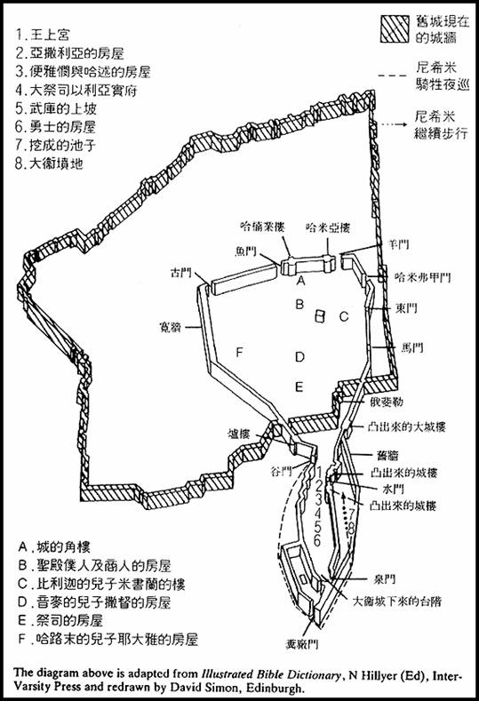
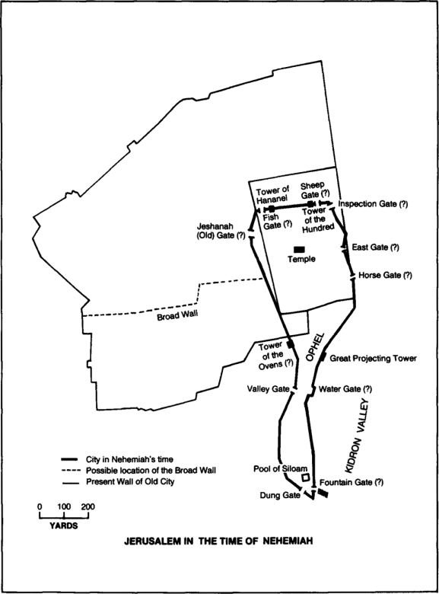

Slide 17
尼希米記 Nehemiah 3:1
¹ 那時，大祭司以利亞實和他的弟兄眾祭司起來建立羊門，分別為聖，安立門扇，又築城牆到哈米亞樓，直到哈楠業樓，分別為聖。
¹ Eliashib the high priest and his fellow priests went to work and rebuilt the Sheep Gate. They dedicated it and set its doors in place, building as far as the Tower of the Hundred, which they dedicated, and as far as the Tower of Hananel.

Slide 18
尼希米記 Nehemiah 3:23
²³ 其次是便雅憫與哈述對著自己的房屋修造。其次是亞難尼的孫子、瑪西雅的兒子亞撒利雅在靠近自己的房屋修造。
²³ Beyond them, Benjamin and Hasshub made repairs in front of their house; and next to them, Azariah son of Maaseiah, the son of Ananiah, made repairs beside his house.

Slide 19
提摩太後書 2 Timothy 2:2
² 你在許多見證人面前聽見我所教訓的，也要交託那忠心能教導別人的人。
² And the things you have heard me say in the presence of many witnesses entrust to reliable people who will also be qualified to teach others.

Slide 20
一個好計劃是: It is a good plan:
各按各職，而不是全是你為他們工作 When each does its part instead of doing all for them
以人為本，而不是以任務為本 When it is people-oriented instead of task-oriented
人是出於甘心，而不是勉強 When people works willingly instead of under compulsion

Slide 21
尼希米記 Nehemiah 3:5
⁵ 其次是提哥亞人修造；但是他們的貴冑不用肩擔他們主的工作。
⁵ The next section was repaired by the men of Tekoa, but their nobles would not put their shoulders to the work under their supervisors.

Slide 22
尼希米記 Nehemiah 3:2, 5, 7
² 其次是耶利哥人建造。… ⁵ 其次是提哥亞人修造；… ⁷ 其次是基遍人米拉提，米倫人雅頓與基遍人，並屬河西總督所管的米斯巴人修造。
² The men of Jericho built the adjoining section… ⁵ The next section was repaired by the men of Tekoa, … ⁷ Next to them, repairs were made by men from Gibeon and Mizpah—Melatiah of Gibeon and Jadon of Meronoth—places under the authority of the governor of Trans-Euphrates.

Slide 23
尼希米記 Nehemiah 3:5, 27
⁵ 其次是提哥亞人修造；但是他們的貴冑不用肩擔他們主的工作。 … ²⁷ 其次是提哥亞人又修一段，對著那凸出來的大樓，直到俄斐勒的牆。
⁵ The next section was repaired by the men of Tekoa, but their nobles would not put their shoulders to the work under their supervisors... ²⁷ Next to them, the men of Tekoa repaired another section, from the great projecting tower to the wall of Ophel.

Slide 24
尼希米記 Nehemiah 3:20
²⁰ 下一段，就是薩拜的兒子巴錄竭力修築的另一段，從城牆轉角的地方，直到大祭司以利亞實住宅的門口。 (CNVT)
²⁰ Next to him, Baruch son of Zabbai zealously repaired another section, from the angle to the entrance of the house of Eliashib the high priest.

Slide 25
一個好計劃是: It is a good plan:
各按各職，而不是全是你為他們工作 When each does its part instead of doing all for them
以人為本，而不是以任務為本 When it is people-oriented instead of task-oriented
人是出於甘心，而不是勉強 When people works willingly instead of under compulsion

