Slide 1
尼希米記 Nehemiah 4
¹ 參巴拉聽見我們修造城牆就發怒，大大惱恨，嗤笑猶大人，² 對他弟兄和撒馬利亞的軍兵說：「這些軟弱的猶大人做甚麼呢？要保護自己嗎？
¹ When Sanballat heard that we were rebuilding the wall, he became angry and was greatly incensed. He ridiculed the Jews, ² and in the presence of his associates and the army of Samaria, he said, “What are those feeble Jews doing? Will they restore their wall?

Slide 2
要獻祭嗎？要一日成功嗎？要從土堆裏拿出火燒的石頭再立牆嗎？」³ 亞捫人多比雅站在旁邊，說：「他們所修造的石牆，就是狐狸上去也必跐倒。」⁴ 我們的上帝啊，求你垂聽，因為我們被藐視。求你使他們的毀謗歸於他們的頭上，
Will they offer sacrifices? Will they finish in a day? Can they bring the stones back to life from those heaps of rubble—burned as they are?” ³ Tobiah the Ammonite, who was at his side, said, “What they are building—even a fox climbing up on it would break down their wall of stones!” ⁴ Hear us, our God, for we are despised. Turn their insults back on their own heads.

Slide 3
使他們在擄到之地作為掠物。⁵ 不要遮掩他們的罪孽，不要使他們的罪惡從你面前塗抹，因為他們在修造的人眼前惹動你的怒氣。 ⁶ 這樣，我們修造城牆，城牆就都連絡，高至一半，因為百姓專心做工。
Give them over as plunder in a land of captivity. ⁵ Do not cover up their guilt or blot out their sins from your sight, for they have thrown insults in the face of the builders. ⁶ So we rebuilt the wall till all of it reached half its height, for the people worked with all their heart.

Slide 4
⁷ 參巴拉、多比雅、阿拉伯人、亞捫人、亞實突人聽見修造耶路撒冷城牆，著手進行堵塞破裂的地方，就甚發怒。⁸ 大家同謀要來攻擊耶路撒冷，使城內擾亂。⁹ 然而，我們禱告我們的上帝，又因他們的緣故，就派人看守，晝夜防備。
⁷ But when Sanballat, Tobiah, the Arabs, the Ammonites and the people of Ashdod heard that the repairs to Jerusalem’s walls had gone ahead and that the gaps were being closed, they were very angry. ⁸ They all plotted together to come and fight against Jerusalem and stir up trouble against it. ⁹ But we prayed to our God and posted a guard day and night to meet this threat.

Slide 5
¹⁰ 猶大人說：「灰土尚多，扛抬的人力氣已經衰敗，所以我們不能建造城牆。」¹¹ 我們的敵人且說：「趁他們不知不見，我們進入他們中間，殺他們，使工作止住。」¹² 那靠近敵人居住的猶大人十次從各處來見我們，說：
¹⁰ Meanwhile, the people in Judah said, “The strength of the laborers is giving out, and there is so much rubble that we cannot rebuild the wall.” ¹¹ Also our enemies said, “Before they know it or see us, we will be right there among them and will kill them and put an end to the work.” ¹² Then the Jews who lived near them came and told us ten times over,

Slide 6
「你們必要回到我們那裏。」¹³ 所以我使百姓各按宗族拿刀、拿槍、拿弓站在城牆後邊低窪的空處。¹⁴ 我察看了，就起來對貴冑、官長，和其餘的人說：「不要怕他們！當記念主是大而可畏的。
“Wherever you turn, they will attack us.” ¹³ Therefore I stationed some of the people behind the lowest points of the wall at the exposed places, posting them by families, with their swords, spears and bows. ¹⁴ After I looked things over, I stood up and said to the nobles, the officials and the rest of the people, “Don’t be afraid of them. Remember the Lord, who is great and awesome,

Slide 7
你們要為弟兄、兒女、妻子、家產爭戰。」 ¹⁵ 仇敵聽見我們知道他們的心意，見上帝也破壞他們的計謀，就不來了。我們都回到城牆那裏，各做各的工。¹⁶ 從那日起，我的僕人一半做工，一半拿槍、拿盾牌、拿弓、穿鎧甲，
and fight for your families, your sons and your daughters, your wives and your homes.” ¹⁵ When our enemies heard that we were aware of their plot and that God had frustrated it, we all returned to the wall, each to our own work. ¹⁶ From that day on, half of my men did the work, while the other half were equipped with spears, shields, bows and armor.

Slide 8
官長都站在猶大眾人的後邊。¹⁷ 修造城牆的，扛抬材料的，都一手做工一手拿兵器。¹⁸ 修造的人都腰間佩刀修造，吹角的人在我旁邊。¹⁹ 我對貴冑、官長，和其餘的人說：
The officers posted themselves behind all the people of Judah ¹⁷ who were building the wall. Those who carried materials did their work with one hand and held a weapon in the other, ¹⁸ and each of the builders wore his sword at his side as he worked. But the man who sounded the trumpet stayed with me. ¹⁹ Then I said to the nobles, the officials and the rest of the people,

Slide 9
「這工程浩大，我們在城牆上相離甚遠；²⁰ 你們聽見角聲在哪裏，就聚集到我們那裏去。我們的上帝必為我們爭戰。」 ²¹ 於是，我們做工，一半拿兵器，從天亮直到星宿出現的時候。²² 那時，我又對百姓說：
“The work is extensive and spread out, and we are widely separated from each other along the wall. ²⁰ Wherever you hear the sound of the trumpet, join us there. Our God will fight for us!” ²¹ So we continued the work with half the men holding spears, from the first light of dawn till the stars came out. ²² At that time I also said to the people,

Slide 10
「各人和他的僕人當在耶路撒冷住宿，好在夜間保守我們，白晝做工。」²³ 這樣，我和弟兄僕人，並跟從我的護兵都不脫衣服，出去打水也帶兵器。
“Have every man and his helper stay inside Jerusalem at night, so they can serve us as guards by night and as workers by day.” ²³ Neither I nor my brothers nor my men nor the guards with me took off our clothes; each had his weapon, even when he went for water.

Slide 11
一個臨危不亂的人 A Person Of Steel
尼希米記 Nehemiah 4

Slide 12
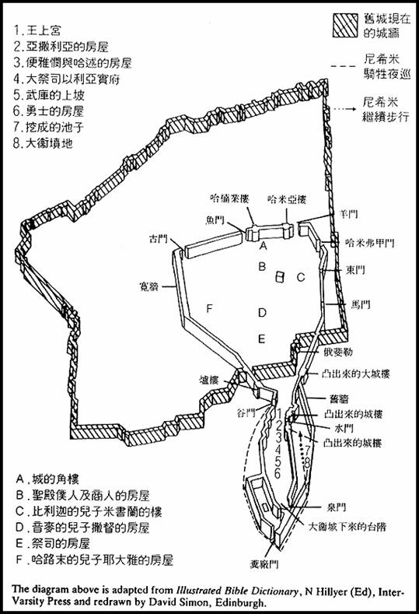
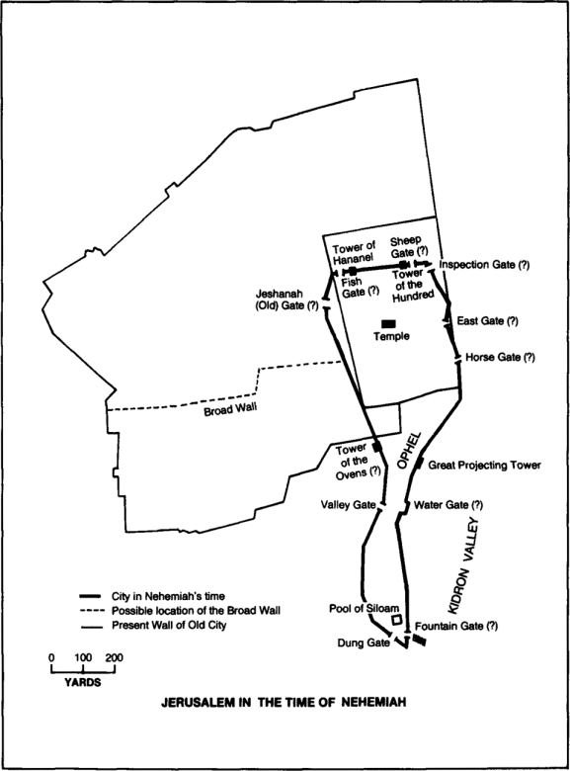

Slide 13
尼希米記 The Book of Nehemiah
一個禱告的人 A Person of Prayer (1)
一個勇敢的人 A Person of Courage (2)
一個有計劃的人 A Person of Planning (3)
一個臨危不亂的人 A Person of Steel (4)

Slide 14
1. 嘲笑之險 The Danger Of Ridicule（1-6）
尼希米記 Nehemiah 4:1
¹ 參巴拉聽見我們修造城牆就發怒，大大惱恨，嗤笑猶大人，
¹ When Sanballat heard that we were rebuilding the wall, he became angry and was greatly incensed. He ridiculed the Jews,

Slide 15
尼希米記 Nehemiah 4:2–3
² 對他弟兄和撒馬利亞的軍兵說：「這些軟弱的猶大人做甚麼呢？要保護自己嗎？要獻祭嗎？要一日成功嗎？要從土堆裏拿出火燒的石頭再立牆嗎？」
² and in the presence of his associates and the army of Samaria, he said, “What are those feeble Jews doing? Will they restore their wall? Will they offer sacrifices? Will they finish in a day? Can they bring the stones back to life from those heaps of rubble—burned as they are?”

Slide 16
³ 亞捫人多比雅站在旁邊，說：「他們所修造的石牆，就是狐狸上去也必跐倒。」
³ Tobiah the Ammonite, who was at his side, said, “What they are building—even a fox climbing up on it would break down their wall of stones!”

Slide 17
尼希米記 Nehemiah 4:4–5 ⁴ 我們的上帝啊，求你垂聽，因為我們被藐視。求你使他們的毀謗歸於他們的頭上，使他們在擄到之地作為掠物。⁵ 不要遮掩他們的罪孽，不要使他們的罪惡從你面前塗抹，因為他們在修造的人眼前惹動你的怒氣。
⁴ Hear us, our God, for we are despised. Turn their insults back on their own heads. Give them over as plunder in a land of captivity. ⁵ Do not cover up their guilt or blot out their sins from your sight, for they have thrown insults in the face of the builders.

Slide 18
尼希米記 Nehemiah 4:6
⁶ 這樣，我們修造城牆，城牆就都連絡，高至一半，因為百姓專心做工。
⁶ So we rebuilt the wall till all of it reached half its height, for the people worked with all their heart.

Slide 19
2. 恐懼之險 The Danger Of Fear（7-9）
尼希米記 Nehemiah 4:7–8 ⁷ 參巴拉、多比雅、阿拉伯人、亞捫人、亞實突人聽見修造耶路撒冷城牆，著手進行堵塞破裂的地方，就甚發怒。⁸ 大家同謀要來攻擊耶路撒冷，使城內擾亂。
⁷ But when Sanballat, Tobiah, the Arabs, the Ammonites and the people of Ashdod heard that the repairs to Jerusalem’s walls had gone ahead and that the gaps were being closed, they were very angry. ⁸ They all plotted together to come and fight against Jerusalem and stir up trouble against it.

Slide 20
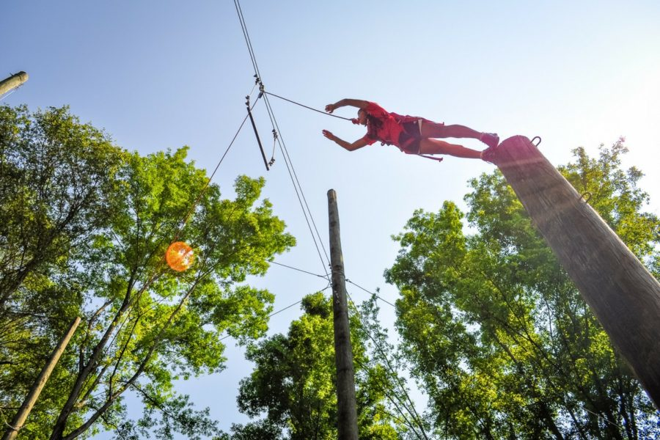

Slide 21
尼希米記 Nehemiah 4:9
⁹ 然而，我們禱告我們的上帝，又因他們的緣故，就派人看守，晝夜防備。
⁹ But we prayed to our God and posted a guard day and night to meet this threat.

Slide 22
詩篇 Psalm 127:1
¹ 若不是耶和華建造房屋， 建造的人就枉然勞力； 若不是耶和華看守城池， 看守的人就枉然警醒。
¹ Unless the Lord builds the house, the builders labor in vain. Unless the Lord watches over the city, the guards stand watch in vain.

Slide 23
尼希米記 Nehemiah 4:9
⁹ 然而，我們禱告我們的上帝，又因他們的緣故，就派人看守，晝夜防備。
⁹ But we prayed to our God and posted a guard day and night to meet this threat.

Slide 24
3. 憂慮之險 The Danger of Worries (10-23)
尼希米記 Nehemiah 4:10–11 ¹⁰ 猶大人說：「灰土尚多，扛抬的人力氣已經衰敗，所以我們不能建造城牆。」¹¹ 我們的敵人且說：「趁他們不知不見，我們進入他們中間，殺他們，使工作止住。」
¹⁰ Meanwhile, the people in Judah said, “The strength of the laborers is giving out, and there is so much rubble that we cannot rebuild the wall.” ¹¹ Also our enemies said, “Before they know it or see us, we will be right there among them and will kill them and put an end to the work.”

Slide 25
尼希米記 Nehemiah 4:12-13
¹² 那靠近敵人居住的猶大人十次從各處來見我們，說：「你們必要回到我們那裏。」 ¹³ 所以我使百姓各按宗族拿刀、拿槍、拿弓站在城牆後邊低窪的空處。
¹² Then the Jews who lived near them came and told us ten times over, “Wherever you turn, they will attack us.” ¹³ Therefore I stationed some of the people behind the lowest points of the wall at the exposed places, posting them by families, with their swords, spears and bows.

Slide 26
尼希米記 Nehemiah 4:14
¹⁴ 我察看了，就起來對貴冑、官長，和其餘的人說：「不要怕他們！當記念主是大而可畏的。你們要為弟兄、兒女、妻子、家產爭戰。」
¹⁴ After I looked things over, I stood up and said to the nobles, the officials and the rest of the people, “Don’t be afraid of them. Remember the Lord, who is great and awesome, and fight for your families, your sons and your daughters, your wives and your homes.”

Slide 27
馬太福音 Matthew 10:28
²⁸ 那殺身體、不能殺靈魂的，不要怕他們；惟有能把身體和靈魂都滅在地獄裏的，正要怕他。
²⁸ Do not be afraid of those who kill the body but cannot kill the soul. Rather, be afraid of the One who can destroy both soul and body in hell.

Slide 28
尼希米記 Nehemiah 4:15
¹⁵ 仇敵聽見我們知道他們的心意，見上帝也破壞他們的計謀，就不來了。我們都回到城牆那裏，各做各的工。
¹⁵ When our enemies heard that we were aware of their plot and that God had frustrated it, we all returned to the wall, each to our own work.

Slide 29
尼希米記 Nehemiah 4:16–18 ¹⁶ 從那日起，我的僕人一半做工，一半拿槍、拿盾牌、拿弓、穿鎧甲，官長都站在猶大眾人的後邊。¹⁷ 修造城牆的，扛抬材料的，都一手做工一手拿兵器。¹⁸ 修造的人都腰間佩刀修造
¹⁶ From that day on, half of my men did the work, while the other half were equipped with spears, shields, bows and armor. The officers posted themselves behind all the people of Judah ¹⁷ who were building the wall. Those who carried materials did their work with one hand and held a weapon in the other, ¹⁸ and each of the builders wore his sword at his side as he worked.

Slide 30
尼希米記 Nehemiah 4:18-20
吹角的人在我旁邊。¹⁹ 我對貴冑、官長，和其餘的人說：「這工程浩大，我們在城牆上相離甚遠；²⁰ 你們聽見角聲在哪裏，就聚集到我們那裏去。我們的上帝必為我們爭戰。」
But the man who sounded the trumpet stayed with me. ¹⁹ Then I said to the nobles, the officials and the rest of the people, “The work is extensive and spread out, and we are widely separated from each other along the wall. ²⁰ Wherever you hear the sound of the trumpet, join us there. Our God will fight for us!”

Slide 31
尼希米記 Nehemiah 4:21–23 ²¹ 於是，我們做工，一半拿兵器，從天亮直到星宿出現的時候。²² 那時，我又對百姓說：「各人和他的僕人當在耶路撒冷住宿，好在夜間保守我們，白晝做工。」
²¹ So we continued the work with half the men holding spears, from the first light of dawn till the stars came out. ²² At that time I also said to the people, “Have every man and his helper stay inside Jerusalem at night, so they can serve us as guards by night and as workers by day.”

Slide 32
²³ 這樣，我和弟兄僕人，並跟從我的護兵都不脫衣服，出去打水也帶兵器。
²³ Neither I nor my brothers nor my men nor the guards with me took off our clothes; each had his weapon, even when he went for water.

Slide 33
以弗所書 Ephesians 6:18
¹⁸ 靠著聖靈，隨時多方禱告祈求；並要在此警醒不倦，為眾聖徒祈求，
¹⁸ And pray in the Spirit on all occasions with all kinds of prayers and requests. With this in mind, be alert and always keep on praying for all the Lord’s people.

